Slide 1
Developing Coaching Skills
WHAT IS
COACHING?
Photo source: unsplash / Toa Heftiba

Slide 2
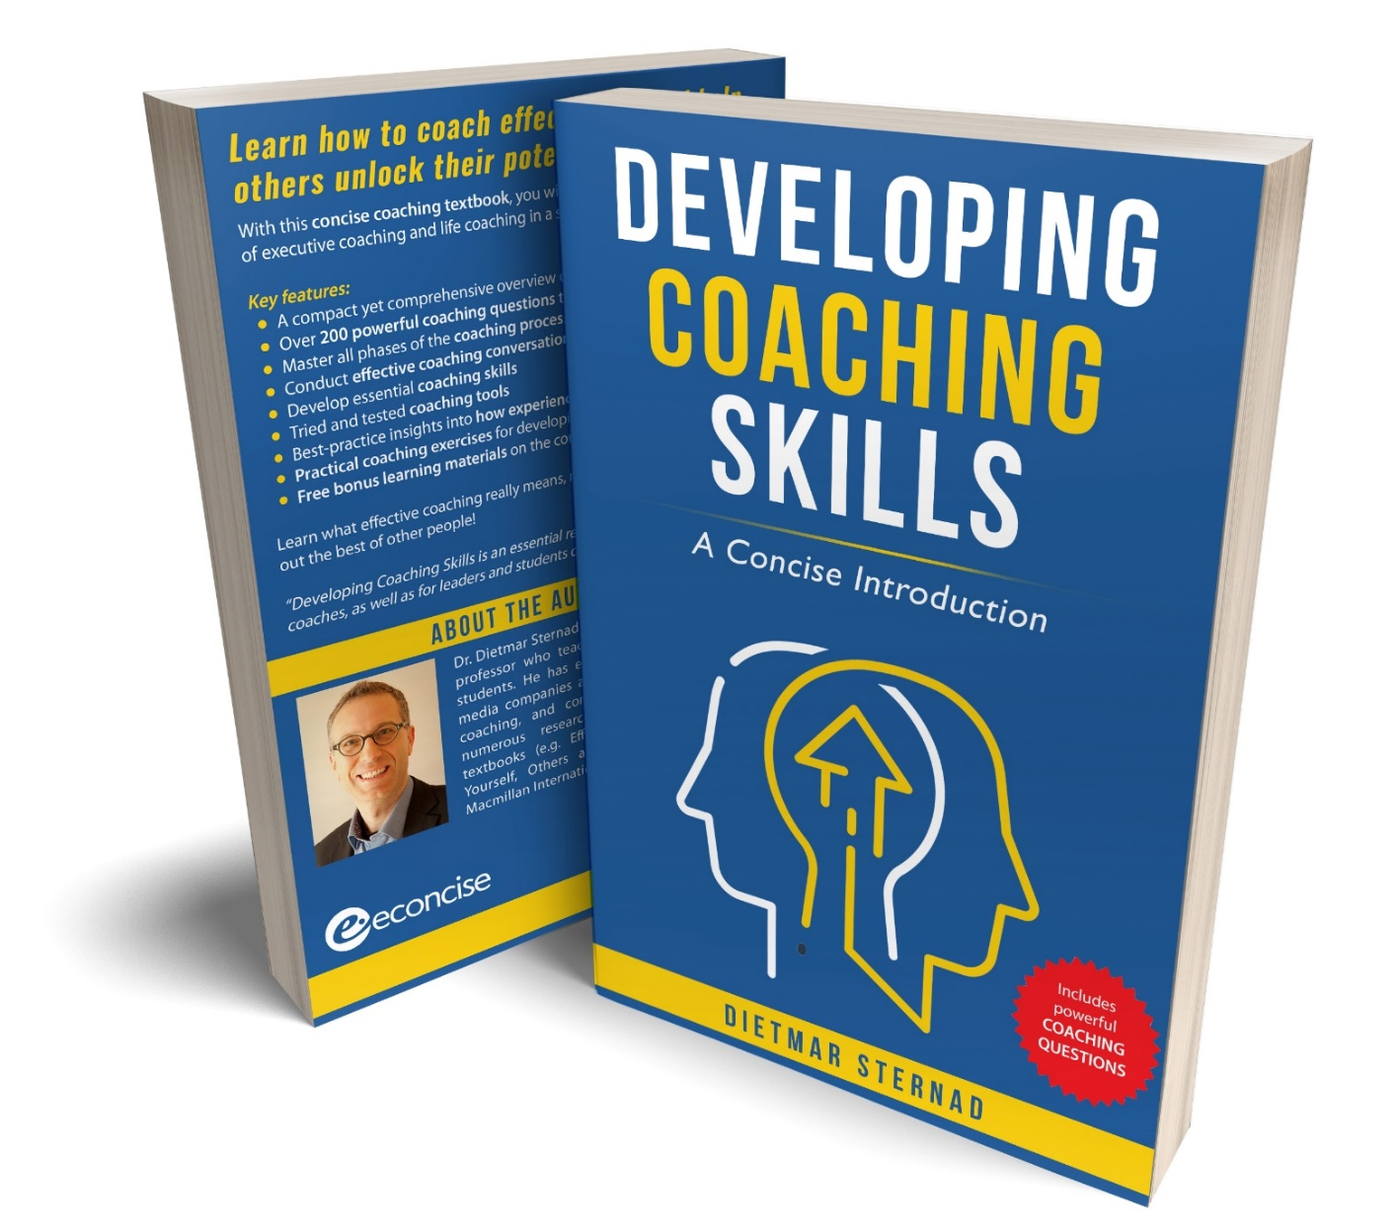
The coaching textbook
These slides are based on Chapter 1 of the textbook
Developing Coaching Skills: A Concise Introduction
Author: Dietmar Sternad
©2021 by econcise publishing
2
Cover illustration (heads): © Stmool/Shutterstock

Slide 3
Learning objectives – What is coaching?
Explain what coaching is all about
Distinguish coaching from other types of developmental activities
Describe the main outcomes of coaching
Explore what professional coaches do
Recognize the main factors that influence the effectiveness of coaching
3
Photo source: pixabay.com

Slide 4
Coaching defined
Coaching is a purposeful interaction in which one person (the coach) uses a questioning approach to help another person (the coachee) think through challenging issues, raise their self-awareness, consider their options, and take the right actions to realize their full potential and reach their personal or professional goals.
DEFINITION
4

Slide 5
The essence of the coaching process
Structuring a goal- and solution- oriented thinking process
…? …? …?
This is the issue.
This is my role in this issue.
This is my my goal.
Questions
These are my options.
Answers
This is what I will do.
COACH
COACHEE
Answers
5

Slide 6
How coaching differs from other developmental activities [2]
Coaching
Counseling
Focus on reaching personal and work-related goals
A form of remedial action, exploration of a client's past
Coaching
Psychotherapy
Development intervention
Therapeutic intervention to cure mental illness problems
Coaching
Mentoring
Short-term, focused on specific development goals
Long-term, advice and guidance regarding career
development and socialization
6
Photo source: unsplash / Toa Heftiba

Slide 7
How coaching differs from other developmental activities [2]
Coaching
Career counseling
Performance improvement in the current job
Finding a suitable job on the (external) job market
Coaching
Consulting
Helping coachees find their own solutions
Sharing advice, suggesting how to solve problems
Coaching
Teaching
Helping the coachee to reach their development goals
Transferring knowledge or skills in a certain domain
7
Photo source: unsplash / Toa Heftiba

Slide 8
The main outcomes of coaching
Outcomes of coaching
Outcomes for the coachee
Outcomes for the organization
Cognition/attitude
Self-confidence and motivation Clear focus
Positive effect on well-being and
work-related attitudes
Learning
Self-awareness and reflection
Accelerated learning and problem solving
Personal development
Results
Goal attainment
Enhanced work performance
Behavioral change
Improved social and leadership skills
Improved team performance
Higher work productivity and
improved work performance
of the coachee and their teams
Return on investment
8

Slide 9
Life coaching
Helping coachees enhance their well-being and attain greater fulfillment in their life
Helping coachees design an 'ideal life'
Exploring which areas of their lives coachees would like to improve
Focus on goal attainment and enhanced quality of life
Finding purpose in life, identifying strengths, personal mission, and passions
Helping coachees to find solutions to concrete problems in their life
9
Photo source: unsplash/Harli Marten

Slide 10
Types of coaching in an organizational context
'Manager-coaches'
Trained internal coaches
External executive coaches
10

Slide 11
The professionalization of coaching
Executive coaching (since the 1980s) – coachees with managerial responsibility
Organizations hire coaches (sponsoring organizations)
From addressing performance problems to an effective tool for developing people
Professional accreditation bodies, e.g. ICF, IAC, EMCC
Coaching supervision
11
Photo source: unsplash/Christina @ wocintechchat.com

Slide 12
What executive coaches do
Areas of assistance: e.g. developing capabilities, facilitating transitions, sounding board, discussing strategic matters
Acting as an accountability partner
(trust as a major precondition)
'Free agenda' coaching vs. predefined and specific organizational agenda
Conversational techniques, e.g. goal-oriented conversation, questioning, deep listening, summaries, observations, feedback
Duration: typically 2-12 months
Coaching conversations: develop insight, create options, decide on goals and action plans
12
Photo source: unsplash/Amy Hirschi

Slide 13
Team coaching
Purpose: Developing the capacity of the team to perform well together
Strengths, styles, and team roles of individual team members
Team values and norms
Building trust / open conversations
Collaboration process
Team goals and strategies, action plans to achieve them
Solving conflicts within the team
13
Photo source: unsplash/Leon

Slide 14
The essence of team coaching
Structuring a goal- and solution- oriented discussion process
…? …? …?
Our strengths, styles, and roles.
Our values and norms.
Our goals and action plan.
Questions
Our relationships.
Answers
TEAM COACH
How we work together (and solve conflicts).
TEAM
Answers
14
Photo source: unsplash/Leon

Slide 15
Preconditions for effective coaching
Joint goal-orientation
Good, trustful relationship between the coach and the coachee
Collaborative mindset
A coachable coachee
A coachee who feels responsible
COACH
COACHEE
15

Slide 16
End of module
WHAT IS
COACHING?
16
Photo source: unsplash / Toa Heftiba

