Slide 1

Developing Coaching Skills
EFFECTIVE COACHING
CONVERSATIONS
Photo source: unsplash / Toa Heftiba

Slide 2
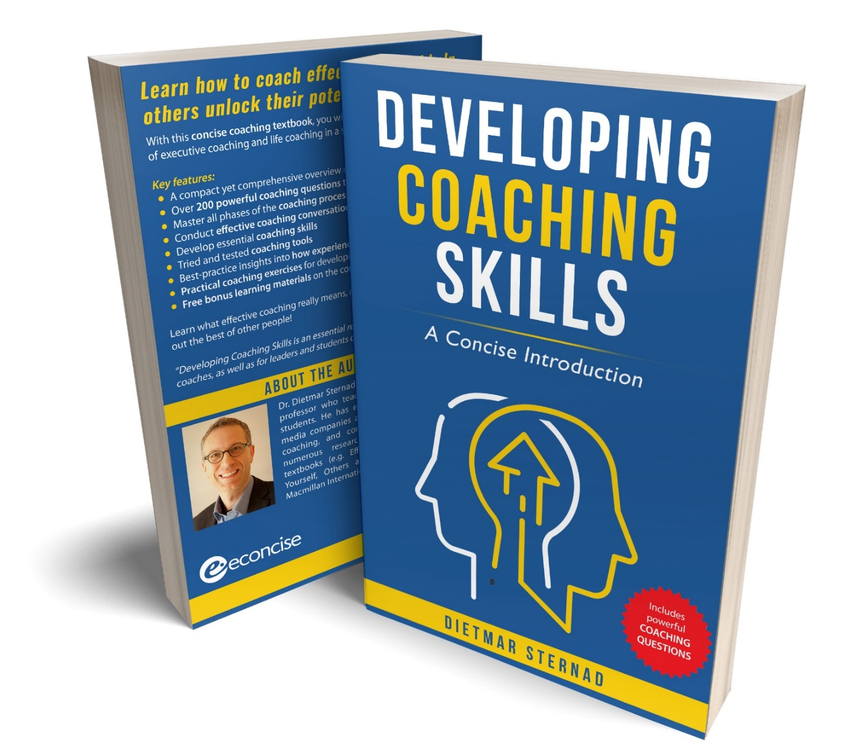
The coaching textbook
These slides are based on
Chapter 2 of the textbook
Developing Coaching Skills:
A Concise Introduction
Author: Dietmar Sternad
©2021 by econcise publishing
2
Cover illustration (heads): © Stmool/Shutterstock

Slide 3


Learning objectives – Effective coaching conversations
Structure a coaching conversation in a goal- and solution-oriented way
Apply the GROW model, one of the most widely used frameworks for coaching.
Ask coaching questions that help a coachee identify their goals, analyze their current situation,
develop alternative strategies for making progress, and commit to concrete action steps
Use a cognitive behavioral coaching approach to help a coachee adopt a positive mindset for change
3
Illustration source: pixabay.com

Slide 4

Coaching conversations
A coaching conversation can also be seen as a
process of enquiry, in which the coach facilitates the coachee’s learning and development through asking questions in a structured, solution-oriented process.
DEFINITION
A coaching conversation is focused on the coachee and the issues
that are challenging and important for them
4
Illustration source: pixabay.com

Slide 5

A typical coaching session
Warm-up phase
Greetings, maybe smalltalk, checking
whether the coachee is fully present
Review of previous session
What was agreed last time?
What has been implemented?
Goals for the current session
‟What would you like us to focus on today?ˮ
Main coaching conversation
e.g. following the GROW model
Action plan / agreements
What will the coachee do to address the issues
that were discussed in the coaching session?
5
Illustration source: pixabay.com

Slide 6
The GROW model
6
Source: Graphical representation by Sternad (2021) inspired by concepts in Whitmore (2017), Coaching for Performance: The Principles and Practice of Coaching and Leadership, 5th ed. (London/Boston: Nicholas Brealey Publishing). Illustration source: pixabay.com.

Slide 7
Goal: What does the coachee want to achieve?
Coaching is a goal-oriented process
Goal setting before the reality check: not to limit
creativity, think in possibilities instead of limitations
Clarity about the desired future state –
and why this is important for the coachee
7
Illustration source: pixabay.com

Slide 8

Outcome of the goal-setting phase
A joint understanding about:
the end goal that the coachee wants to reach (in the long term),
the performance goals (ideally not more than three) that the coachee needs to achieve in order to be able to reach the end goal, and
the concrete goal for (or focus of) the current coaching session
8
Illustration source: pixabay.com

Slide 9
Examples for questions for the ʻGoalʼ stage
Goals for the current coaching session
“What would you like to achieve with today’s discussion?”
“What would be a good outcome for you of our conversation?”
“What is the most important thing that you would like to talk about today?”
End goals
“What exactly would you like to have accomplished in three months/a year/…?”
“What is your ultimate goal? What would your life look like if you had achieved it?”
“What makes this goal so important for you?”
Performance goals
“What are the main milestones on the way to achieving this goal?
When would you need to reach them by?”
“How could you set a goal in a way that it primarily depends on your actions and performance rather than on the circumstances or what others do?”
9
Illustration source: pixabay.com

Slide 10
Reality: What does the current situation look like?
Objectively assess the situation together
Present the facts (without evaluation/judgement)
What is the role of the coachee in the situation?
(self-awareness)
Enquiry mode instead of jumping to a ʻquick fixʼ solution
10
Illustration source: pixabay.com
Illustration source: pixabay.com

Slide 11

External vs. internal reality
External reality
Internal reality
e.g. power relationships, other
peopleʼs attitudes and actions,
processes and structures
within an organization
e.g. coacheeʼs values,
expectations, attitudes,
feelings (fears, anxieties)
11

Slide 12
Examples for questions for the ʻRealityʼ stage
External reality
“What are the main factors that contributed to this situation?”
“Who else is involved in this issue? What is their role?”
“Which steps have you already taken to tackle this issue?”
“What happened as a consequence?”
“What are the main obstacles?”
Internal reality
“How would you describe your emotions when XY happened?”
“What are your expectations regarding XY?”
“What fears do you have regarding XY?”
“What are your main concerns?”
“What holds you back from taking action?”
12
Illustration source: pixabay.com

Slide 13
Options: What are the alternative courses of action?
Aim: Generate a range of different options for
reaching the coacheeʼs goal
Allow for creativity: Do not limit yourself too early
Focus on removing obstacles
Once all options are on the table → explore advantages
and disadvantages, prioritize
13
Illustration source: pixabay.com

Slide 14
Examples for questions for the ʻOptionsʼ stage
Generating alternative courses of action
“What could be a potential solution here?”
“What choices do you have?”
“What steps could you take to make progress in this issue?”
Overcoming restrictions
“What could you do to remove this obstacle?”
“How would you proceed if you had more money/time/information …?”
“Who could help you here? Who knows more about this?”
Prioritizing options
“Which of these options do you see as the most promising one?”
“What are the most important advantages of following this option?”
“What are the main risks involved in following this option?”
14
Illustration source: pixabay.com

Slide 15
Will: Which concrete actions will the coachee take?
Making a decision, developing an action plan
From a ʻdeliberateʼ to an ʻimplementalʼ mindset
What to do? By when? How (which concrete steps)?
How to overcome potential obstacles?
Ensuring accountability (e.g. action memo)
15
Illustration source: pixabay.com

Slide 16
Examples for questions for the ʻWillʼ stage
Setting up an action plan
“Which option will you pursue to achieve your goal?”
“Which concrete action steps will you take?”
“When (exactly) will you do this?”
“How will this action help you to achieve your goal?”
“Whose support do you need to make it happen?”
“What are the main obstacles that you expect to face when you implement your actions?
“How will you overcome these obstacles?”
Checking the level of commitment
“On a scale of 1–10, how committed are you to taking this step?”
“What would you have to change to turn your commitment from 7 to 10?”
16
Illustration source: pixabay.com

Slide 17

Cognitive behavioral coaching (CBC)
Based on cognitive behavioral therapy (CBT)
It is often not an adverse event in our life that causes the most trouble for us,
but the way we interpret such an event
We can influence our interpretations and beliefs
17
Illustration source: pixabay.com

Slide 18
The ABCDE model of cognitive behavioral coaching
18
Source: Graphical representation by Sternad (2021) inspired by concepts in Ellis (1994), Reason and Emotion in Psychotherapy (Secausus, NJ: Birch Lane Press).

Slide 19
A process model for cognitive behavioral coaching
19
Source: Sternad (2021).

Slide 20
End of module
EFFECTIVE COACHING
CONVERSATIONS
20
Photo source: unsplash / Toa Heftiba

