Slide 1
Developing Coaching Skills
THE COACHING
PROCESS
Photo source: unsplash / Toa Heftiba

Slide 2
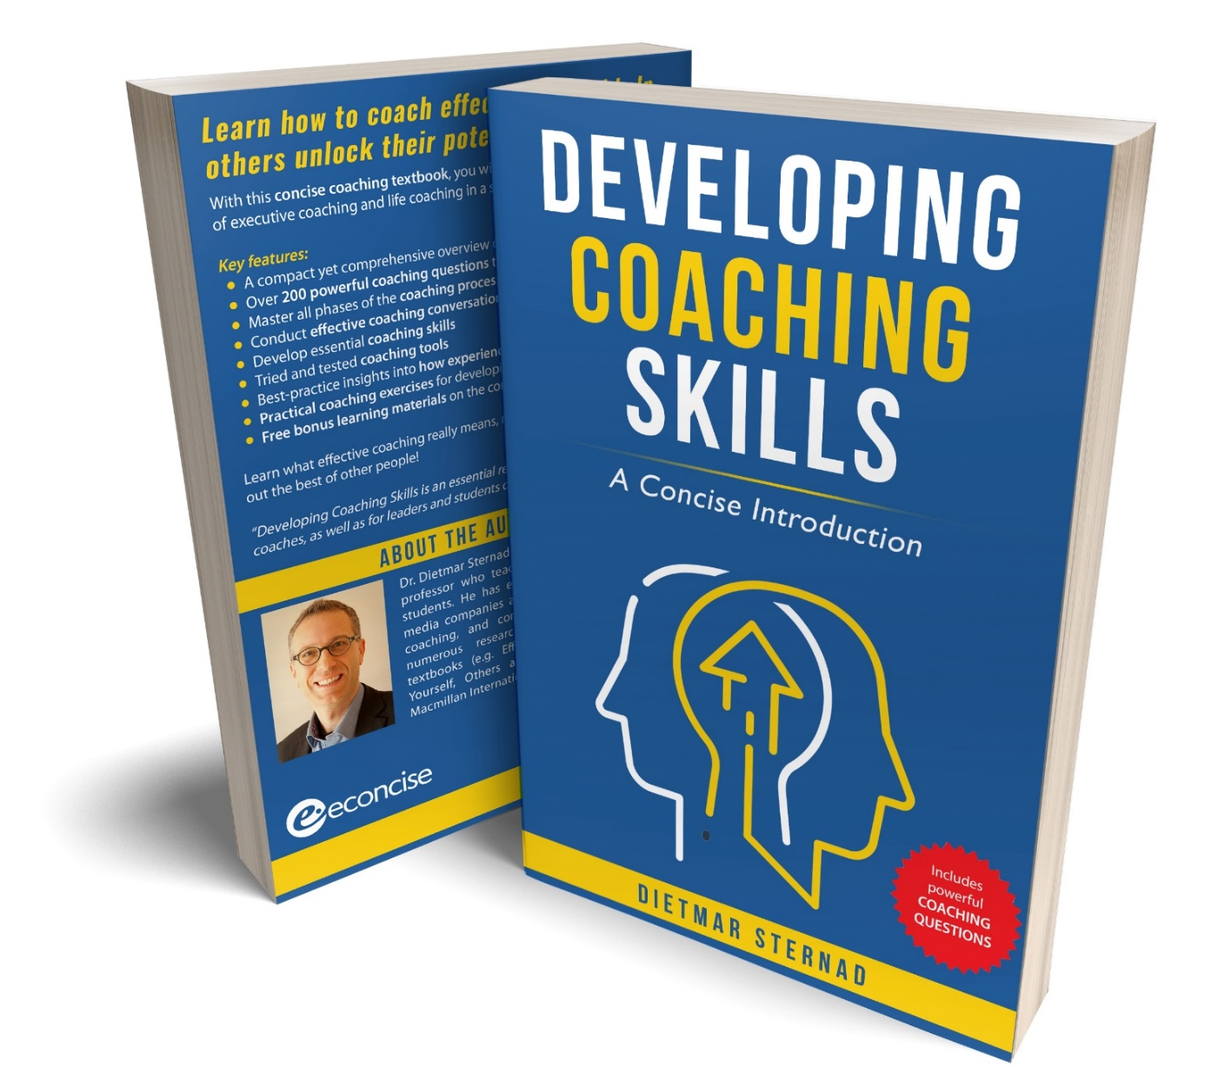
The coaching textbook
These slides are based on Chapter 3 of the textbook
Developing Coaching Skills: A Concise Introduction
Author: Dietmar Sternad
©2021 by econcise publishing
2
Cover illustration (heads): © Stmool/Shutterstock

Slide 3
Learning objectives – The coaching process
Organize a professional coaching process
Define the purpose and goals of a coaching intervention together with the client
Explain what a coach needs to consider for building a positive relationship with both the client organization and the coachee
Use assessment tools, progress reviews, and structured refection and evaluation to improve the quality of the coaching process
3
Illustration source: pixabay.com

Slide 4
Typical phases of an executive coaching process
Defining the purpose of the coaching intervention
Relationship-building (coachee)
Relationship-building (organization)
Goal alignment
Optional: Gathering and analyzing data (assessment)
Coaching sessions
Progress review
Reflection and evaluation of the coaching process
4
Illustration source: pixabay.com

Slide 5
Clarifying the purpose of a coaching intervention
Reaching a joint understanding about:
What is the issue that the coachee wants to explore?
Who are the key stakeholders and what are their expectations?
What are the roles of the coach, coachee, and stakeholders?
How is the coaching intervention linked to the wider organizational context?
5
Illustration source: pixabay.com

Slide 6
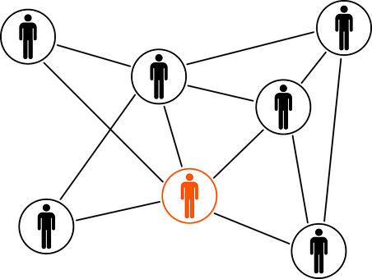
Building a relationship with the client organization
Goals of the coaching assignment – link to organizational goals
Organizational context
Contractual agreement
Goal alignment
Information about progress and results of the coaching process
Goals
Culture
Structure/processes
Power relationships
Purpose/goal/desired outcome
Number/duration of sessions
Duration of coaching service
Compensation of the coach
Coaching setting
Use of assessment tools
Support required by the organization
Confidentiality clause
6
Illustration source: pixabay.com

Slide 7
Building trust with the coachee
Being open and honest
Ensuring confidentiality
Managing mutual expectations
Keeping commitments
Showing care and concern for the coachee and their interests
Bolstering the self-confidence of the coachee
7
Illustration source: pixabay.com

Slide 8
Gathering and analyzing data
s
G
A
P
S
Goals and values of the coachee
Abilities and strengths of the coachee
Perceptions of others about the coachee
Success factors (what you need to be successful in the coachee’s role)
Tools: questionnaires, personality inventories, 360-degree feedback surveys, expectations of stakeholders
Coacheeʼs strengths and development needs
8
Illustration source: pixabay.com. GAPS model based on Peterson, D. B. (2011). Executive coaching: A critical review and recommendations for advancing the practice. In: Zedeck, S. (ed), APA Handbook of Industrial and Organizational Psychology, Vol. 2, (pp. 527–566). Washington, DC: American Psychological Association.

Slide 9
Typical structure of a coaching session
Reconnecting
Progress review / follow-up
Setting the agenda
(goal for the session)
Goal-oriented coaching conversation
Setting up
accountability
9

Slide 10
Progress review (follow-up)
The coach as an accountability partner
Which actions where taken, what was the impact,
what did the coachee learn?
Recognizing progress and success
Other ways to increase accountability: journal, accountability email, feedback meeting between the coachee and their boss
10
Illustration source: pixabay.com

Slide 11
Reflection and evaluation of the coaching process
Joint reflection with the coachee (ʼquick checksʼ or final evaluation)
To what degree where the goals achieved?
Progress in the coacheeʼs development?
Effectiveness of coaching sessions?
How to improve the coaching sessions?
Self-reflection by the coach (notes, journal)
Reflection with coaching supervisors (developmental, resourcing, qualitative function)
11

Slide 12
End of module
THE COACHING
PROCESS
12
Photo source: unsplash / Toa Heftiba

