Slide 1
Developing Coaching Skills
ESSENTIAL
COACHING SKILLS
Photo source: unsplash / Toa Heftiba

Slide 2
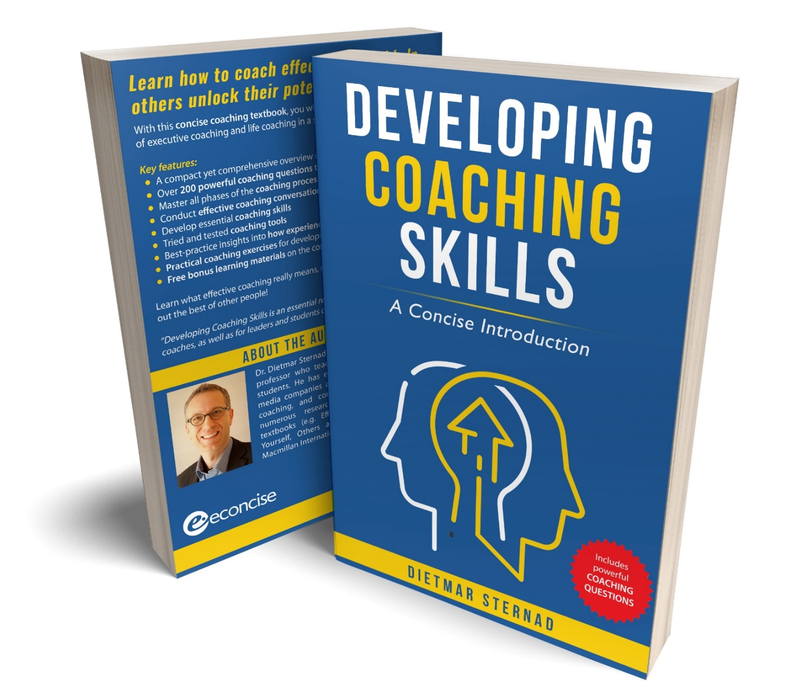
The coaching textbook
These slides are based on Chapter 4 of the textbook
Developing Coaching Skills: A Concise Introduction
Author: Dietmar Sternad
©2021 by econcise publishing
2
Cover illustration (heads): © Stmool/Shutterstock

Slide 3
Learning objectives – Essential coaching skills
Develop the mindset needed to become an effective coach
Formulate effective coaching questions
Enhance your active listening skills
Give constructive feedback to coachees
Help you and the coachee deal with difficult emotional situations
3
Photo source: pixabay.com

Slide 4
The coaching mindset
Forward-looking
cognitive state
A collaborative attitude
Support
Focus
A supportive attitude
“You have potential.”
A clear focus on the coachee
Collaboration
Belief in the coachee’s potential
COACH
COACHEE
Creating a “forward-looking cognitive state” in coachees
4
Source: Sternad, D. (2021). Developing Coaching Skills: A Concise Introduction. Moosburg: econcise.
“Forward-looking cognitive state” is an expression by Lai, Y.-L. & Palmer, S. (2019). Psychology in executive coaching: An integrated literature review. Journal of Work-Applied Management, 11(2), 143-164.

Slide 5
Questioning skills
Ask only one question at a time
Use open-ended questions
Avoid leading questions
Translate problem statements into forward-looking questions
Explore a situation with the TED model
“Could you tell me more about …?”
“Can you give me an example for …?”
“Could you describe this situation in more detail?”
5
Source: Sternad, D. (2021). Developing Coaching Skills: A Concise Introduction. Moosburg: econcise. Illuststration source: pixabay.com
TED model: O´Connor, J. & Lages, A. (2019). Coaching the Brain: Practical Applications of Neuroscience of Coaching. London: Routledge.

Slide 6
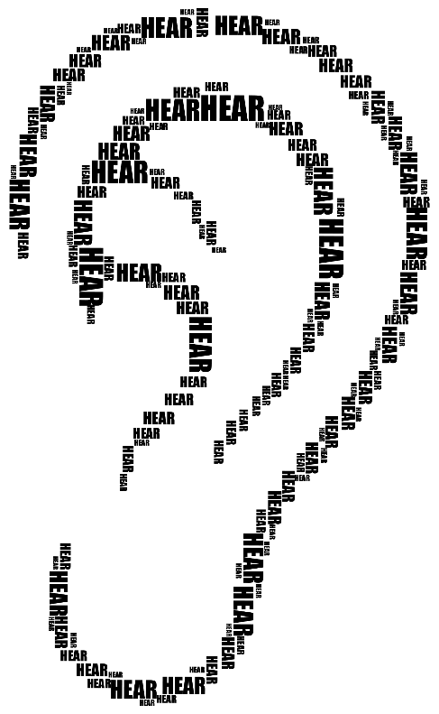
Active listening skills
ACTIVE LISTENING
DO
DO NOT
pay undivided attention
attend to your own thoughts
acknowledge what was said
interrupt the speaker
paraphraze and summarize
finish sentences
ask clarifying questions
present your own views
Note-taking can also be used to convey to coachees that you are actively involved.
6
Source: Sternad, D. (2021). Developing Coaching Skills: A Concise Introduction. Moosburg: econcise. Illustration source: openclipart.org

Slide 7
Summarizing skills
Provide a concise overview of the points that were discussed
Coachee can rest and reflect
Coachee can see the whole picture and form new links, associations, insights
Refocus the attention on the goal
Gives the coachee the feeling that you listened well
Transition to a new part of the conversation
7
Illustration source: pixabay.com

Slide 8
Feedback for coachees
In a coaching context, feedback can be defined as information that the coachee receives about their behavioral tendencies, actual behavior, and the effects of their behavior
DEFINITION
Feedback goals:
Raising the coachee’s self-awareness
Helping the coachee maintain a positive emotional state
1
2
8
Illustration source: pixabay.com

Slide 9
Constructive feedback skills
Can help coachees to raise their level of awareness
Information sharing should not be confused with criticism
Focus on helping the coachee to achieve a positive outcome,
link observations to coachee’s goals
Use positive non-verbal signals and open questions
Importance of framing
“You are not listening to me.” vs.
“I have the feeling that you are thinking about something here.”
9
Illustration source: pixabay.com

Slide 10
Dealing with emotions
How to deal with strong negative emotions?
Help coachees to get out of a victim mindset
Use the AAA exercise
Explore the emotion together with the coachee
Instead of sympathizing: acknowledge the feelings, but then try to progress in a goal-oriented way / focus on solutions
Accept (Identify the emotion)
Allow (Feel the emotion)
Ask (What is the emotion telling me?)
Take a time-out (reflect on the emotion)
Refer the coachee to a specialist
10
Illustration source: pixabay.com. Dealing with strong negative emotions: based on contents in Cox & Bachkirova (2021). AAA exercise: based on contents in Belton (2021). https://suebelton.com

Slide 11
End of module
ESSENTIAL
COACHING SKILLS
11
Photo source: unsplash / Toa Heftiba

