Slide 1

Developing Coaching Skills
COACHING
TOOLS
Photo source: unsplash / Toa Heftiba

Slide 2
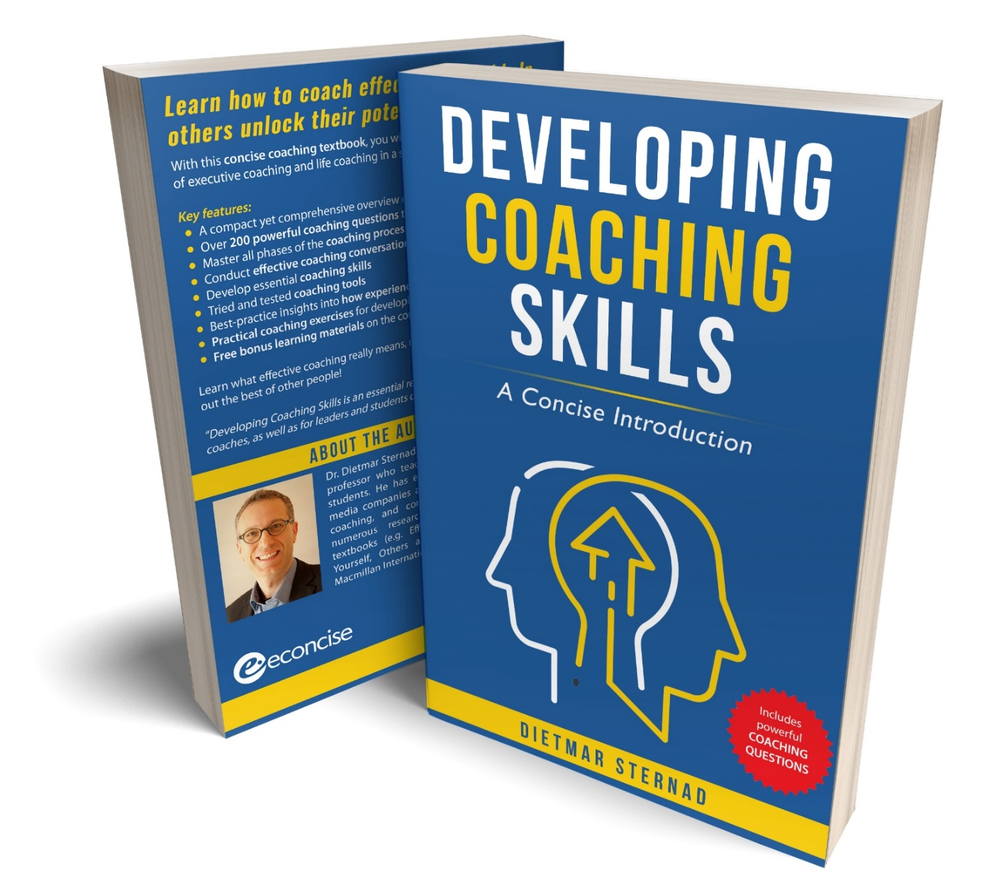
The coaching textbook
These slides are based on
Chapter 5 of the textbook
Developing Coaching Skills:
A Concise Introduction
Author: Dietmar Sternad
©2021 by econcise publishing
2
Cover illustration (heads): © Stmool/Shutterstock

Slide 3


Learning objectives – Coaching tools
Select coaching tools that can help coachees better understand themselves
Apply coaching tools that can facilitate the behavior change of coachees
Support coachees in their goal-setting process
Reframe a problem in a way that opens up the space for new solutions
Use action memos to focus coachees on goal-oriented action
3
Illustration source: pixabay.com

Slide 4

Tools for raising a coachee’s self-awareness
Personality profiles
Reading and
reflecting on books
Strengths profiles
Self-reflection exercises,
diary
Team roles tests
Feedback from others
(e.g. 360-degree feedback,
feedback interviews)
4
Photo source: pixabay.com

Slide 5

Motivational interviewing (MI)
Motivational interviewing: A conversation about change – a conversation that strengthens the coachee’s motivation and commitment to change
1
Focusing – clarifying the change goals
2
Evoking – helping the coachee to express their motivations for change
3
Planning – helping the coachee to commit to concrete action steps
5
Illustration source: pixabay.com. MI process based on contents from Miller, W. R. & Rollnik, S. (2013). Motivational Interviewing: Helping People Change. 3rd ed. New York, NY: The Guilford Press.

Slide 6

Decisional balance sheet
Do not change
Change
Benefits of the current behavior
Benefits of change
Costs of the current behavior
Costs of change
6
Illustration source: pixabay.com. Concept of decisional balance sheet based on contents in Passmore (2021).

Slide 7
The Transtheoretical Model
7
Source: Graphical representation by Sternad (2021) inspired by concepts in Prochaska & DiClemente (1982; 2005) and Grant (2021). Source of illustration: pixabay.com

Slide 8
Goal setting – types of goals
Distal goals
Proximal goals
Performance goals
Learning goals
Outcome goals
Approach goals
Achievement goals
Avoidance goals
Coachee’s goals
Organizational goals
Complementary goals
Conflicting goals
It is easier for coachees to focus on goals over which they have some influence
8
Source: Sternad (2021). Illustration source: pixabay.com

Slide 9
Goal hierarchy framework
9
Source: Sternad (2021). Illustration source: pixabay.com

Slide 10

Reframing a goal or problem
How a problem is formulated generally limits the number
of solutions
Reframing: changing our point of view on a problem situation
Strategies for reframing:
Are there any missing contextual factors / influences on the situation?
Is the coachee really pursuing the right (proximal) goal?
Focus on what the coachee can influence
What is the coachee’s role in creating the problem?
Get an outside view
Perspective taking (How would others see the problem?)
10
Illustration source: pixabay.com. Strategies for reframing based on contents in Wedell-Wedellsborg, T. (2020). What’s Your Problem: To Solve Your Toughest Problems, Change the Problems You Solve. Boston, MA: Harvard Business Review Press.

Slide 11
Example for an action memo
11
Source: Sternad (2021).

Slide 12
End of module
COACHING
TOOLS
12
Photo source: unsplash / Toa Heftiba

