Slide 1

The Mindset and Tools of Smart Problem Solvers
THE PROBLEM-SOLVING
MINDSET
Photo source: pixabay.com

Slide 2
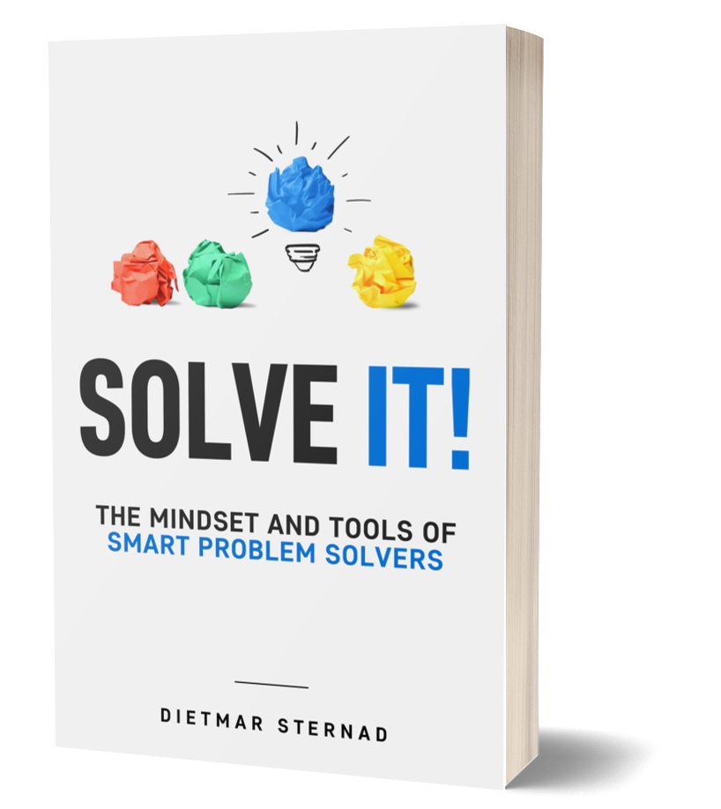
The problem-solving book
These slides are based on
Part I of the book
SOLVE IT!
The Mindset and Tools of
Smart Problem Solvers
Author: Dietmar Sternad
©2021 by econcise publishing
2
Cover illustration (heads): © Stmool/Shutterstock

Slide 3

Overview of the problem-solving mindset
Problems are there
to be solved
Use the power of your unconscious mind
Believe in
your abilities
Rally your
support team
Focus on what you
can influence
Beware of common problem-solving errors
3

Slide 4

1 Problems are there to be solved
The Wright Brothers
Helen Keller &
Anne Sullivan
Nelson Mandela
For every problem solved, there is someone
who first believed that it could be solved.
4
Photo source: pixabay.com (Mandela, Wright Brothers), https://commons.wikimedia.org/wiki/File:Hellen_Keller_holding_doll_with_Ann_Sullivan_1888.jpg (Helen Keller/Anne Sullivan)

Slide 5
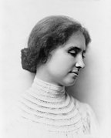
The power of optimism
“Optimism is the faith that leads to achievement;
nothing can be done without hope.″
–Helen Keller
Optimistic problem-solving mindset vs. victim mindset
Taking control instead of blaming others/the circumstances
Acknowledge the existence of challenges, but do not
see them as unsurmountable obstacles
5
Photo source: https://commons.wikimedia.org/wiki/File:Helen_KellerA.jpg

Slide 6
Research: The link between optimism and problem solving
Optimistic ‘high-hope’ students had greater problem-solving abilities and were better able to cope with stressful situations than ‘low-hope’ students.
(Cheng 1998)
Optimism supported elementary school students in their ability to collaboratively
and creatively solve mathematical problems. (Williams 2014)
A link was found between optimism and having satisfying romantic relationships
(explained by a higher degree of cooperative problem-solving abilities). (Assad et al. 2007)
6
Illustration source: pixabay.com.

Slide 7
2 Believe in your abilities
FIXED
MINDSET
GROWTH
MINDSET
‟I am just not made for this.”
Being confident that you will be able to develop the skills that can help you to solve the problem.
‟I will never be able to solve such problems.”
7
Illustration source: pixabay.com. The concept of growth mindset vs. fixed mindset is based on the work of Carol Dweck.

Slide 8
Learning from failure
Seeing failure as a learning opportunity
Every problem holds within it an opportunity to learn and grow
“I will never give up.” (Elon Musk)
8
Illustration source: pixabay.com

Slide 9
Research: A growth mindset and problem solving
Lower-achieving students were taught that they can develop their intellectual abilities. This short intervention led to a more positive approach to challenges
and helped to improve the students’ academic performance. (Dweck & Yaeger 2019)
A study among employees of Thai manufacturing companies revealed that a learning orientation—the internal drive to develop and seek challenges that provide a learning opportunity—was positively linked with innovative problem-solving behavior.
(Atitumpong & Badir 2018)
A study in a Norwegian government agency showed a strong link between the learning
orientation of employees and their propensity to come up with creative ideas for
solving problems in their work role. (Mutonyi & al. 2020)
9
Illustration source: pixabay.com.

Slide 10

3 Focus on what you can influence
“Care is to be bestowed on any enterprise only in proportion to its proper value. For if you keep this in mind you will not be disheartened from overconcern with things of less importance.″
–Marcus Aurelius, Roman Emperor and Stoic philosopher
Know where you can change things and where you can’t
Do not spend energy on what is outside of your control
Focus on where you can make a difference instead
10
Illustration source: https://commons.wikimedia.org/wiki/File:Aurelius_edit.png

Slide 11
Two conditions to accept a problem as your problem
IMPORTANCE
The issue is important for you (Covey’s “Circle of Concern”)
CONTROL
You can do something about it (Covey’s “Circle of Influence”)
Smart problem solvers particularly work on their inputs—on their own attitude and actions.
11
Photo source: pixabay.com

Slide 12
Research: Mastery orientation and problem solving
Mastery orientation (focused on input-related goals) vs. performance orientation
(focus on reaching certain outcomes).
In a study among 868 Indian managers, differences in the level of mastery orientation had a significant effect on job performance (no differences were found for performance goal orientation).
(Bhargava & Pradhan 2018)
Nursing students who received a short-term educational intervention that helped them develop a stronger mastery orientation were then found to be much more persistent in solving problems.
(Gardner 2006)
12
Illustration source: pixabay.com.

Slide 13

4 Use the power of your unconscious mind
Do not underestimate the power of daydreaming
The unconscious mind is a ‘star’ in pattern detection
Prime the subconscious part of your brain with a problem statement,
then resort to resting or doing something unrelated
13
Photo source: pixabay.com

Slide 14
Research on the power of the unconscious mind
An incubation period—some time spent away from the problem on completely different tasks—can significantly improve creative problem-solving performance.
(Gilhooly et al. 2013)
College students who were better in solving creative problems reported significantly more mind wandering during the incubation stage of the problem-solving process than ‘non-solvers.’
(Tan et al. 2015)
Study among writers and physicists: One fifth of the participants reported that their best ideas were formed during mind wandering that was completely independent of the task. These ideas were then
also more likely the right ones to solve a problem.
(Gable et al. 2019)
14
Illustration source: pixabay.com.

Slide 15

5 Rally your support team
One of the best ways to solve a problem is to ask others for help
Problem-solving can also be seen as a team sport
Share your problem and get new insights, new perspectives, new ideas
15
Photo source: pixabay.com

Slide 16
Three questions: Who can help you to solve the problem?
Who knows the most about this problem?
Who has already successfully solved a similar problem?
Who could I include in my support team?
Look for people with the right mindset (positive, encouraging, seeing the potential)
16

Slide 17
Research: The role of teamwork for problem solving
Groups of 3 performed better than the best individuals and pairs on highly intellective problems (larger groups did not perform better than groups of 3).
(Laughlin et al. 2006)
Positive spillover effect of joint problem solving on subsequent individual performance
(experience of team decision making can have a positive effect on individual problem-
solving skills) (Maciejovsky et al. 2013)
Working with others can help people to better comprehend a problematic situation, generate more creative solutions, and gain new insights. Benefits of social interaction: seeking and giving help,
reframing a problem with the help of different perspectives, getting positive reinforcement from others.
(Hargadon & Bechky 2006)
17
Illustration source: pixabay.com.

Slide 18
Beware of common problem-solving errors
Solving the wrong problem
Being too attached to
pet ideas
Misjudging other people
Think twice before taking a
problem for granted.
Do not waste time trying to solve the wrong problem.
Avoid selective thinking
and assumptive thinking.
Question your assumptions.
Remain open to hearing and considering contradicting facts.
Beware of the fundamental attribution error (assumption that
how people behave in one situation
is a good indicator for their general behavior).
Understand that people behave differently in different situations.
18
Photo source: pixabay.com

Slide 19
Research on avoiding problem-solving errors
A clear correlation was observed between problem construction ability (the ability to find and formulate the right problem before you attempt to solve it) and the quality and originality of solutions.
(Reiter-Palmon et al. 1998)
Confirmation bias: Psychiatrists who failed to seek evidence that might contradict their initial diagnosis of a patient made a wrong diagnosis in 70 percent of the cases.
(Mendel et al. 2011)
A very low correlation was observed between performance in job interviews and actual job performance
(→ beware of judging people only on how they present themselves in one particular situation).
(Nisbett 2016)
19
Illustration source: pixabay.com.

Slide 20
End of presentation
THE PROBLEM-SOLVING
MINDSET
20
Photo source: pixabay.com

