Slide 1

The Concise Leadership Textbook
WHAT IS
LEADERSHIP?
Photo source: unsplash / Natalia Pedigo

Slide 2
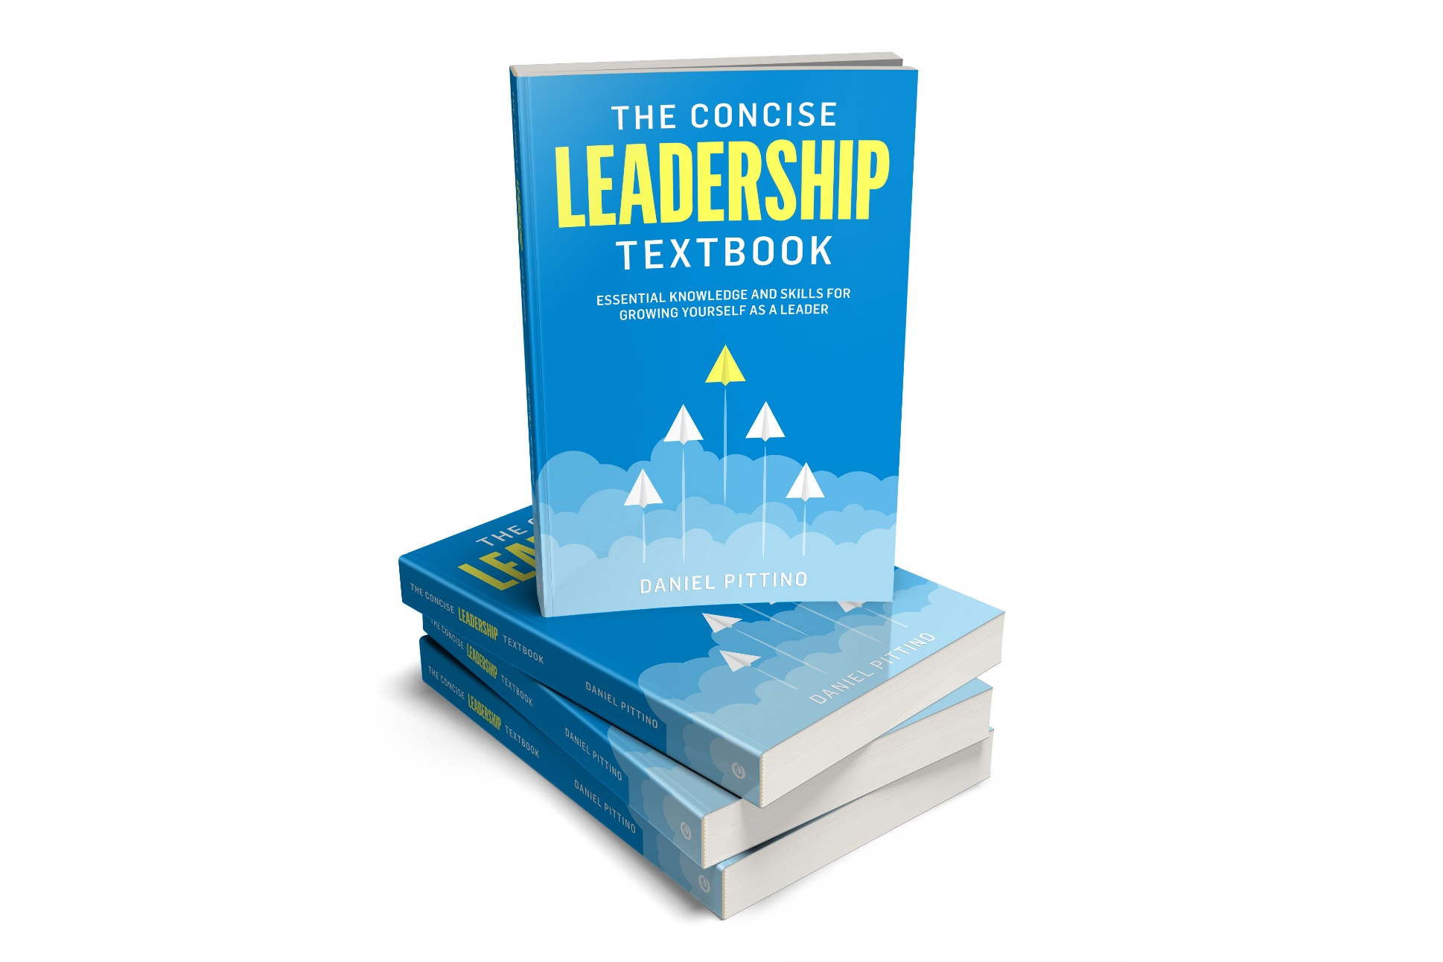
The leadership textbook
These slides are based on
Chapter 1 of
THE CONCISE LEADERSHIP
TEXTBOOK
Author: Daniel Pittino
©2022 by econcise publishing
2
Cover illustration (planes): iStock/Dmitry Volkov

Slide 3


Learning objectives – What is leadership?
Describe what leadership is all about
Compare different perspectives on the study of leadership
Recognize the link between leadership and the ability to solve ʻwickedʼ problems
Distinguish between management and leadership
3
Photo source: pixabay.com

Slide 4
Leadership defined
Leadership is a process of social influence aimed at reaching a common goal within a group or organization
DEFINITION
Leadership needs followership
The leader is the person who guides the process of social influence toward the common goal
Shared (joint) leadership is possible
4

Slide 5

Sources of power
Referent power: based on viewing the leader as a reference point and as a person with whom followers can identify
Expert power: based on the leader’s competence and/or expertise in specific fields.
Information power: derives from having exclusive access to information or knowledge that is important for others.
Legitimate power: associated with holding a position that entails formal job authority.
Coercive power: derives from the capacity to penalize or punish followers.
Reward power: comes from the capacity to provide rewards to followers.
Leaders exert influence on others
based on a combination of several
of these sources of power
5
Source: The sources of power are based on French, J. P. R. Jr. & Raven, B. (1968). The bases of social power. In: Cartwright, D. & Zander, A. F. (eds), Group Dynamics: Research and Theory, 3rd ed, pp. 259–269. New York, NY: Harper & Row.Photo source: unsplash/Miguel Bruna

Slide 6
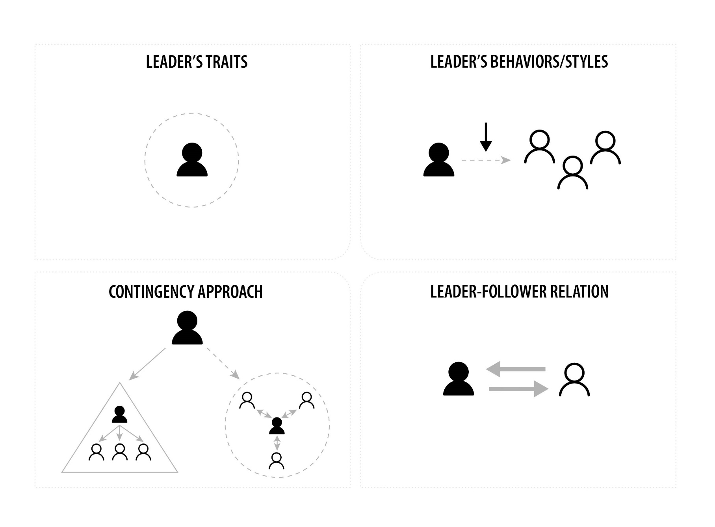
Different perspectives on studying leadership
6
Source: Pittino (2022). Picture credit (people): iStock.com/Ville Heikkinen

Slide 7

The leaderʼs traits approach
Focuses on the attributes of leaders such as personality, skills and abilities, motivation, or values
Assumption: some people are born with certain attributes that make them ‘natural leaders’
Criticism:
Failed to identify ‘one best way’
Ignores the role of other social factors and context
Neglects the possibility of developing through learning and practice
Tends to overlook the actual behaviors of a leader
7
Source: Pittino (2022). Picture credit (people): iStock.com/Ville Heikkinen

Slide 8
Leadership behaviors and styles
Understanding (through empirical observation) which recurrent types of leadership behavior (ʻleadership stylesʼ) can be linked to certain performance outcomes
Lewinʼs behavioral styles: autocratic, participative, delegative
Task-oriented vs. relationship-oriented behaviors
Concern for people vs. concern for production (Blake/Mouton)
Criticism:
Categories of leader behavior generally too broadly defined
(inconsistencies of research results regarding outcomes)
Failed to identify ‘one best way’
8
Source: Pittino (2022). Picture credit (people): iStock.com/Ville Heikkinen

Slide 9
Contingency approach
Focuses on contextual factors that influence the relationship between leadership behaviors and outcomes
Contextual factors: e.g. nature of work tasks, type of organization, characteristics of the external environment, characteristics of followers
Assumption: Leadership styles and behaviors should be adapted to match the situation
Situational Leadership Model (Hersey/Blanchard),
Path-Goal-Theory (Fiedler)
Emotional Leadership Styles (Goleman et al.)
Criticism:
Excessive complexity (too many variables) limits application
Some potential contingent factors may be overlooked
9
Source: Pittino (2022). Picture credit (people): iStock.com/Ville Heikkinen

Slide 10
Approaches focusing on the leader-follower relationship
Views that are more centered around leaders’ values that appeal to followers
Transformational leadership
Neo-charismatic leadership
Ethical leadership
Authentic leadership
Spiritual leadership
Servant leadership
ʻFollower-centeredʼ views (how is the relationship between
leaders and followers built?)
Leader-Member-Exchange (LMX) (in-group/out-group)
Leadership as social construction
10
Source: Pittino (2022). Picture credit (people): iStock.com/Ville Heikkinen

Slide 11
Leadership and effectiveness
When and to what extent does leadership really
affect organizational behaviors and performance?
Different streams of literature
Forces that limit the actual
impact of leaders
(internal, e.g. organizational structure,
external, e.g. market forces)
Leadership matters for the
effectiveness of organizations
(studies on the impact of business
leaders on economic performance)
ʻDeterministic viewʼ
Especially in complex situations
(ʻwicked problemsʼ)
11

Slide 12
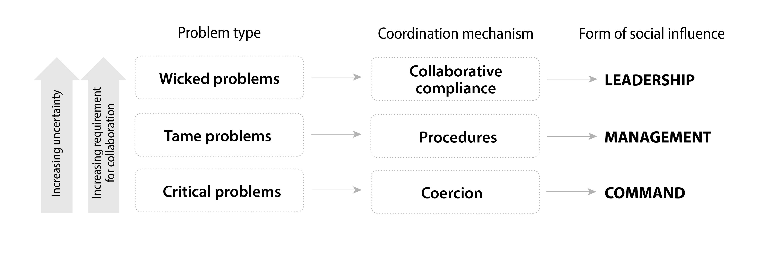
What are wicked problems?
12
Picture source: Pittino (2022), inspired by concepts in Grint, K. (2010). Leadership: A Very Short Introduction. Oxford: Oxford University Press.

Slide 13

Defining characteristics of wicked problems
Wicked problems cannot be described or ‘formulated’ in a definitive way
There is no ‘stopping rule’ for a wicked problem
Solutions to wicked problems are ‘one-shot operations.’
Wicked problems can only be addressed through leadership (by guiding a process of
social influence involving collaboration, shared goals, and joint problem solving).
Leadership effectiveness can be ultimately assessed by the ability to work with wicked problems.
13
Picture source: pixabay.com

Slide 14
5 phases for dealing with wicked problems
1
2
3
4
5
Framing the
problem
Patiently
exploring
the options
Taking a firm
decision and clearly
explaining the
motivation behind it
Executing with
commitment
Assessing the
outcomes, learning
to adapt, and
starting again
14
Source: Pittino (2022), inspired by concepts in Adapted from Karelaia, N., & Van der Heyden, L. (2020). Leadership in wicked times. INSEAD Knowledge. https://knowledge.insead.edu/leadership-organisations/leadership-in-wicked-times-15286, published October 13 2020, accessed April 13 2022. Picture source: pixabay.com

Slide 15
Leadership and management
MANAGEMENT
LEADERSHIP
Ensure order and consistency in existing activities
Concerned with future goals and change
Focused on efficiency
Focused on effectiveness
(fulfilling an important purpose)
Planning, organizing,
staffing, controlling
Influencing the context in which people work
Orderliness, timeliness, motivating extrinsically,
rule orientation
Focused on organizational culture and climate, and employee engagement
Organizations need both
15

Slide 16
End of module
WHAT IS
LEADERSHIP?
16
Photo source: unsplash / Natalia Pedigo

