Slide 1
The Concise Leadership Textbook
KNOW YOURSELF
LEADERSHIP TRAITS, SKILLS, AND BEHAVIORS
Photo source: unsplash / Natalia Pedigo

Slide 2
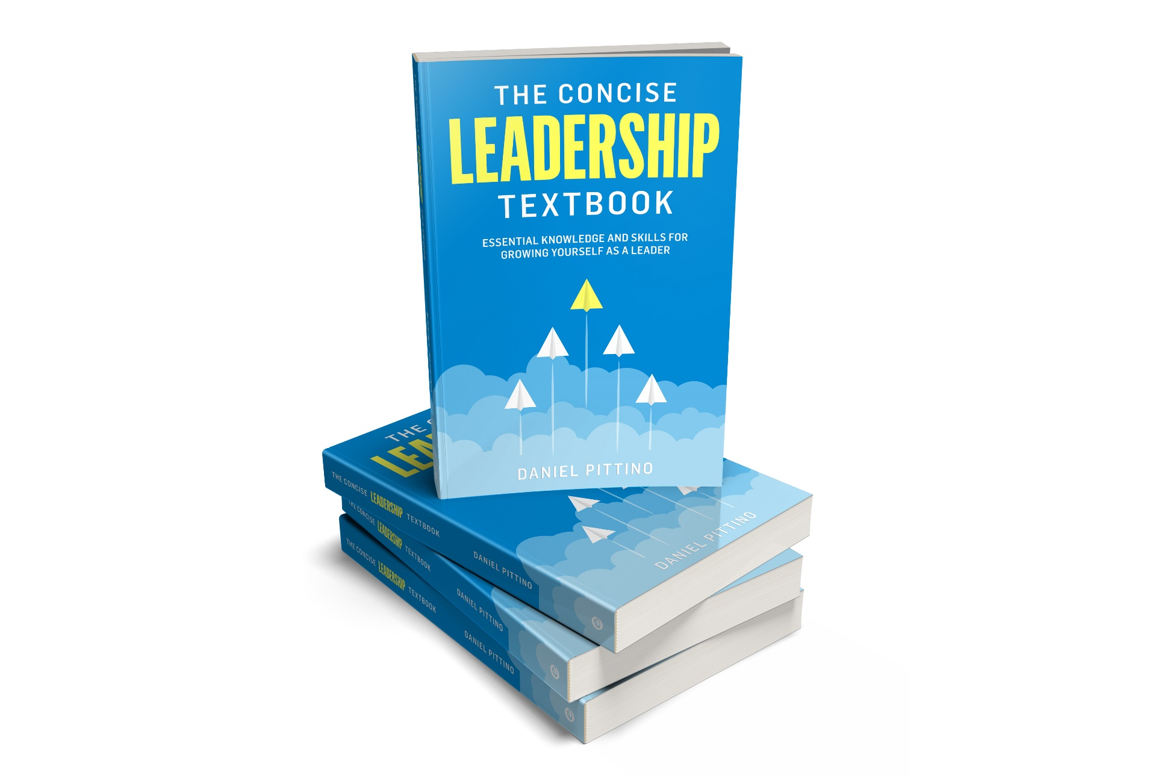
The leadership textbook
These slides are based on Chapter 2 of
THE CONCISE LEADERSHIP TEXTBOOK
Author: Daniel Pittino
©2022 by econcise publishing
2
Cover illustration (planes): iStock/Dmitry Volkov

Slide 3
Learning objectives – What is leadership?
Recognize the importance of self-awareness as a fundamental leadership skill
Examine the link between different personality traits and effective leadership
Assess which problem-solving, human, and technical skills you will need to develop to perform well in a leadership role
Reflect on the impact of different leadership styles and behaviors on your effectiveness as a leader
3
Photo source: pixabay.com

Slide 4
Personality traits
Personality traits are patterns of feeling, thinking and behaving that characterize each of us as individuals. These traits are relatively stable throughout a person’s life; they may change, but only in the long term
DEFINITION
Personality traits help to define our ʻcomfort zoneʼ
Personality traits can affect your approach to leadership situations and interpersonal relations
4
Source: The definition is taken from Pittino (2022) inspired by Roberts, B. W., & DelVecchio, W. F. (2000). The rank-order consistency of personality traits from childhood to old age: A quantitative review of longitudinal studies. Psychological Bulletin, 126(1), 3–25.

Slide 5
The ʻBig Fiveʼ personality traits
1
2
3
4
5
Conscientiousness
Extroversion
Openness to experience
Emotional
stability
Agreeableness
to what extent an individual is responsible, dependable, and organized
how much an individual is sociable, talkative, and outgoing
how much an individual is open-minded, curious, and eager for new experiences
how much an individual is able to remain stable and balanced in their emotions versus easily becoming anxious, angry or insecure
how much a person is likable, kind, flexible, and sympathetic
Strongest correlation found to perfomance in work tasks
Facilitates interpersonal interactions, but introverts can be effective leaders, too
Facilitates leadership development (motivation to explore new paths), helps leaders deal with different cultures
Tolerating high levels of stress and frustration in the leadership role; ʻinstabilityʼ can also be linked with enthusisam
Least clearly associated with leadership
(relevant where group cohesion is important)
5
Source: Pittino (2022) inspired by Costa, P. T., & McCrae, R. R. (1999). A five-factor theory of personality. In Pervin, L. A., & Oliver, J. P. (eds). Handbook of Personality: Theory and Research, 2nd ed, pp. 139–153. New York: Guilford Press.

Slide 6
Personality traits and leadership effectiveness
 | High | Medium or low
Conscientiousness | Consistency and reliability | Risk tolerance and dynamism
Extroversion | More easily recognized as a leader, ability to engage with others | Thoughtfulness
Openness to experience | Innovativeness | Loyalty to norms and values
Emotional stability | Stress tolerance | Passion, enthusiasm
Agreeableness | Empathy, flexibility | Assertiveness, decisiveness
6
Source: Pittino (2022) inspired by concepts in in Kaiser, R. B., LeBreton, J. M., & Hogan, J. (2015). The dark side of personality and extreme leader behavior. Applied Psychology: An International Review, 64(1), 55–92

Slide 7
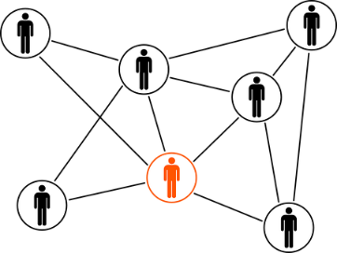
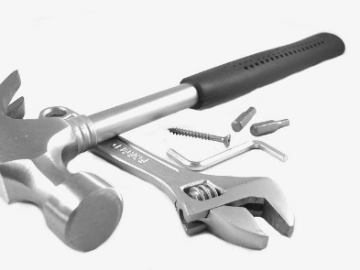
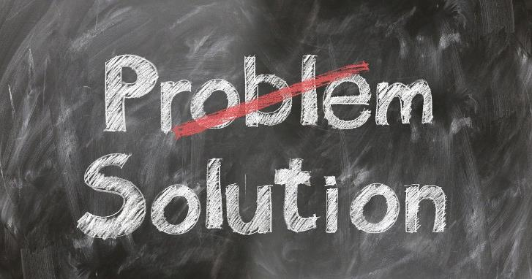
Leadership skills
Problem-solving skills
Human skills (intrapersonal/interpersonal)
Technical skills
Ability to solve difficult (ʻwickedʼ) problems
1. Define problems, 2. generate possible solutions, 3. plan actions and predict consequences, 4. implement the plan and identify alternative actions if the plan does not work out as expected
Project management skills (implementation)
(Intra-)Personal skills: self-awareness, core self- evaluation, self-confidence, self-efficacy
Interpersonal skills: understand people and social situations
Dependent on the specific context
Specialized knowledge about methods, processes, and tools for conducting the work tasks you are responsible for as a leader
Important for gaining trust and recognition of followers
7
Illustration source: pixabay.com

Slide 8
Overview of the problem-solving process
1
2
3
4
5
CLARIFY
CAUSES
CREATE
CHOOSE
COMMIT
Solve the
right problem
Make the right diagnosis
Find promising solutions
Decide on the optimal solution
Make it happen
8
Source: Sternad, D. (2021). Solve It! The Mindset and Tools of Smart Problem Solvers. Moosburg: econcise.

Slide 9
How to find solutions (creative problem-solving skills)
Describe the problem in a more abstract way and then learn from other people who have solved a similar problem
Creativity techniques (mind map, thought experiments [‟What would happen if …? ”], logic tree)
Smart brainstorming – let people work individually and in small groups first and include incubation time (break)
Examine your own role: How do you contribute to the problem with your own behavior?
Reverse brainstorming – how could we cause the problem?
Question assumptions and constraints
9
Source: Sternad, D. (2021). Solve It! The Mindset and Tools of Smart Problem Solvers. Moosburg: econcise. Illustration source: pixabay.com

Slide 10
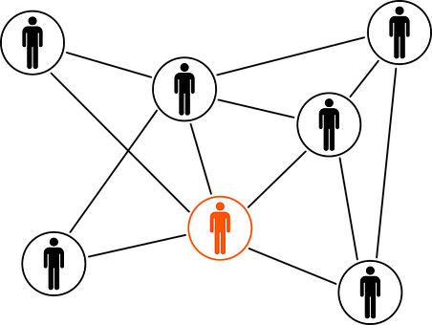
Key interpersonal skills
SOCIAL INTELLIGENCE
BEHAVIORAL
FLEXIBILITY
SOCIAL PERFORMANCE
the ability to understand other people’s perspectives and goals in relation to different problems and solutions
the ability to adjust your behaviors based on other people’s point of view
includes e.g. being able to communicate your vision and perspective to others, being able to mediate in conflict situations, and being able to coach followers, providing them with guidance and support
10
Source: Pittino (2022) inspired by concepts in Northouse, P. G. (2022). Leadership: Theory & Practice, 9th ed. Thousand Oaks, CA: SAGE Publications; Zaccaro, S. J. (2001). Organizational leadership and social intelligence. In: Riggio, R. E., Murphy, S. E., & Pirozzolo, F. J. (eds.). Multiple Intelligences and Leadership, pp. 42–68. New York, NY: Psychology Press

Slide 11
Emotional intelligence
EMPATHY
SELF-REGULATION
the ability to manage emotions and impulses in a way that is appropriate for the situation
the ability to understand
other people’s emotions
EMOTIONAL SELF- AWARENESS
understanding how emotions shift and change, and how they impact interpersonal relationships and the ability to carry out tasks
11
Picture source: pixabay.com

Slide 12
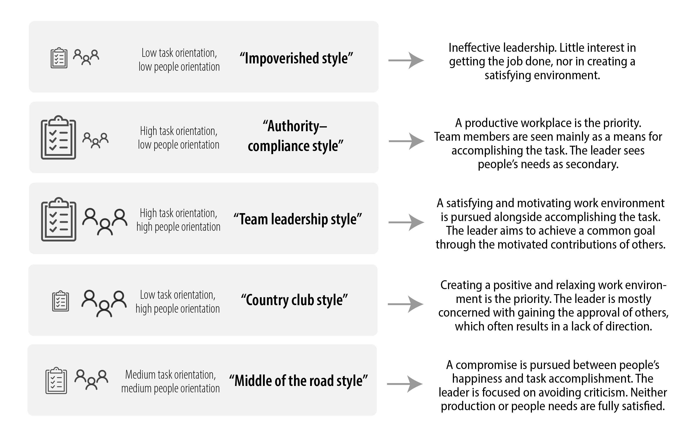
Behavioral styles: people vs. task orientation (Blake/Mouton)
12
Illustration source: Pittino (2022), with icons by iStock.com/Ville Heikkinen. Contents inspired by Blake, R. R., Mouton, J. S., & Bidwell, A. C. (1962). Managerial grid. Advanced Management – Office Executive, 1(9), 12–15; Blake, R. R., & Mouton, J. S. (1978). What’s new with the grid®? Training and Development Journal, 32(5), 3–8

Slide 13
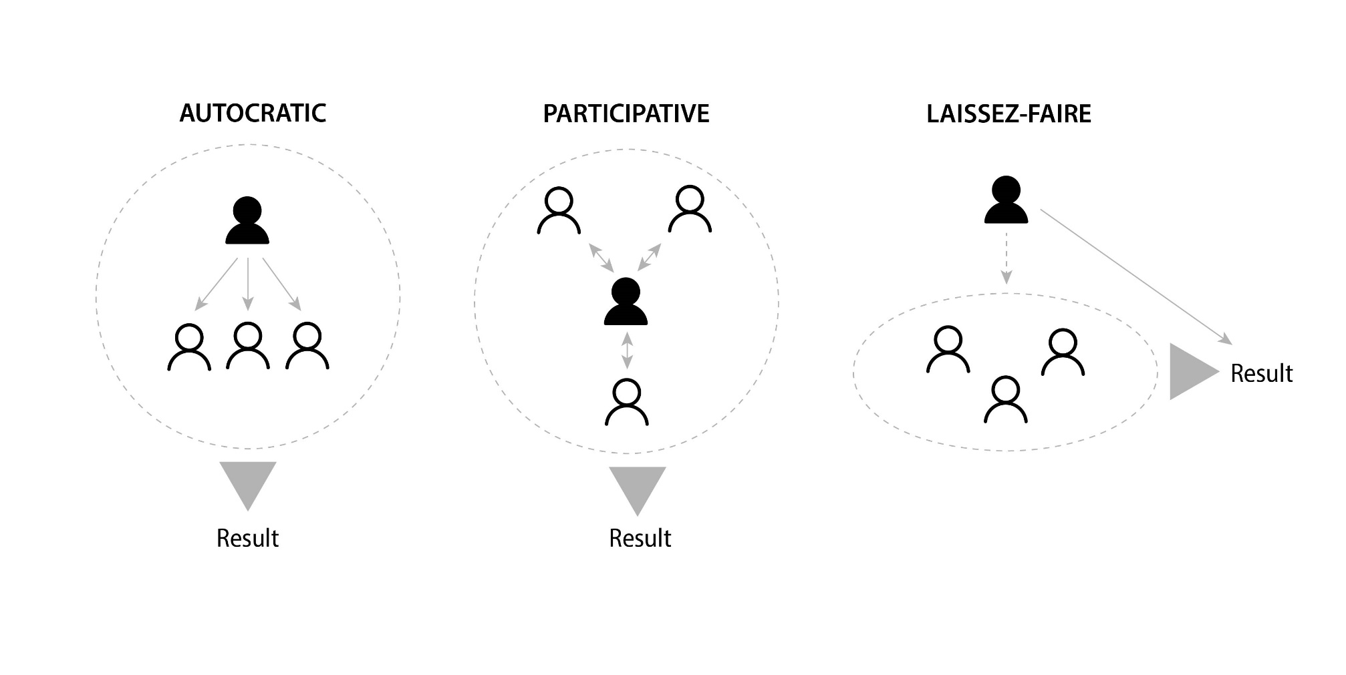
Decision-making styles (Lewin)
making decisions without consulting the members of your team
making the final decisions, but you involve team members extensively in the decision-making process
responsibility to make decisions is largely delegated to the team members who, as a consequence, have high autonomy in how they organize their work
13
Illustration source: Pittino (2022), with icons by iStock.com/Ville Heikkinen; iStock.com/da-vooda. Contents inspired by Lewin, K., Lippitt, R., & White, R. K. (1939). Patterns of aggressive behavior in experimentally created ‘social climates.’ The Journal of Social Psychology, 10(2), 269–299.

Slide 14
End of module
KNOW YOURSELF
LEADERSHIP TRAITS, SKILLS, AND BEHAVIORS
14
Photo source: unsplash / Natalia Pedigo

