Slide 1
The Concise Leadership Textbook
HOW TO LEAD
(WITH) OTHERS
Photo source: unsplash / Natalia Pedigo

Slide 2
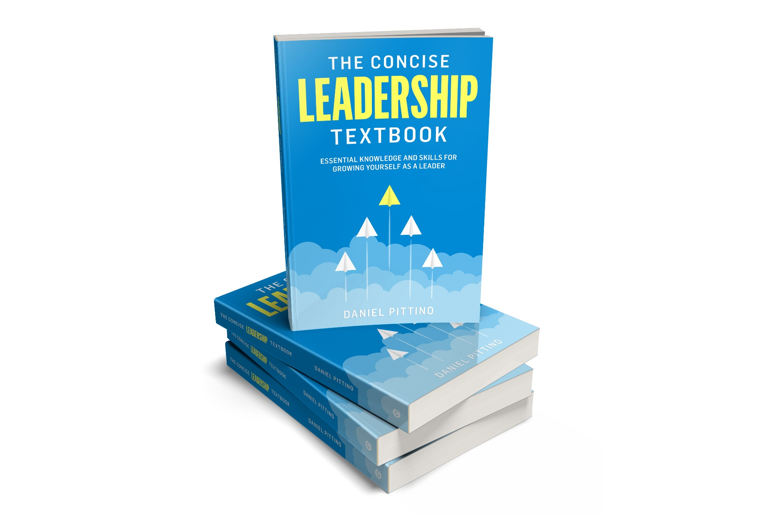
The leadership textbook
These slides are based on Chapter 3 of
THE CONCISE LEADERSHIP TEXTBOOK
Author: Daniel Pittino
©2022 by econcise publishing
2
Cover illustration (planes): iStock/Dmitry Volkov

Slide 3
Learning objectives – What is leadership?
Recognize how different followers may respond better to different types of leadership behavior
Examine how the relationship between you and your followers influences your effectiveness in the leadership role
Explore how you can help your team members develop, learn and grow with a transformational leadership approach
Identify the key aspects that determine your team’s performance
Evaluate the benefits and risks of a shared leadership approach
3
Photo source: pixabay.com

Slide 4
Building a good leader-follower relationship
Followers’ characteristics
Relationship between leader and followers
Team context
influence the most appropriate behavior (style) to adopt, in accordance with the goal that needs to be accomplished
evolves over time and should be, as much as possible, aimed at pursuing personal growth and development goals
leaders and followers typically interact in a team setting
leadership itself can also be exercised within and through a team
4
Illustration source: pixabay.com

Slide 5
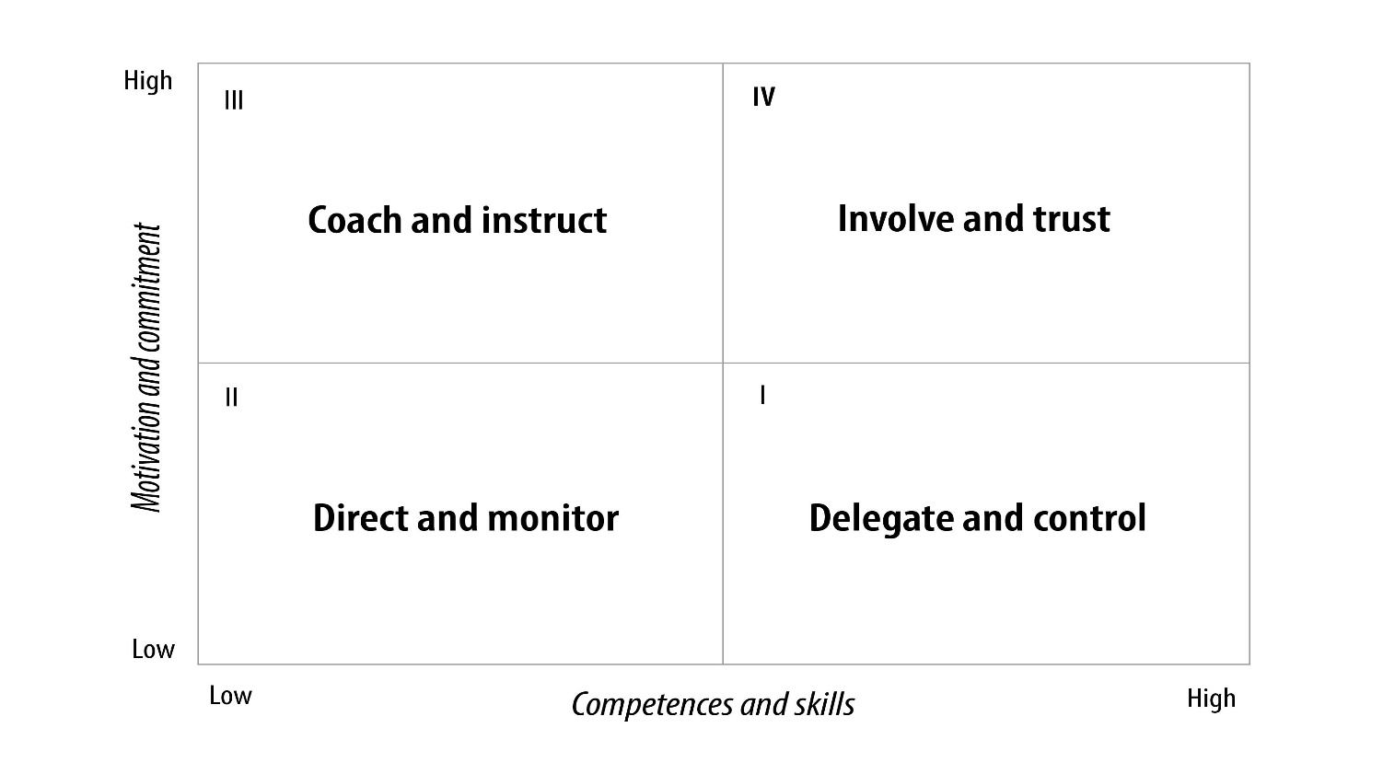
Followers’ characteristics and leader’s behavior
Leadership requirements in different situations depend mostly on the characteristics of the followers
combination of people-oriented and autocratic behavior; detailed instructions, but at the same encouraging them to learn and improve in the required skills (e.g. by asking them for input)
combination of people-oriented and democratic styles, rely on your followers knowing how to accomplish a task, no need for detailed instructions;
high motivation acts as ‘self-control’
combination of task-oriented and autocratic behavior; precise instructions on what goals need to be achieved, and on how to go about accomplishing them; close supervision
combination of laissez-faire and task-oriented styles, leverage the abilities of your followers and assign them tasks that they know how to accomplish very well, but constantly following up on goals
5
Source: Pittino (2022).

Slide 6
Leader-follower relationship: Contingency theory (Fiedler)
‘Good’ relationship
High power
High degree of task structure
Task-oriented style (not so important to focus on building relationships)
‘Good’ relationship
Low power
Low degree of task structure
People-oriented style (preserve relationship/trust)
‘Bad’ relationship
High power
Low degree of task structure
People-oriented style
(focus on improving relationship first)
‘Bad’ relationship
Low power
Low degree of task structure
Task-oriented style
(strengthen position by setting clear rules)
6
Source: Based on concepts in Fiedler, F. E. (1964). A contingency model of leadership effectiveness. Advances in Experimental Social Psychology, 1, 149–190.

Slide 7
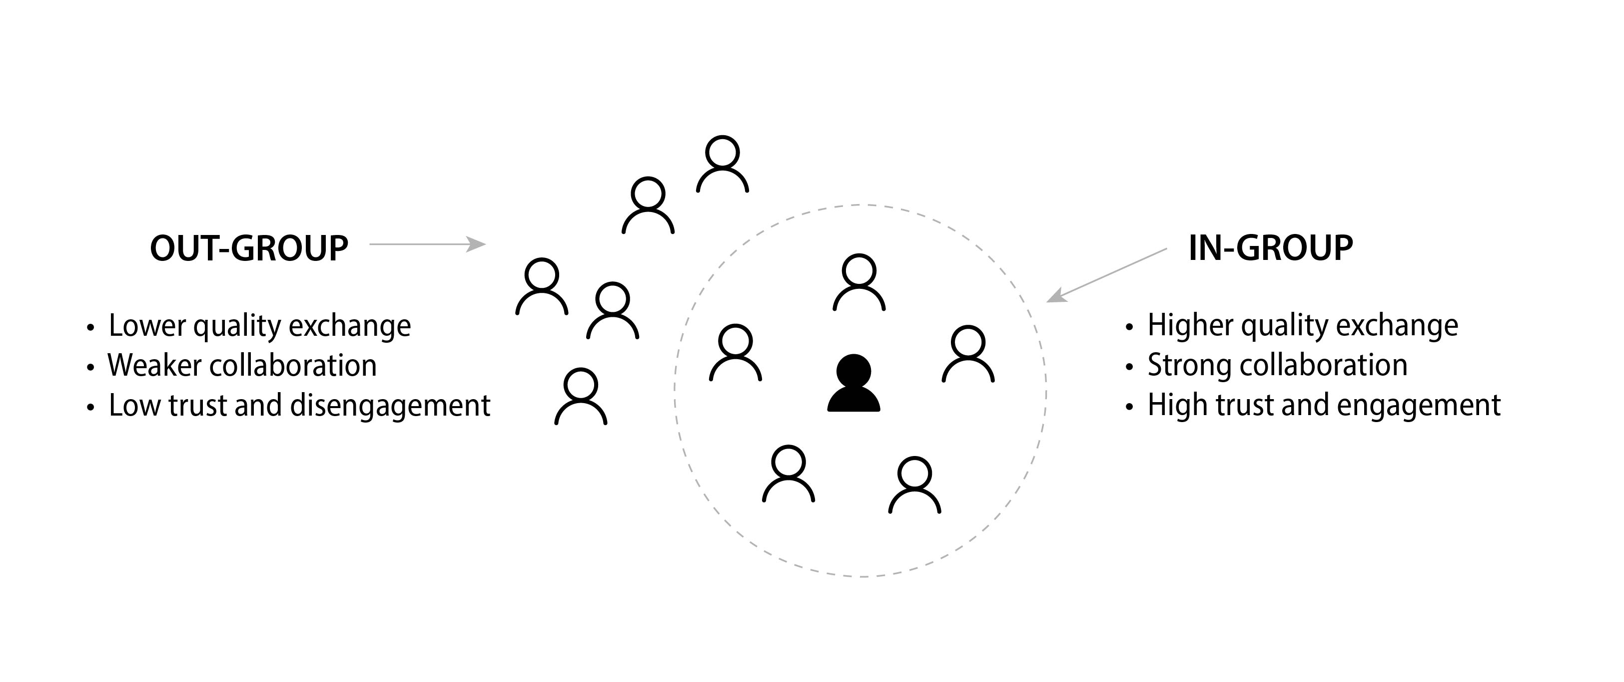
Dynamic view: Leader-member exchange (LMX)
7
Source: Pittino (2022) inspired by concepts Graen, G. B., & Uhl-Bien, M. (1995). Relationship-based approach to leadership: Development of leader–member exchange (LMX) theory of leadership over 25 years: Applying a multi-level multi-domain perspective. The Leadership Quarterly, 6(2), 219–247.
Picture credit: figures used by iStock.com/Ville Heikkinen

Slide 8
Dealing with an in-group/out-group situation
Potentially detrimental effects
Risk that out-group members develop apathy or hostility toward the team
Risk that leader/in-group members become overly confident (‘groupthink’)
How to mitigate risks
Periodically reflecting on the preferences that you may have toward some followers
Helping out-group members to feel involved and empowered (e.g. in-group members as ‘ambassadors’)
Different in-group/out-group combinations for different activities
Leader or members of the in-group act as coaches or mentors
Actively asking out-group members for their opinion and advice on important matters
8
Source: Pittino (2022). Picture credit: figures used by iStock.com/Ville Heikkinen

Slide 9
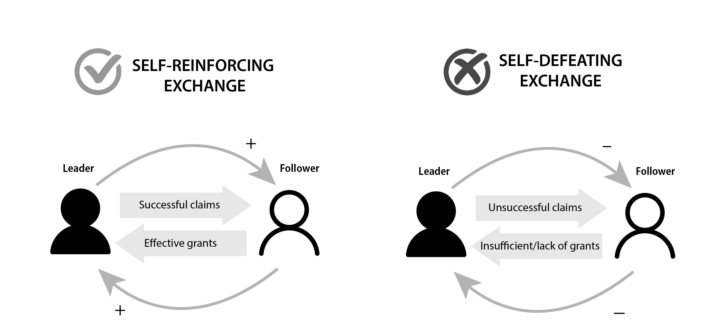
Leadership as a social interaction process
The role of the leader, and the corresponding role of the followers, is built through a social interaction process which is made up of ‘claims’ and ‘grants’ by the people involved.
9
Source: Pittino (2022) inspired by concepts in DeRue, D. S., & Ashford, S. J. (2010). Who will lead and who will follow? A social process of leadership identity construction in organizations. Academy of Management Review, 35(4), 627–647
Picture credit: figures used by iStock.com/Ville Heikkinen; symbols by iStock.com/da-vooda.

Slide 10
Implications of the ‘claims’ and ‘grants’ view
Leadership does not necessarily come from holding a formal position
A group can recognize the leadership of someone who is not formally identified as a leader
Leadership is constructed and continuously reconstructed through the leader’s exchanges with their followers
Claiming and granting can be a mutually reinforcing process that strengthens the leader’s and followers’ roles, or a ‘downward spiral’ that undermines the leader–follower relationship
10
Source: Pittino (2022).

Slide 11
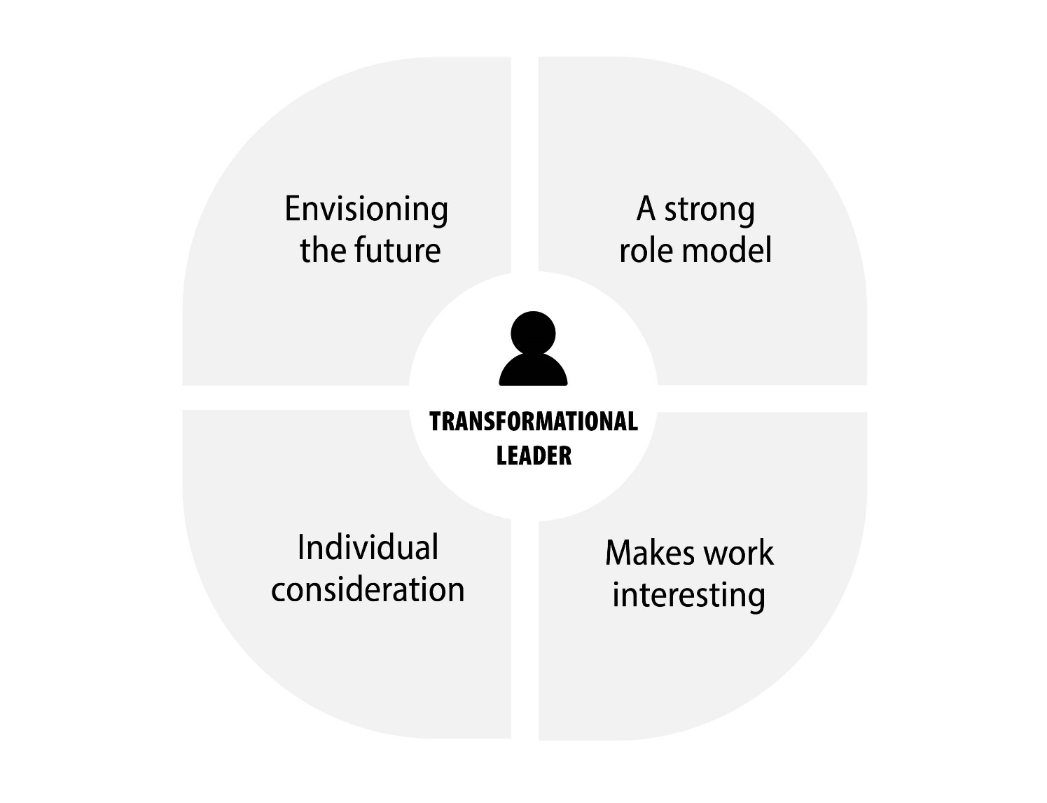
Key features of transformational leadership
create and communicate a positive and engaging vision of the future,
create a climate of inspirational motivation (working toward a greater aim);
increasing the intrinsic motivation through providing a new meaning related to the vision and the associated values and ideals
Can exercise idealized influence on followers (e.g. setting an example of dedication and hard work, sacrificing self-interest or personal gain to benefit the followers and/or the organization,
‘walking the talk’)
care about each follower in a distinctive way (e.g. understanding preferences on work tasks and individual strengths and weaknesses, discussing personal motivations, ambitions, struggles and dreams; provide encouragement and support when needed.
offer intellectual stimulation to followers, e.g. by assigning challenging work tasks that allow them to learn and grow; encourage followers to get out of their comfort zone, and challenge them with problems that stimulate imagination, creativity, and the development of original solutions
11
Source: Pittino (2022) inspired by concepts in Bass, B. M. & Avolio, B. J. (eds.). (1994). Improving Organizational Effectiveness Through Transformational Leadership. Thousand Oaks, CA: Sage Publications.

Slide 12
Leading teams
A team is a small group that has a defined common purpose, and whose members have interdependent roles, as well as complementary skills
DEFINITION
Focus of a leader in team leadership
Clarity of roles and coordination
Assessment and development of members’ skills
Group cohesion, cooperation, and trust
External alignment
Explain responsibilities
Team coordination
Planning roles and activities
Mutual adjustments
Assess members’ skills
Give constructive feedback
Coaching
Communicating a vision
Ceremonies, symbols, rituals
Team building
Informing about achievements
Reviewing ‘health status’ / team climate
Ensure information flow with relevant stakeholders (internal/external)
Nurture network of contacts
12
Source: Pittino (2022) inspired by Yukl, G., & Gardner III, William L. (2020). Leadership in Organizations, 9th ed. Harlow: Pearson Education; Yukl, G., & Gardner III, William L. (2020). Leadership in Organizations, 9th ed. Harlow: Pearson Education; Northouse, P. G. (2021). Leadership: Theory and Practice, 9th ed. Thousand Oaks, CA: Sage Publications.
Illustration: pixabay.com

Slide 13
Shared leadership in teams
Shared leadership emerges when team members instigate a dynamic and interactive influence process in which they lead one another to the achievement of common goals
DEFINITION
+
–
BENEFITS
DIFFICULTIES
Higher levels of participation and collaboration
‘Collectively owned’ choices
Learning from one another; feeling empowered to leverage their abilities
Less pressure; moral support of co-leaders
Dealing with the established assumption that leadership is singular (people are used to be inspired by a specific single leader)
Need for consensus and mutual acceptance
Competing personalities, different career goals, and personal agendas might paralyze the shared leadership model
13
Source: Pittino (2022) inspired by Pearce, C. L., Conger, J. A., & Locke, E. A. (2007). Shared leadership theory. The Leadership Quarterly, 18(3), 281–288; Illustration: pixabay.com

Slide 14
End of module
HOW TO LEAD
(WITH) OTHERS
14
Photo source: unsplash / Natalia Pedigo

