Slide 1
The Concise Leadership Textbook
CONTEMPORARY
LEADERSHIP CHALLENGES
Photo source: unsplash / Natalia Pedigo

Slide 2
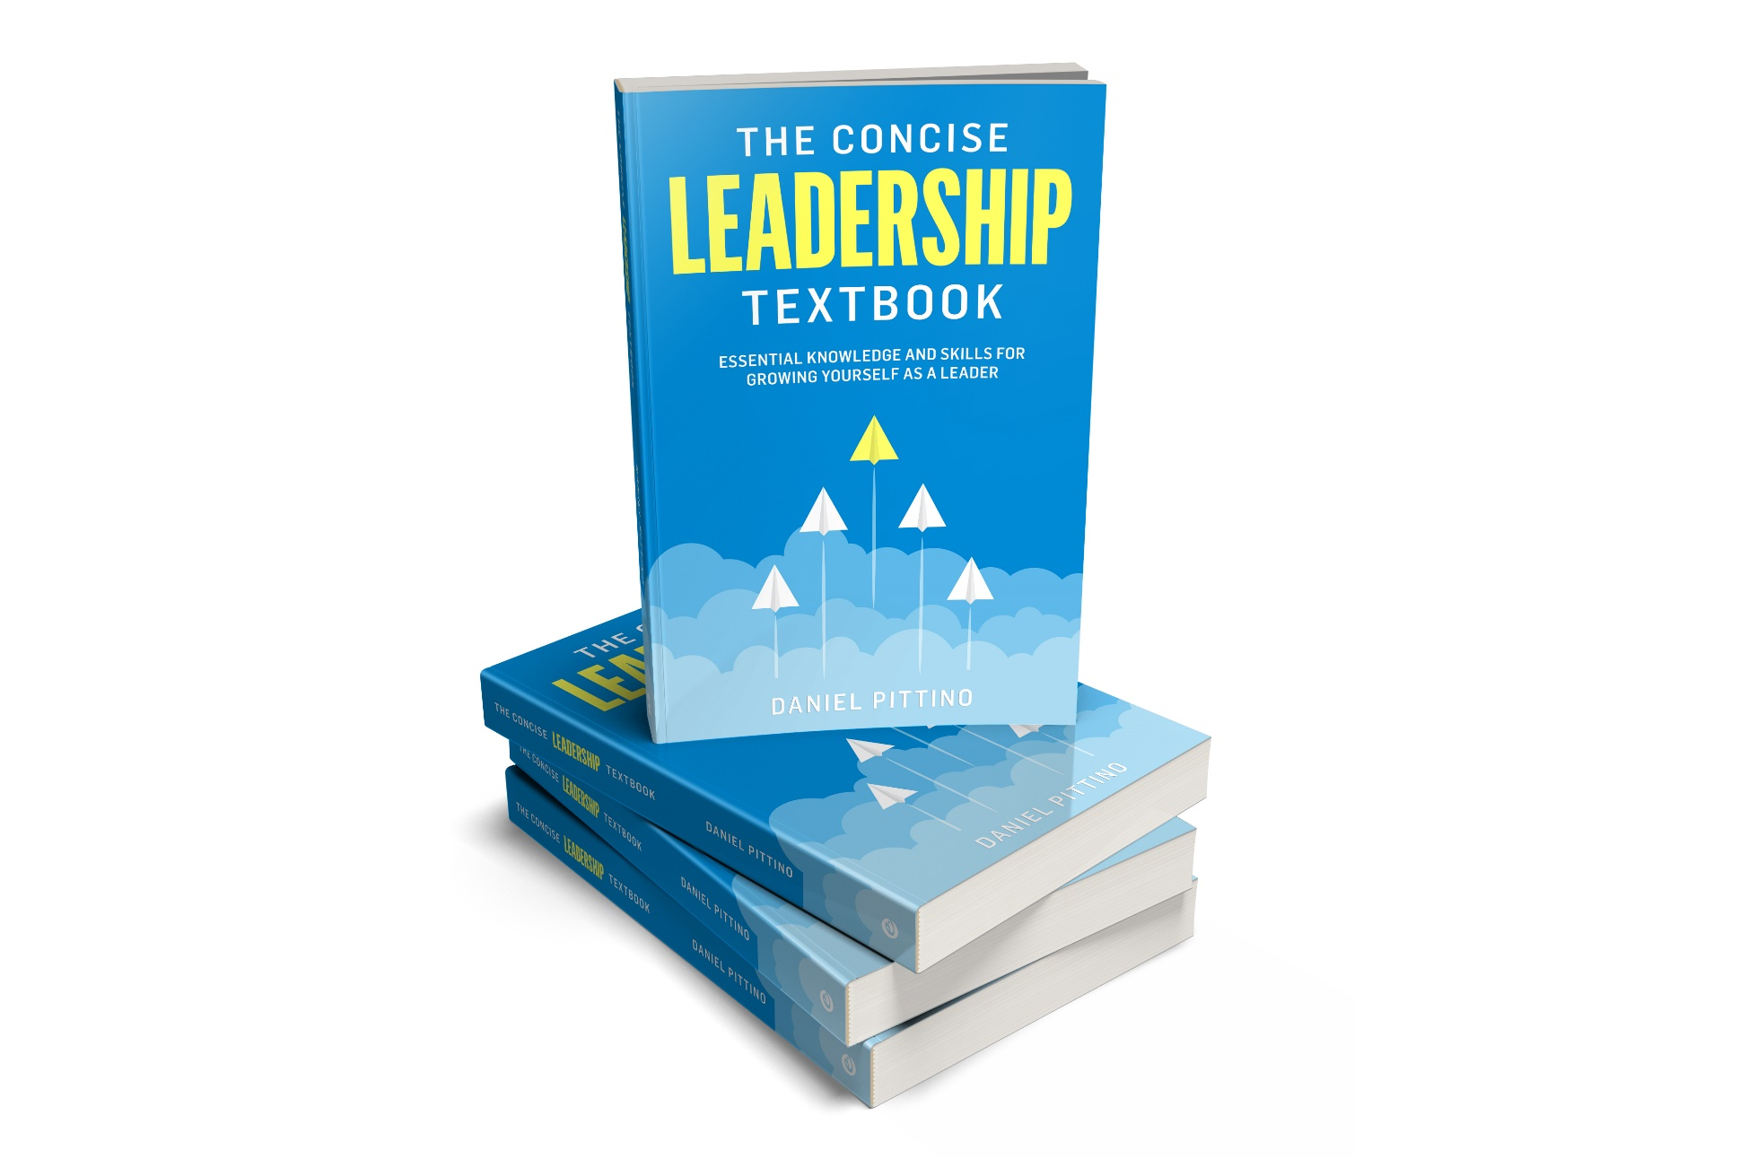
The leadership textbook
These slides are based on Chapter 4 of
THE CONCISE LEADERSHIP TEXTBOOK
Author: Daniel Pittino
©2022 by econcise publishing
2
Cover illustration (planes): iStock/Dmitry Volkov

Slide 3
Learning objectives – What is leadership?
Reflect on the specific requirements of leading global and virtual teams
Recognize the importance of creating a strong ethical compass as a leader
Identify the main leadership competences related to creating more sustainable and inclusive organizations and societies
Confidently plan and lead change processes in both relatively stable and highly dynamic environments
3
Photo source: pixabay.com

Slide 4
Three contemporary leadership challenges
Globalization
Ethics
Turbulent change
leading across cultures
globalization of labor markets and work relationships
digital connectivity – virtual team leadership
honesty and integrity
sustainability
inclusion
accelerating pace of change
strengthening the ability to cope with change and be flexible
4
Source: Pittino (2022). Picture credit: pixabay.com

Slide 5
Leading across cultures
Culture is made of the values, norms, and customs that are shared by a social group. It guides the behavior of those groups, acting as a sort of “collective software” of people’s minds.
DEFINITION
Effective leadership has different meanings in different cultures
Expectations regarding the leader’s role change according to the cultural context
5
Source: Pittino (2022) inspired by Hofstede, G., Hofstede, G. J., & Minkov, M. (2005). Cultures and Organizations: Software of the Mind, 2nd ed. New York, NY: McGraw Hill; Schein, E. H. (2010). Organizational Culture and Leadership, 2nd ed. Hoboken, NJ: John Wiley & Sons

Slide 6
Leadership styles and cultural dimensions
HOFSTEDE
CULTURAL DIMENSIONS
GLOBE STUDY CULTURAL DIMENSIONS
Individualism/collectivism
Power distance
Uncertainty avoidance
Masculinity
Time orientation
Power distance
Uncertainty avoidance
Humane orientation
In-group collectivism
Institutional collectivism
Gender egalitarianism
Future orientation
Performance orientation
Effectiveness depends on …
Leadership styles
Charismatic/value-based
Team-oriented
Participative
Humane-oriented
Autonomous
Self-protective
6
Source: based on ideas in Hofstede, G., Hofstede, G. J., & Minkov, M. (2005). Cultures and Organizations: Software of the Mind, 2nd ed. New York, NY: McGraw Hill; House, R. J., Hanges, P. J., Javidan, M., Dorfman, P. W., and Gupta, V. (eds.) (2004). Culture, Leadership and Organizations: The GLOBE Study of 62 Societies. Thousand Oaks, CA: Sage

Slide 7
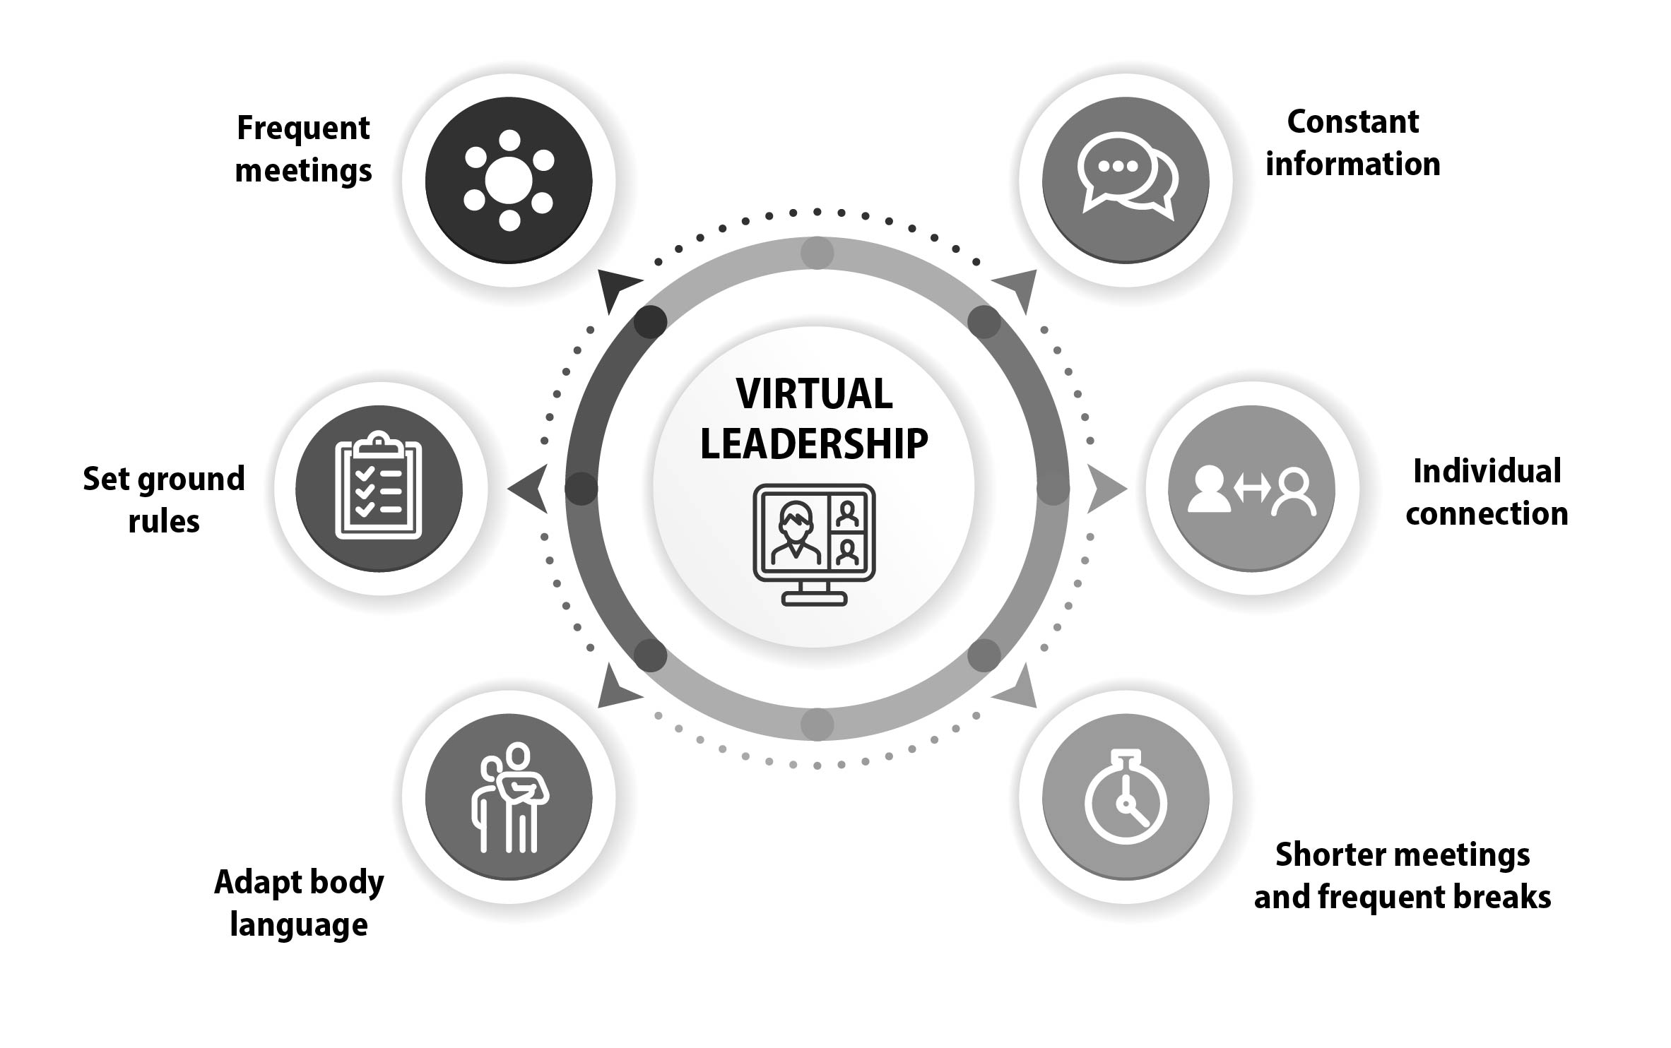
Virtual team leadership – practical guidelines
Beware of ʻZoom fatigueʼ!
7
Source: Pittino (2022), inspired by Kinsey Goman, C. (2021). How to keep your virtual team from tuning out. https://www.forbes.com/sites/carolkinseygoman/2021/10/15/how-to-keep-your-virtual-team-from-tuning-out/, published October 15 2021, accessed July 1 2022; Malhotra, A., Majchrzak, A., & Rosen, B. (2007). Leading virtual teams. Academy of Management Perspectives, 21(1), 60–70 Picture credit: istock.com/artvea; iStock.com/Ville Heikkinen; iStock.com/da-vooda; istock.com/in8finity; istock.com/Shendart

Slide 8
Principles of ethical leadership
Ethical leadership
Justice & fairness
Respect
Community
Integrity
Honesty
Ethical dilemmas: situations where there is an inherent contradiction in the application of ethical principles
8
Source: Pittino (2022) inspired by Yukl, G., Mahsud, R., Hassan, S., & Prussia, G. E. (2013). An improved measure of ethical leadership. Journal of Leadership & Organizational Studies, 20(1), 38–48. Picture source: pixabay.com

Slide 9
Approaches to solving ethical dilemmas
Identify in advance potential situations that are likely to trigger ethical dilemmas
Carefully prepare your response (visualize scenarios, ʻrehearsalʼ)
Assess all the information (collect evidence about the issue, get advice from trusted people)
Be courageous (sometimes the right choice can be painful)
Re-evaluate your decision before you act (take a different perspective)
9
Source: Pittino (2022) inspired by Yukl, G., Mahsud, R., Hassan, S., & Prussia, G. E. (2013). An improved measure of ethical leadership. Journal of Leadership & Organizational Studies, 20(1), 38–48. Picture source: pixabay.com

Slide 10
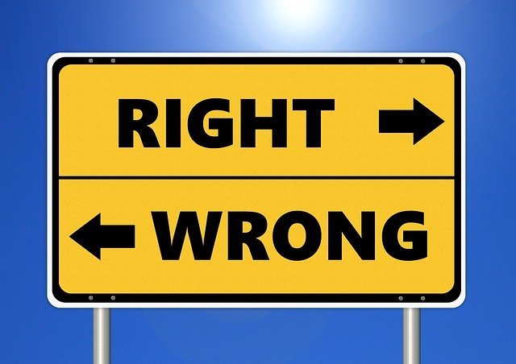
Leadership styles for dealing with ethical dilemmas
Duty-driven (“doing what is right”)
Utilitarian (“doing what benefits most people”)
Care-oriented (“doing what shows care to people that are close to me”)
Duty-driven (“doing what a ʻgood personʼ would do”)
Egoistic (“doing what is personally beneficial”)
Justice-driven (“doing what is fair”)
10
Source: Based on ideas in Chikeleze, M. C., & Baehrend Jr, W. R. (2017). Ethical leadership style and its impact on decision‐making. Journal of Leadership Studies, 11(2), 45–47. Picture source: pixabay.com

Slide 11
Focus on sustainability
THE ʻTRIPLE BOTTOM LINEʼ
SOCIAL
SUSTAINABILITY
ENVIRONMENTAL
SUSTAINABILITY
ECONOMIC
SUSTAINABILITY
create and distribute value for the good of society
fair exchange of resources
caring for the community
preserving and restoring the ecological system
environmentally responsible practices
pursue the creation of net economic value that is necessary for the organization to survive
11
Source: Pittino (2022). Picture credit: pixabay.com

Slide 12
Sustainability-related leadership behaviors and competences
Leadership behaviors
promoting a sustainable vision
defining measurable outcomes for social responsibility
engaging and empowering diverse stakeholders
setting clear ethical standards
Leadership competences
systems-thinking attitude
relationship-building capabilities
a sustainability mindset (nurturing a strong sense of purpose and commitment in the team to meet the triple bottom line
12
Source: Pittino (2022), inspired by DʼAmato, A., Eckert, R., Ireland, J., Quinn, L., & Van Velsor, E. (2010). Leadership practices for corporate global responsibility. Journal of Global Responsibility, 1(2), 225–249; . Picture credit: pixabay.com

Slide 13
The inclusive leader
Inclusion, in organizations and in society, consists of providing fair access to opportunities and resources for people who might otherwise be excluded or marginalized.
DEFINITION
Characteristics of inclusive leaders
Visible commitment to promoting diversity
Curiosity about others
Humility (modest about their own capabilities)
Cultural intelligence
Awareness of bias
Effective collaboration (empowering followers)
13
Source: based on contents in Bourke, J., Titus, A., & Espedido, A. (2020). The key to inclusive leadership. Harvard Business Review, https://hbr.org/2020/03/the-key-to-inclusive-leadership, published March 6 2020, accessed July 3 2022.

Slide 14
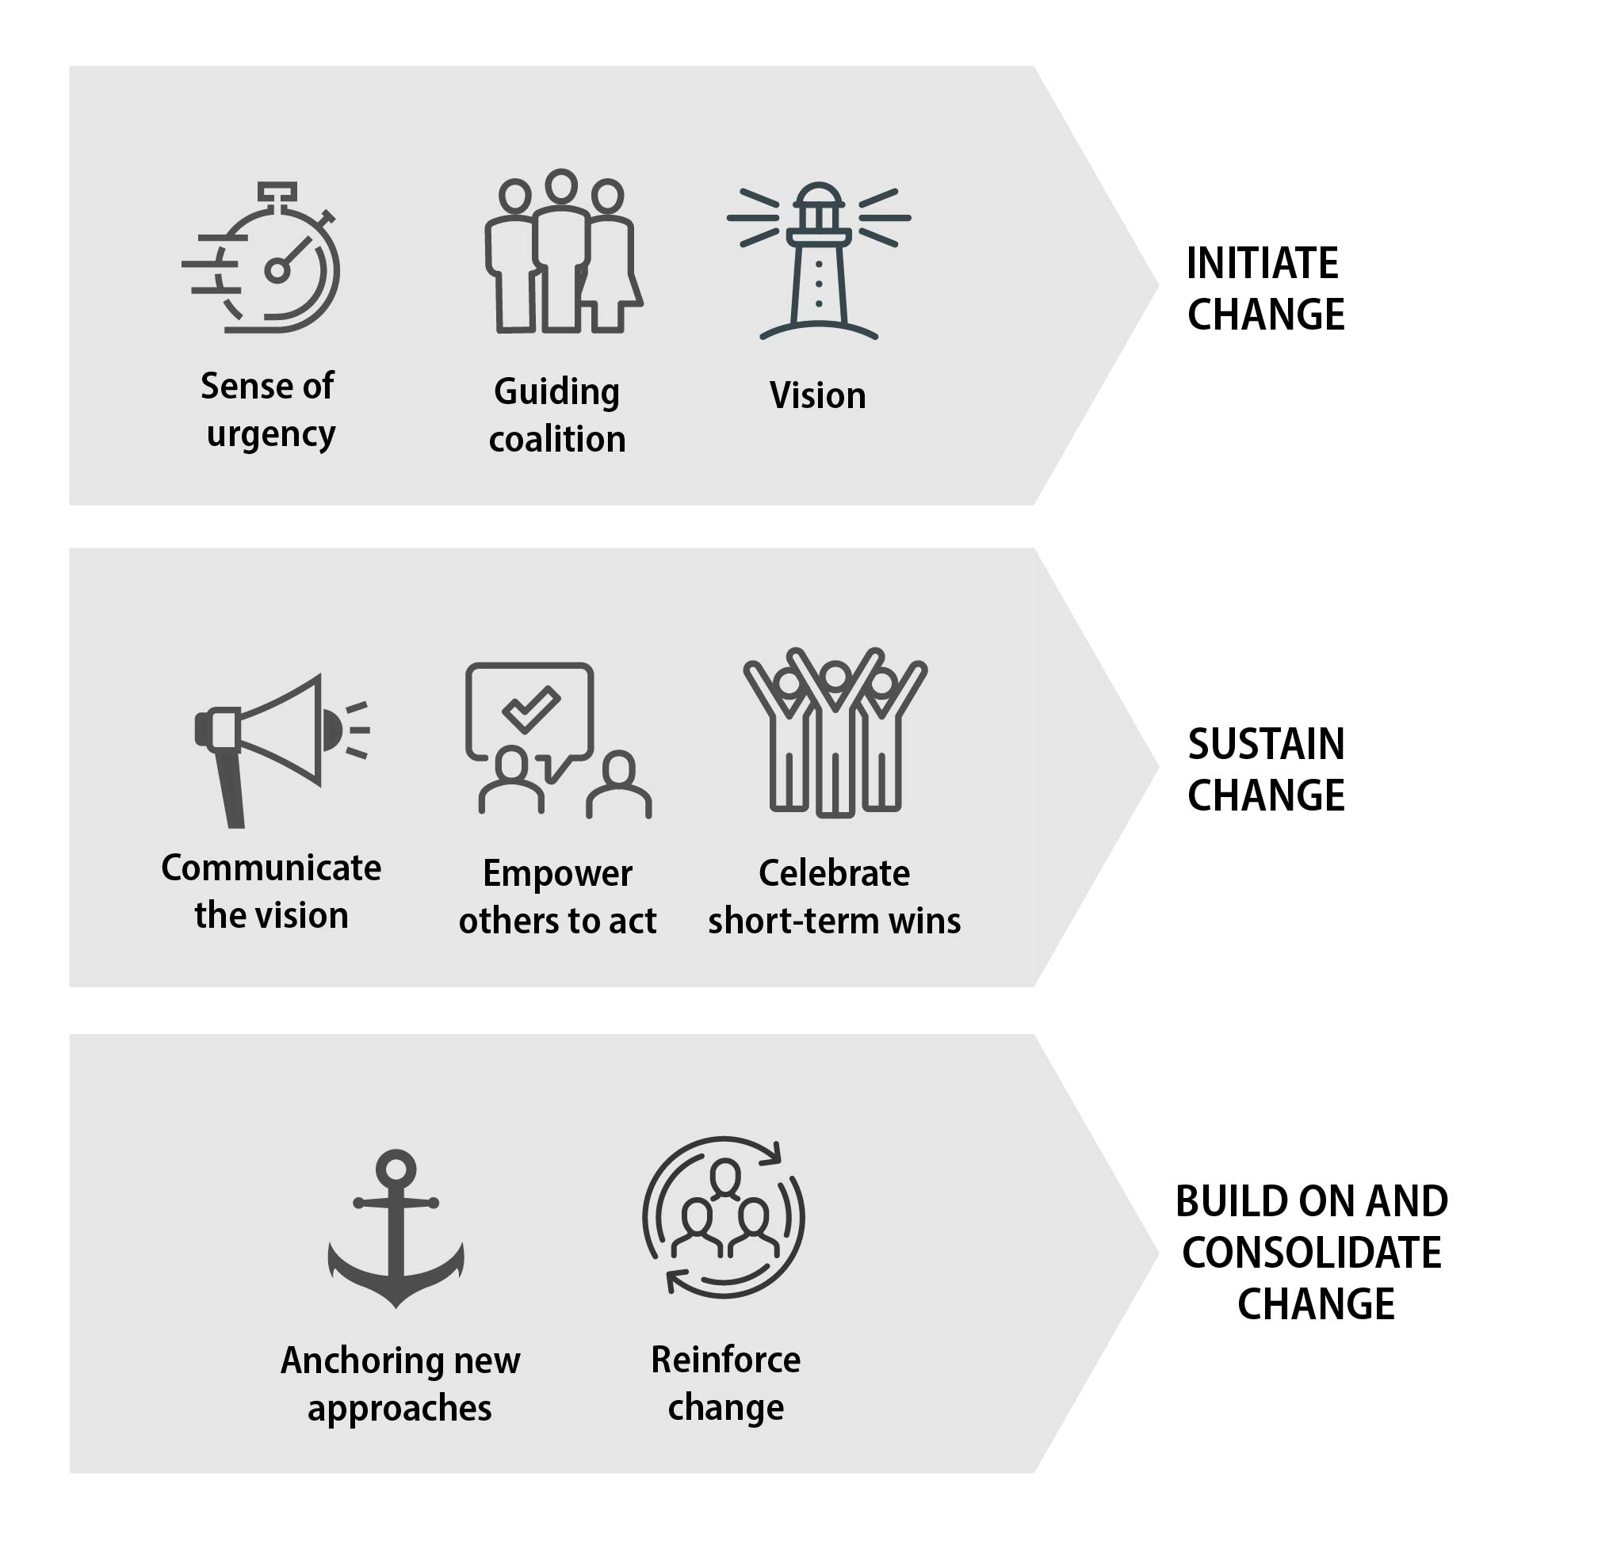
The eight-step model for leading change (based on Kotter)
14
Source: Visual summary from Pittino (2022) inspired by contents in Kotter, J. P. (2012). Leading Change. Boston, MA: Harvard Business Press. Picture credit: istock.com/Peacefully7; istock.com/fonikum; pixabay.com; iStock.com/da-vooda; istock.com/in8finity

Slide 15
Agile view of change leadership
Foster the creation of self-organizing teams and ‘local leaders’
Adopt and promote a ‘test and learn’ mindset and tools
Establish a short-term accountability system
Be prepared to make quick decisions based on limited information
Be personally responsible (take ownership, especially also in crisis situations)
15
Source: Based on information in Clayton, S. J. (2021). An agile approach to change management. Harvard Business Review. https://hbr.org/2021/01/an-agile-approach-to-change-management, published January 12 2021, accessed July 2022. Picture credit: pixabay.com

Slide 16
Leadership styles for different change processes
LEADERSHIP STYLE
CHANGE SITUATION IN WHICH IT IS APPROPRIATE
Coercive
In crisis situations (only when absolutely needed)
Authoritative
In change processes that require long and sustained effort
Affiliative
When you need to restore relationships, overcome conflicts, reestablish trust
Democratic
When you can rely on your teamʼs ability to self-direct and organize in a change
Pacesetting
When you need to reach an ambitious target, and when you have a highly motivated and skilled team
Coaching
When individuals need to acquire new skills or knowledge as part of the changes being made
16
Source: Based on information in Goleman, D., Boyatzis, R. E., & McKee, A. (2013). Primal Leadership: Unleashing the Power of Emotional Intelligence. Boston, MA: Harvard Business Review Press

Slide 17
End of module
CONTEMPORARY
LEADERSHIP CHALLENGES
17
Photo source: unsplash / Natalia Pedigo

