Slide 1

The Concise Leadership Textbook
LEADERSHIP TOOLS
AND TECHNIQUES
Photo source: unsplash / Natalia Pedigo

Slide 2
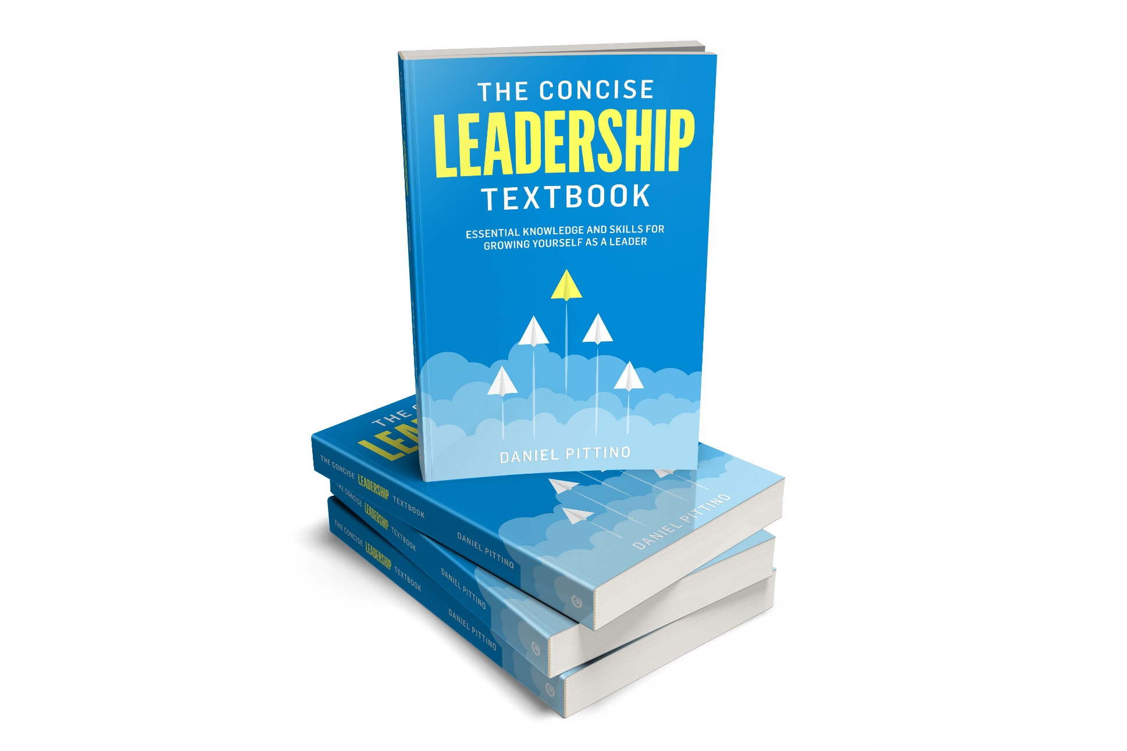
The leadership textbook
These slides are based on
Chapter 5 of
THE CONCISE LEADERSHIP
TEXTBOOK
Author: Daniel Pittino
©2022 by econcise publishing
2
Cover illustration (planes): iStock/Dmitry Volkov

Slide 3


Learning objectives – What is leadership?
Recognize the prerequisites for effective leadership communication
Prepare and deliver an engaging leadership speech
Determine which decision-making style is the best fit in specific situations
Analyze and choose different approaches to managing and resolving conflicts
Use coaching techniques to help others develop and find solutions for their problems
Create your own leadership development plan
3
Photo source: pixabay.com

Slide 4
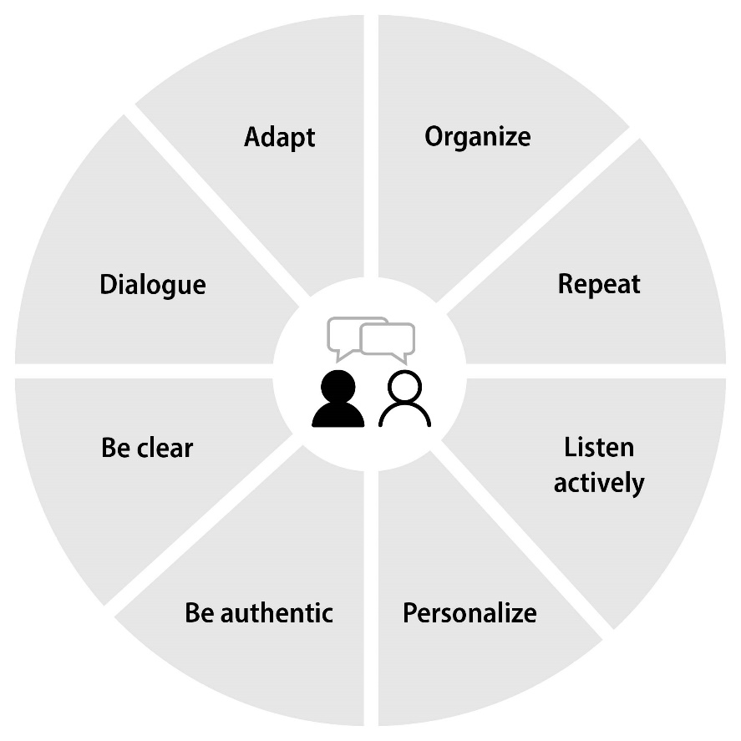
Elements of effective leadership communication
Through communication, leaders ‘create reality.’
DEFINITION
Adapt your leadership style to the situation and audience
Decide on what you are going to say in advance, make a plan
Don’t deliver monologues, give them the opportunity to share their thoughts and ideas
Make sure that the message is
absorbed and understood
Don’t be vague, translate complex concepts into simple ideas that people can relate to
Listen carefully with a focus on the other person
Be yourself, don’t try to behave
like someone else
Address everyone as individuals
4
Source: Pittino (2022), inspired by contents in Landry L. (2019). 8 essential leadership communication skills. Harvard Business School Online Business Insights. https://online.hbs.edu/blog/post/leadership-communication, published November 14 2019, accessed July 5 2022Picture credit (people icon): iStock.com/Ville Heikkinen

Slide 5
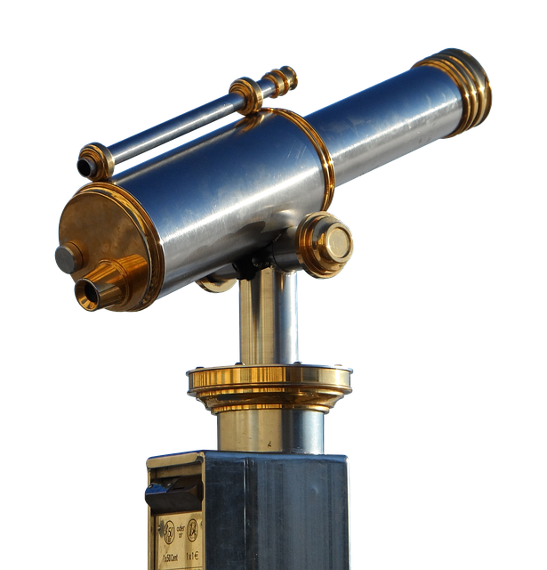
How to create a vision
Focus on long-term ideals
and objectives
Address issues that are highly important for the organization and the stakeholders
Foresee an attainable future that is linked to the current reality rather than being ‘wishful thinking’
Be as simple as possible so it can be communicated concisely and clearly
short – inspiring – easy to remember
5
Source: inspired by contents in Yukl, G. (2013). Leadership in Organizations, 8th ed. Boston, MA: Pearson Education. Picture source: pixabay.com

Slide 6
The structure of a leadership speech
Situation—Complication—Resolution (SCR)
Explanation (facts & storytelling or metaphors to clarify the facts)
Pitch (progression of events or facts leading to an obstacle that can ultimately be overcome thanks to an effective idea)
STRUCTURE
Drama (inspirational story of overcoming hardships)
Situation—Opportunity—Resolution
Hook, Meat, and Payoff (catchy message, information/story and rewarding/inspiring conclusion)
6
Source: Pittino (2020). Picture source: pixabay.com

Slide 7
Using rhetorical devises in a leadership speech
Get your message across more effectively by using …
Metaphors and figurative language
Repetition and rhythm
RHETORICAL DEVICES
Tricolon (three phrases that resemble each other in wording, length, structure, and/or rhythm)
Antithesis (contrast of two opposing ideas in the same sentence, or in two consecutive sentences)
Anaphora (repeating the same word or phrase at the beginning of two or more sentences)
Epistrophe (repeating the same word or phrase at the end of two or more sentences)
7
Source: Pittino (2020). Picture source: pixabay.com

Slide 8

The delivery of the speech: body and voice
Non-verbal components of a speech
Be loud and clear enough
Vary your tone
Keep an appropriate pace
… but vary the pace in some parts of the speech
BODY AND VOICE
Maintain a good posture
Maintain eye contact
8
Source: Pittino (2020). Picture source: pixabay.com

Slide 9

Identify your decision-making style
Decision-making styles
Analytical
Directive
Conceptual
Behavioral
Information-based
Weighing different
options
Takes time
Results-orientation
Relying on experience
Taking action – fast
Other people’s interests
may be sacrificed
Seeing interconnections
Big picture
Creative ideas, holistic
solutions
Sometimes difficult to
implement
Maintaining harmony
Consider opinions and
needs of others
Makes others feel included
Potential for sub-optimal
outcomes
9
Source: Pittino (2020) inspired by Rowe, A. J. and Boulgarides, J. D. (1992). Managerial Decision Making. New York, NY: Macmillan Publishing Company. Picture source: pixabay.com

Slide 10
Vroom-Yetton-Yago model of decision making
Decision-making styles
Autocratic 1 (A1)
Leader decides,
no input from the team
Autocratic 2 (A2)
Leader decides,
with information from the team
Consultative (C1)
Team is informed about the problem,
getting opinion, then leader decides
Choice depends on the following factors:
Decision quality needed
Information requirements
Team commitment/harmony
Team trust
Problem structure (well-structured or not)
Consultative (C2)
Group discussion about the problem,
then leader decides
Collaborative (G)
Group discussion about the problem,
group consensus/agreement
Different combinations of factors require different decision-making styles,
e.g. decision quality is important, not enough information available, team commitment is high,
well-structured problem, team will support an individual decision → choose A2
10
Source: Pittino (2020) inspired by Vroom, V. H., & Jago, A. G. (1988). The New Leadership: Managing Participation in Organizations. Englewood Cliffs, NJ: Prentice Hall. Picture source: pixabay.com

Slide 11

Conflict management
2 types of conflicts
How to deal with serious conflicts
Task-related conflicts
Recognize the potential causes of conflicts and try to prevent these from developing into actual conflicts
Person-related conflicts
Develop codes of conduct and guidelines
(usually more difficult to resolve)
Intervene only when necessary
Remain neutral and work collaboratively
Your own behavior in conflict situations
Control your emotions (know your triggers), remain calm/professional
Establish boundaries (avoid spill-over effects)
Understand and define the goals
11
Source: Pittino (2022). Illustration source: pixabay.com

Slide 12

Conflict resolution as negotiation
Different conflict resolution/
negotiation strategies
Competing
(‘win-lose’)
Avoiding
(detachment)
Compromising
(aiming for a middle-ground outcome)
Accomodating
(focus on good relationship)
Collaborating
(trying to find creative ‘win-win’ solutions)
Agreement is usually the outcome of a negation process
12
Source: based on Thomas, K. W. (1976). Conflict and conflict management. In: Dunnette, M. (ed.), Handbook of Industrial and Organizational Psychology, pp. 889–935. Chicago: Rand McNall. Illustration source: pixabay.com

Slide 13
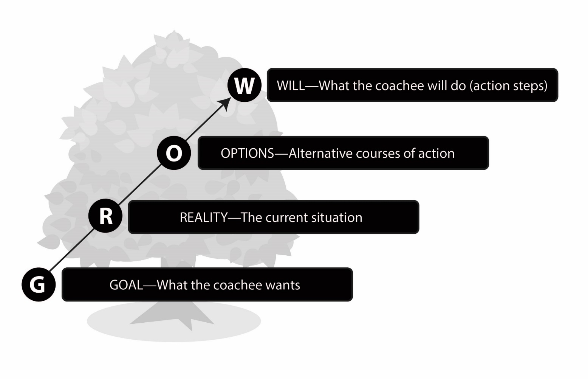
Coaching as a leadership tool
Coaching is a purposeful interaction in which one person (the coach) uses a questioning approach to help another person (the coachee) to take the appropriate actions to realize their full potential and achieve their
personal or professional goals
DEFINITION
The GROW model
for leading coaching
conversations
13
Source: Sternad D. (2021). Developing Coaching Skills: A Concise Introduction. Moosburg: econcise; GROW model based on concepts in Whitmore, J. H. D. (2010). Coaching for Performance: The Principles and Practice of Coaching and Leadership. London: Hachette UK.

Slide 14
Your personal leadership development plan
1
2
3
4
Craft a personal vision
(why to grow as a leader,
which leadership profile
to achieve)
Identify current
leadership traits, skills,
Competences, behaviors
Identify areas in which
you need to develop/grow/
Improve and formulate
key objectives
Set specific goals for each
objective, define actions,
resources and support
needed
EXAMPLE
Objective | Specific goals | Actions to reach the goal | Resources and support needed to reach the goal | Planned timeline to reach the goal | Potential obstacles in the pursuit of the goal | Key performance indicators | Responsibility for the evaluation
Master problem-solving techniques as a leader | Acquire knowledge of analytical decision-making tools | Participate in formal training initiatives and courses | Support from the immediate manager at work | Within the next 12 months | Limited time to prepare course assignments | Certification of successful course completion | Self-evaluation; mentor
 | Acquire creative thinking skills | … | … | … | … | … | …
14
Source: Pittino (2022)

Slide 15
End of module
LEADERSHIP TOOLS
AND TECHNIQUES
15
Photo source: unsplash / Natalia Pedigo

