Slide 1
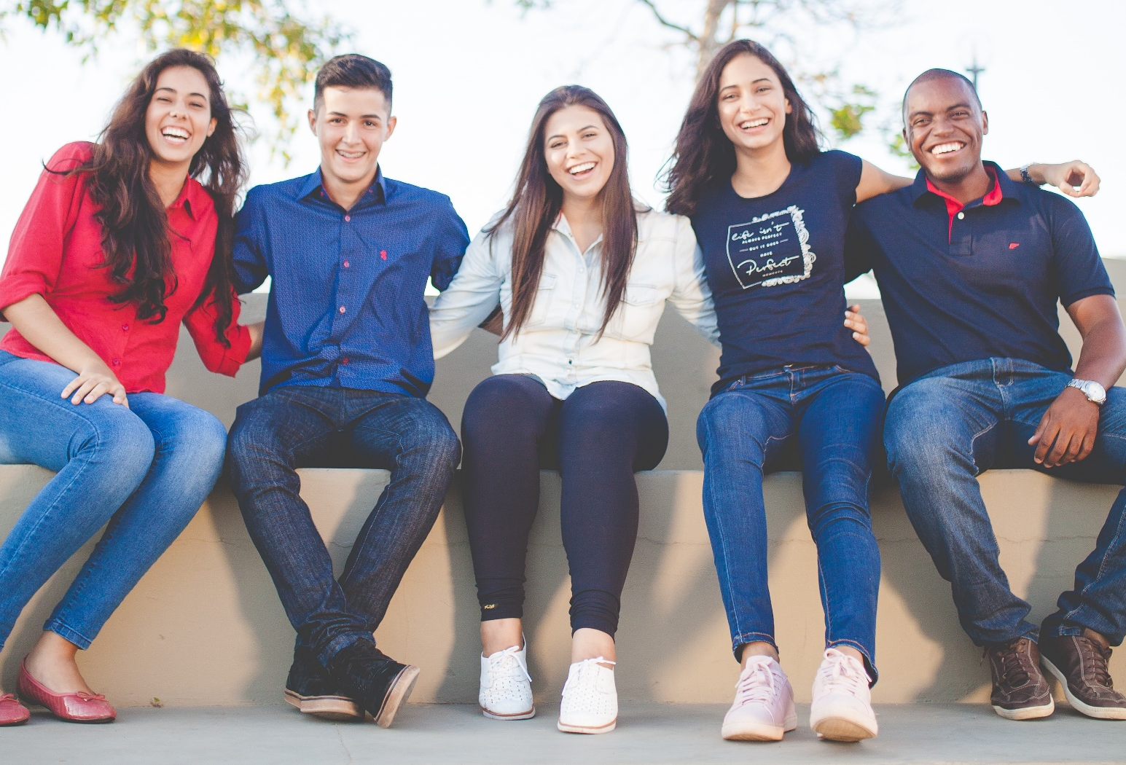
Cultural Sensitivity Training
React
Automatisms and how to overcome them
Photo source: unsplash / Naassom Azevedo

Slide 2
The cultural sensitivity textbook
These slides are based on Chapter 1 of the textbook
Cultural Sensitivity Training: Developing the Basis for Effective Intercultural Communication
Author: Susann Kowalski
© 2023 by econcise publishing
2
Cover illustration (heads): © iStock/Glopphy

Slide 3
Learning objectives – React
Describe why and how cultural values, attitudes, and beliefs evolve.
Recognize the danger of stereotypes and bias.
Learning Outcomes
Become aware of your automatic reactions and how you can consciously
influence them.
3
Photo source: pixabay.com

Slide 4
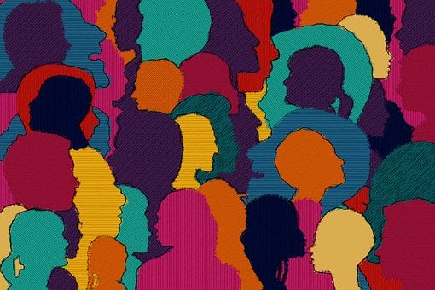
Formation of groups
Has an evolutionary function.
Develops a social or group identity.
Fast reactions to protect against danger could overlay the wish to cooperate.
Fast mode of decision making or ‘System 1’ thinking.
Slow mode of decision making or ‘System 2’ thinking.
Development of stereotypes and categorization to quickly distinguish between members of own and other groups.
Automatic information processing.
Controlled information processing.
Especially in connection with power, development of discrimination, and racism.
One mechanism to cope with cognitive dissonance.
4
Photo source: pixabay.com

Slide 5
Culture - definition
Geert Hofstede and colleagues (2010):
“collective programming of the mind”
“software of the mind”
We share the same (or similar) culture with the people we live and grow up with because we have learned it from them.
DEFINITION
5
Photo source: pixabay.com

Slide 6
Culture
Three levels at which we form our values, attitudes, and beliefs [according to Hofstede and Hofstede (2006)]
Biological foundation → universally the same for all people
Families and closer groups → group-specific
Individual experience → personal level
Group-dependent “coloring” of our individual culture [according to Browaeys and Price (2019)]
Professional culture
Corporate / Organizational culture
National culture
6

Slide 7
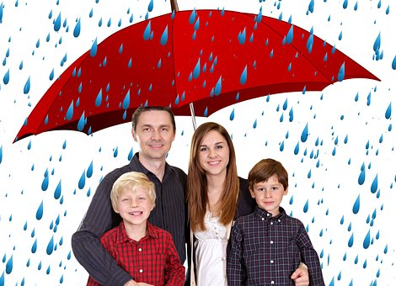
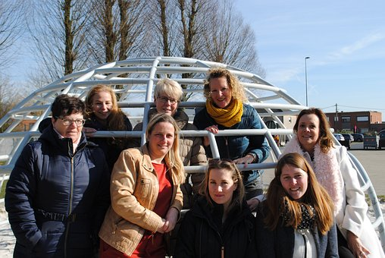
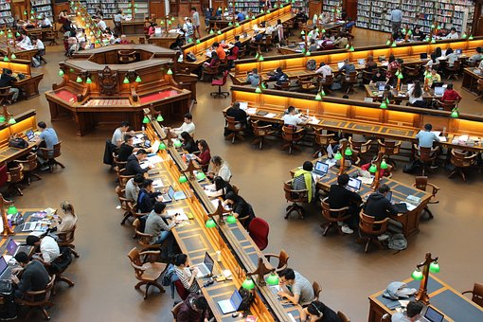
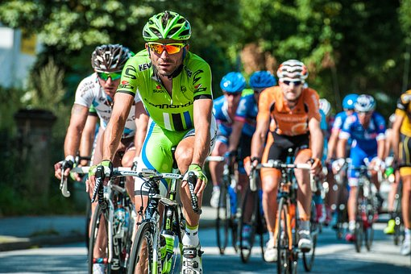
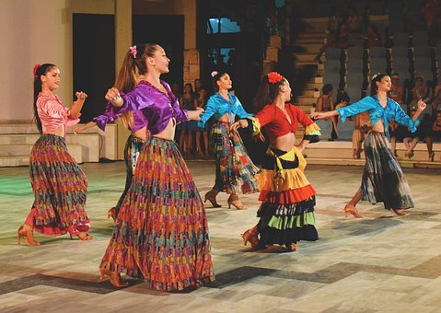
Multiculturalism – you and your groups
all women
my family
myself
my
university
sports
club
dance club
7
Photo source: pixabay.com

Slide 8
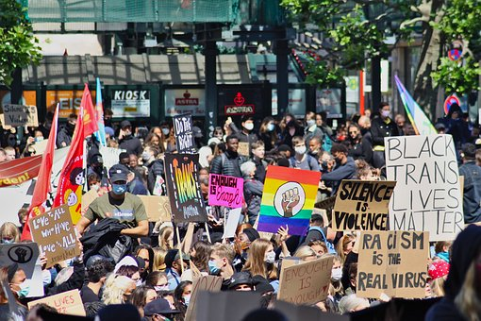
Stereotyping: root for discrimination and racism
Difficulties with culture, cultural values, and stereotypes
When differences are denied.
When stereotypical ideas are thoughtlessly transferred to all people of the corresponding group.
When stereotypes are charged with negative evaluation (prejudice).
Stereotypes depending on social status and felt competition between groups [according to Fiske et al. (2002); Fiske (2018)]
Paternalistic stereotypes
Admiring stereotypes
Disdainful stereotypes
Envious stereotypes
8
Photo source: unsplash.com

Slide 9
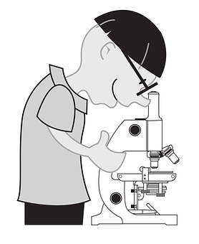
Possible solutions for dealing with the automatisms
spending as much time as possible in diverse environments,
recognizing and interrupting the automatisms,
practicing and automatizing new patterns of action, and
developing social, emotional, and intercultural competence.
9
Photo source: pixabay.com

Slide 10
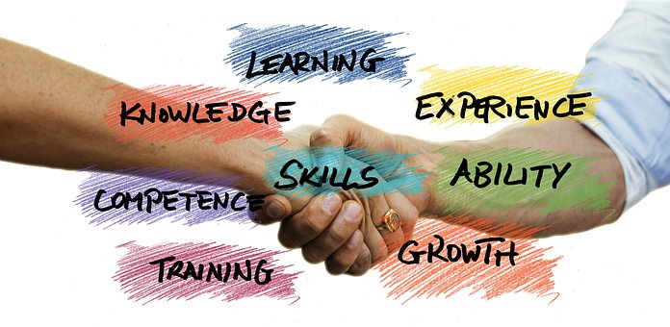
Fields of competence for intercultural interactions
Key aspects of intercultural competencies [according to Gertsen (1990)]
Cognitive aspect (thoughts)
Behavioral aspect (behavior)
Affective (emotional) aspect (emotions)
Social competencies
Growing intercultural competencies also strengthens our social competence
Sensitivity and empathy
Own experiences
Frequent reflection of experiences and situations
Self-reflection
10
Photo source: pixabay.com

Slide 11
Takeaways – React
Groups have an evolutionary function. We join different groups during our lifetime, and behave (at least to a certain degree) in conformity with the groups’ norms and values.
The protection of one’s own group was evolutionarily important for survival. We still prefer our own group to other groups.
Stereotypes and categorizations help us deal with the complexity of the world. They become a problem when they are associated with (especially negative) judgments, i.e. when they lead to prejudice.
Takeaways
Stereotypes are the outcome of automatized reactions in our brain (with ‘system 1’ thinking, our fast system of decision making).
We can break the automatized reactions and consciously choose to react differently (with ‘ system 2’ thinking, our slow system of decision making).
Sensitivity and empathy are core elements of intercultural competence. We can acquire them through frequent interaction with people from other cultures and purposeful self-reflection. Experience and reflection build up competence.
11
Photo source: pixabay.com

Slide 12
End of module
React
Automatisms and how to overcome them
Photo source: unsplash / Naassom Azevedo

Slide 13
List of references
Browaeys, M.-J., & Price, R. (2019). Understanding Cross-Cultural Management, 4th ed. Harlow: Pearson Education Limited.
Fiske, S. T. (2018). Stereotype content: Warmth and competence endure. Current Directions in Psychological Science, 27(2), 67–73.
Fiske, S. T., Cuddy, A. J. C., Glick, P., & Xu, J. (2002). A model of (often mixed) stereotype content: Competence and warmth respectively follow from perceived status and competition. Journal of Personality and Social Psychology, 82(6), 878–902.
Gertsen, M. C. (1990). Intercultural competence and expatriates. The International Journal of Human Resource Management, 1(3), 341–362.
Hofstede, G., & Hofstede, G. J. (2006). Lokales Denken, globales Handeln: Interkulturelle Zusammenarbeit und globales Management, 3rd ed. Munich: DTV/ Beck.
Hofstede, G., Hofstede, G. J., & Minkov, M. (2010). Cultures and Organizations: Soft ware of the Mind; Intercultural Cooperation and its Importance for Survival, 3rd ed. New York, NY: McGraw-Hill.
13
Photo source: pixabay.com

