Slide 1
Cultural Sensitivity Training
Recognize
Cultural systems, cultural adaptability, and your own cultural profile
Photo source: unsplash / Naassom Azevedo

Slide 2
The cultural sensitivity textbook
These slides are based on Chapter 2 of the textbook
Cultural Sensitivity Training: Developing the Basis for Effective Intercultural Communication
Author: Susann Kowalski
© 2023 by econcise publishing
2
Cover illustration (heads): © iStock/Glopphy

Slide 3
Learning objectives – Recognize
Discover different ways of classifying cultural characteristics.
Recognize the purpose and benefits of cultural classification systems
and be aware of the limitations of such systems.
Learning Outcomes
Describe your own cultural background.
3
Photo source: pixabay.com

Slide 4
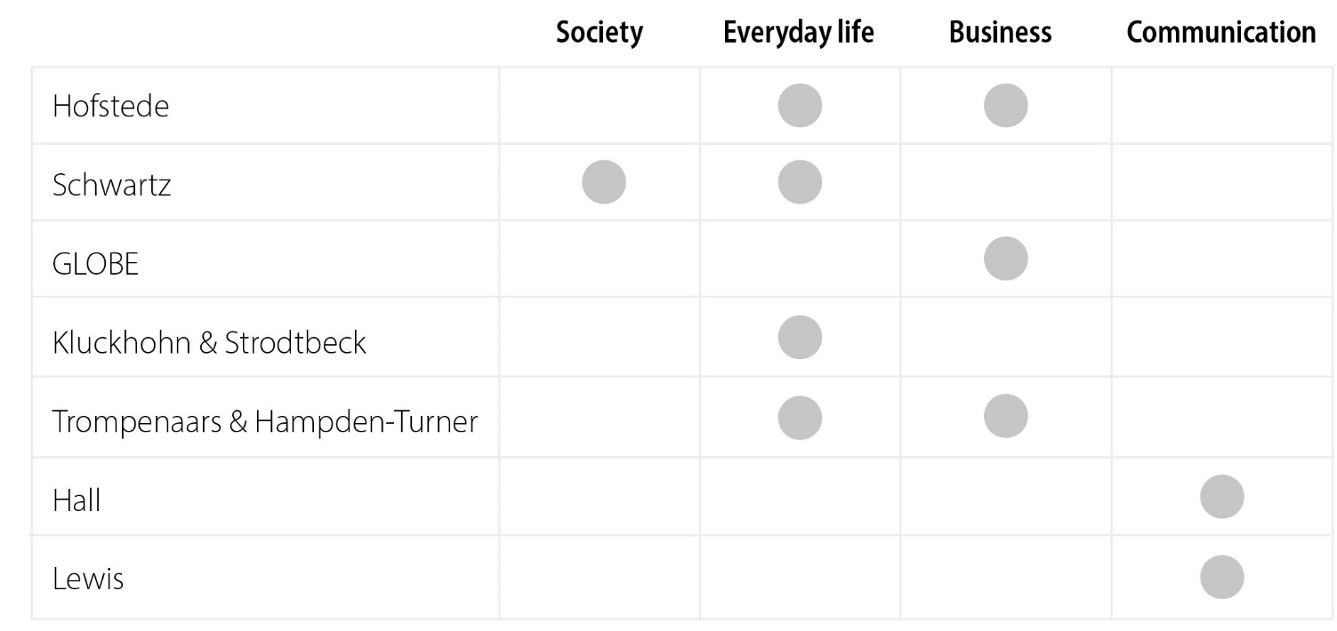
Cultural (classification) systems
Sort cultures according to how they answer questions about how we typically behave in certain aspects of our life.
It’s about the ‘typical’ or ‘usual’ orientation of thought patterns and behavioral tendencies
Different systems with different perspectives and different research interest → different areas of application
4

Slide 5
The cultural system according to Hofstede
PDI: low power distance – high power distance
The degree of tolerance for uncertainty or instability
IDV: collectivistic – individualistic
Importance of work goals (earnings, advancements) compared with personal goals (cooperation, relationship)
MAS: femininity – masculinity
Attitudes toward authority
Distance between individuals in a hierarchy
LTO: short – long term; normative – pragmatic
Fostering virtues related to the past and present or virtues related to the future
UAI: low uncertainty avoidance – high uncertainty avoidance
The degree of tolerance for uncertainty or instability
IND: restraint – indulgent
This dimension describes the extent to which people try to control their desires and impulses.
5
Hofstede (2001); Hofstede et al. (2010)

Slide 6
Cultural dimensions: Schwartz / GLOBE Project
Schwartz
GLOBE Project
10 cultural dimensions (or values)
Nine cultural dimensions
Performance orientation
Self-direction
Assertiveness
Stimulation
Future orientation
Hedonism
Humane orientation
Achievement
Institutional collectivism
Power
In-group collectivism
Security
Gender egalitarianism
Conformity
Power distance
Tradition
Uncertainty avoidance
Benevolence
Universalism
6
Schwartz (2012); Inglehart (2018); Chhokar et al. (2019); House et al. (2013).

Slide 7
Other cultural systems
Hall
Kluckhohn and Strodtbeck
Trompenaars and Hampden-Turner
Three basic dimensions
Five questions about …
Five dimensions concerning the relationships between people
Context
… the character of human nature
Space
… the relationship of humans to nature
Obligation
Time
Relationship with people
…the time period that people are focused on
Emotional orientation
Structuring
Lewis
…the goals that people pursue with their activities
Legitimating power and status
Characterization of societies
according to their communication
behavior
One dimension about the relationship of people to time
…the relationship between people
Linear-active societies
One dimension about the relationship of people to the environment
Multi-active societies
Reactive societies
7
Hall and Hall (1990); Lewis (2018); Kluckhohn and Strodtbeck (1961); Trompenaars and Hampden-Turner (1998).

Slide 8
Your own culture
Your own culture according to a cultural system
• Step 1: Draw horizontal lines or a rectangle (depending according to which system you want to find out your culture) and label them accordingly.
• Step 2: Read the descriptions of the dimensions, and try to objectively and calmly consider to what extent they apply to you. You will notice that it is not easy to come to a clear conclusion since you will lean toward the low pole with some aspects and toward the high
pole with others. Try to locate a midpoint between these extremes that you feel best represents you. Put a point on the line that belongs to this dimension, at the place where you see yourself located in this particular dimension.
• Step 3: Finally, you can connect the points with lines (except for Lewis) and get your cultural profile. If you, somewhen, feel that your choices could be refined, simply change them.
Exercise
8

Slide 9
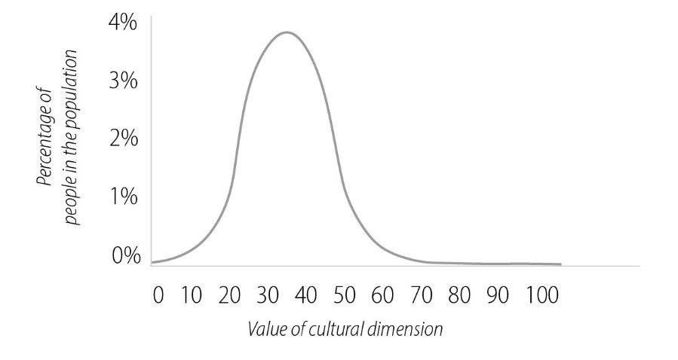
Be cautious when using cultural systems
Cultural systems are just models and abstract from many details and might oversimplify
Applying cultural systems means categorizing people into groups that we assume to have the ‘same’ culture. (left-hand-side picture)
Within these groups of people, people strongly differ from each other. (sample right-hand-side graph)
Cultural systems can give first rough orientation. Check it against the real people.
9
Picture source: pixabay.com

Slide 10
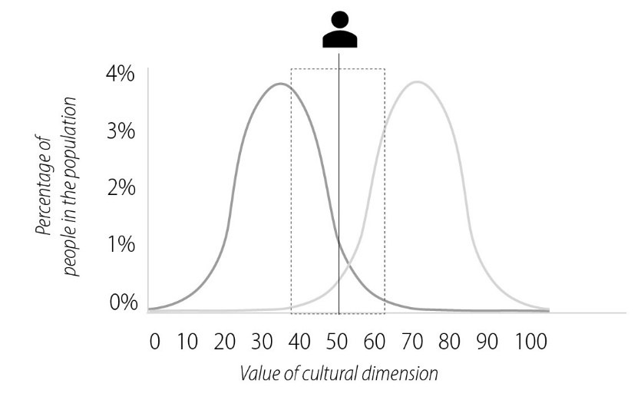
The adaptability of one’s culture
Left-hand bell curve: culture 1
Right-hand bell curve: culture 2
Rectangle: sample area of adaptability
10

Slide 11
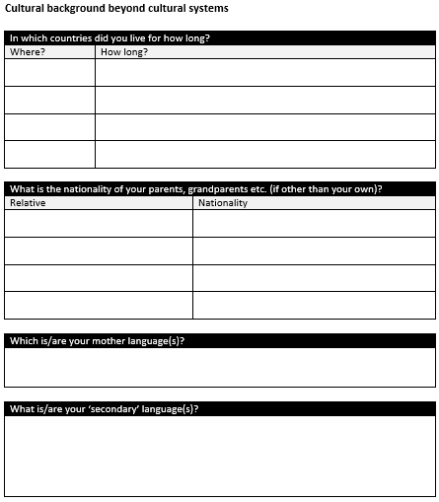
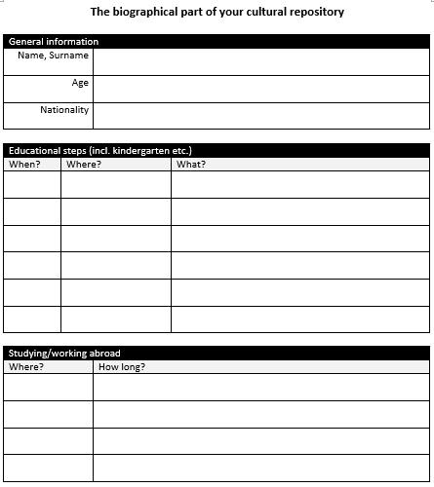
Your own cultural repository
Collection of the single profile according to specific cultural systems
Biographical part
General information
Age
Nationality
Education (from kindergarten to university-level studies)
Studying/working abroad
General information
Countries in which you lived, and for how long
Nationality of parents, grandparents etc. (if different from your own)
Your mother tongue(s)
‘Secondary’ language(s)
11

Slide 12
Takeaways – Recognize
Regardless of their culture, people ask the same questions about life. But depending on their culture, they answer these questions differently. Researchers have used this as a starting point to develop cultural systems.
Each cultural system reflects the research interests of the researchers who developed them. This also influences the potential field of application of these systems.
Cultural systems can provide basic guidance, but never accurately describe an individual. You will rarely find an individual person with a culture that is identical to their country’s culture.
Takeaways
No one is bound to the values that we can find in cultural systems. We can react flexibly (within certain limits) and develop culturally, even as adults.
The cultural repository is a good way to better understand your own culture, but also to prepare for encounters with people from other countries or for a stay abroad.
Inform yourself about the country and its people before a trip or meeting, and be prepared that not all information that you find will prove true. Then correct your knowledge based on the new information that you acquire on site.
12
Photo source: pixabay.com

Slide 13
End of module
Recognize
Cultural systems, cultural adaptability, and your own cultural profile
Photo source: unsplash / Naassom Azevedo

Slide 14
List of references
Chhokar, J. S., Brodbeck, F. C., & House, R. J. (eds) (2019). Culture and Leadership Across the World: The GLOBE Book of In-Depth Studies of 25 Societies. Hove: Psychology Press.
Hall, E. T., & Hall, M. R. (1990). Understanding Cultural Differences. Boston, MA: Intercultural Press.
Hofstede, G. (2001). Culture’s Consequences: Comparing Values, Behaviors, Institutions, and Organizations across Nations, 2nd ed. Thousand Oaks, CA: SAGE Publications.
Hofstede, G., Hofstede, G. J., & Minkov, M. (2010). Cultures and Organizations: Soft ware of the Mind; Intercultural Cooperation and its Importance for Survival, 3rd ed. New York, NY: McGraw-Hill.
House, R. J., Dorfman, P. W., Javidan, M., Hanges, P. J., & Sully De Luque, Mary F. (2013). Strategic Leadership Across Cultures: The GLOBE Study of CEO Leadership Behavior and Effectiveness in 24 Countries. Thousand Oaks, CA: SAGE Publications.
Inglehart, R. (2018). Cultural Evolution: People's Motivations are Changing, and Reshaping the World. Cambridge: Cambridge University Press.
Kluckhohn, F. R., & Strodtbeck, F. L. (1961). Variations in Value Orientations. Evanston, IL: Row, Peterson.
Lewis, R. D. (2018). When Cultures Collide: Leading across Cultures, 4th ed. Boston, MA: Nicholas Brealey Publishing.
Schwartz, S. H. (2012). An overview of the Schwartz theory of basic values. Online Readings in Psychology and Culture, 2(1). https://doi.org/10.9707/2307-0919.1116
Trompenaars, F., & Hampden-Turner, C. (1998). Riding the Waves of Culture: Understanding Cultural Diversity in Global Business, 2nd ed. New York, NY: McGraw Hill.
14
Photo source: pixabay.com

