Slide 1
Cultural Sensitivity Training
Realize
Motivation, personal traits, comparison with others, and the inner team
Photo source: unsplash / Naassom Azevedo

Slide 2
The cultural sensitivity textbook
These slides are based on Chapter 3 of the textbook
Cultural Sensitivity Training: Developing the Basis for Effective Intercultural Communication
Author: Susann Kowalski
© 2023 by econcise publishing
2
Cover illustration (heads): © iStock/Glopphy

Slide 3
Learning objectives – Realize
Make assumptions about the culture of other groups or people and
be aware of the tentativeness of these assumptions.
Recognize differences between your culture, motives, needs, and
personality traits and those of other people or groups of people in a
non-judgmental way, and assess the opportunities and risks of similarities
and differences between these elements.
Learning Outcomes
Develop a sense of how you normally react to people from another
culture.
3
Photo source: pixabay.com

Slide 4
Your own culture in comparison with that of others
Compare your own cultural repository with that of others
Take (at least) one of the cultural profiles that you developed for yourself in the exercise in the previous chapter. Compare it to the corresponding profiles of your friends, colleagues, or fellow students. In which cultural dimensions are the profiles very similar? Where do you find differences? What could this imply if you had to work together in a team? Remember that similarities, as well as differences, can lead to both opportunities and risks.
Exercise
4

Slide 5
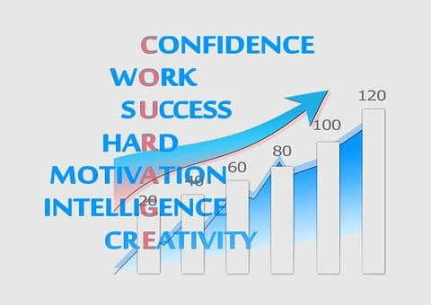
Regulation by Deci and Ryan [Ryan & Deci (2017)]
External regulation
Introjected regulation
Identified regulation
Integrated regulation
Intrinsic regulation
5
Photo source: pixabay.com

Slide 6
Needs according to McClelland (1961)
Theory of needs
Power
Affiliation
Achievement
6
Photo source: pixabay.com

Slide 7
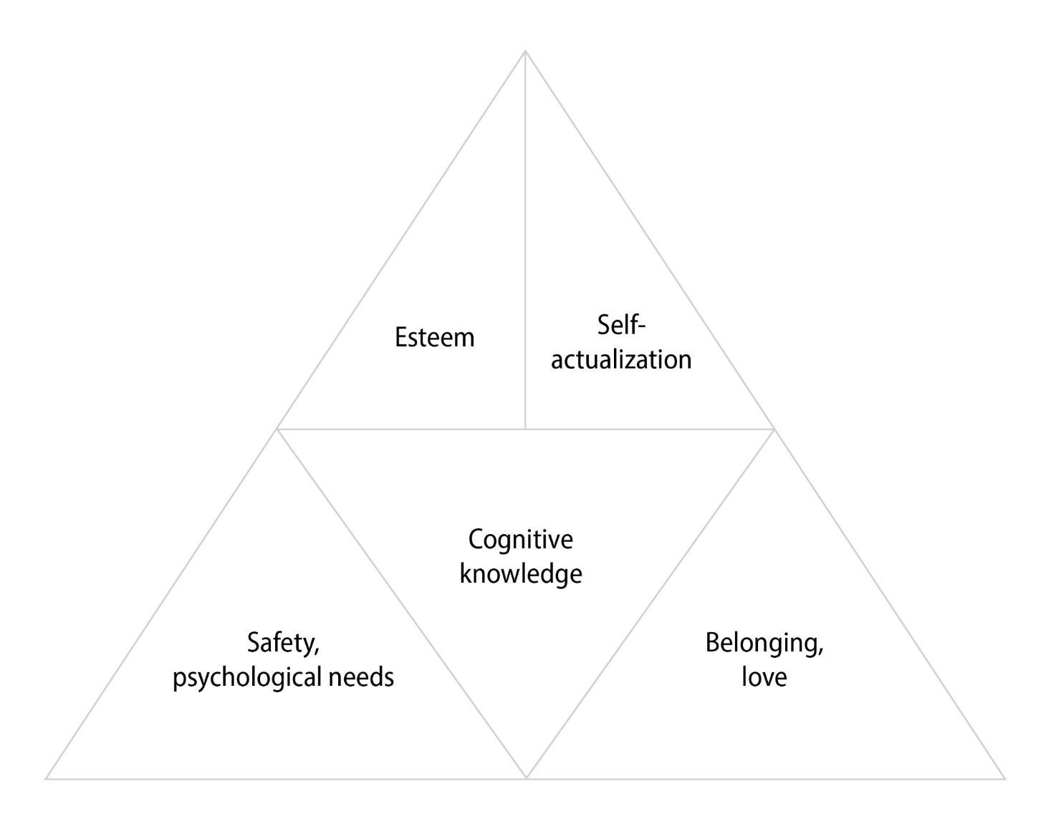
Maslow’s pyramid of needs
Highly accepted model. [Maslow (1943)]
Normally represented as a pyramid
Need for self-actualization
Esteem needs
Love needs
Safety needs
Physiological needs
The structural arrangement could vary (see example at the right →)
7

Slide 8
Motivation in the workplace
?
Live to work
Work to live
8

Slide 9
The ‘Big Five’ personality model
The ‘Big Five’ - OCEAN
Openness
Conscientiousness
Extraversion
Agreeableness
Neuroticism
9
Neyer and Asendorpf (2018)

Slide 10
Basic orientations according to Riemann and Thomann
Two basic dimensions of a person’s basic orientation
Temporal dimension
duration
change
Spatial dimension
proximity
distance
10
Riemann (2013); Thomann and Schulz von Thun (2003)

Slide 11
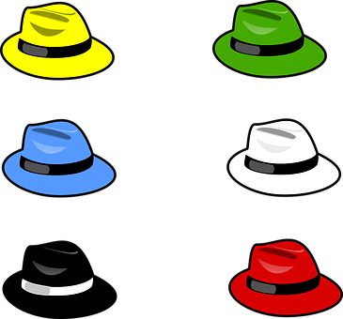
Thinking and discussion styles [de Bono (1992)]
realistic
innovative
ordering
analytical
critically
emotional
11
Photo source: pixabay.com

Slide 12
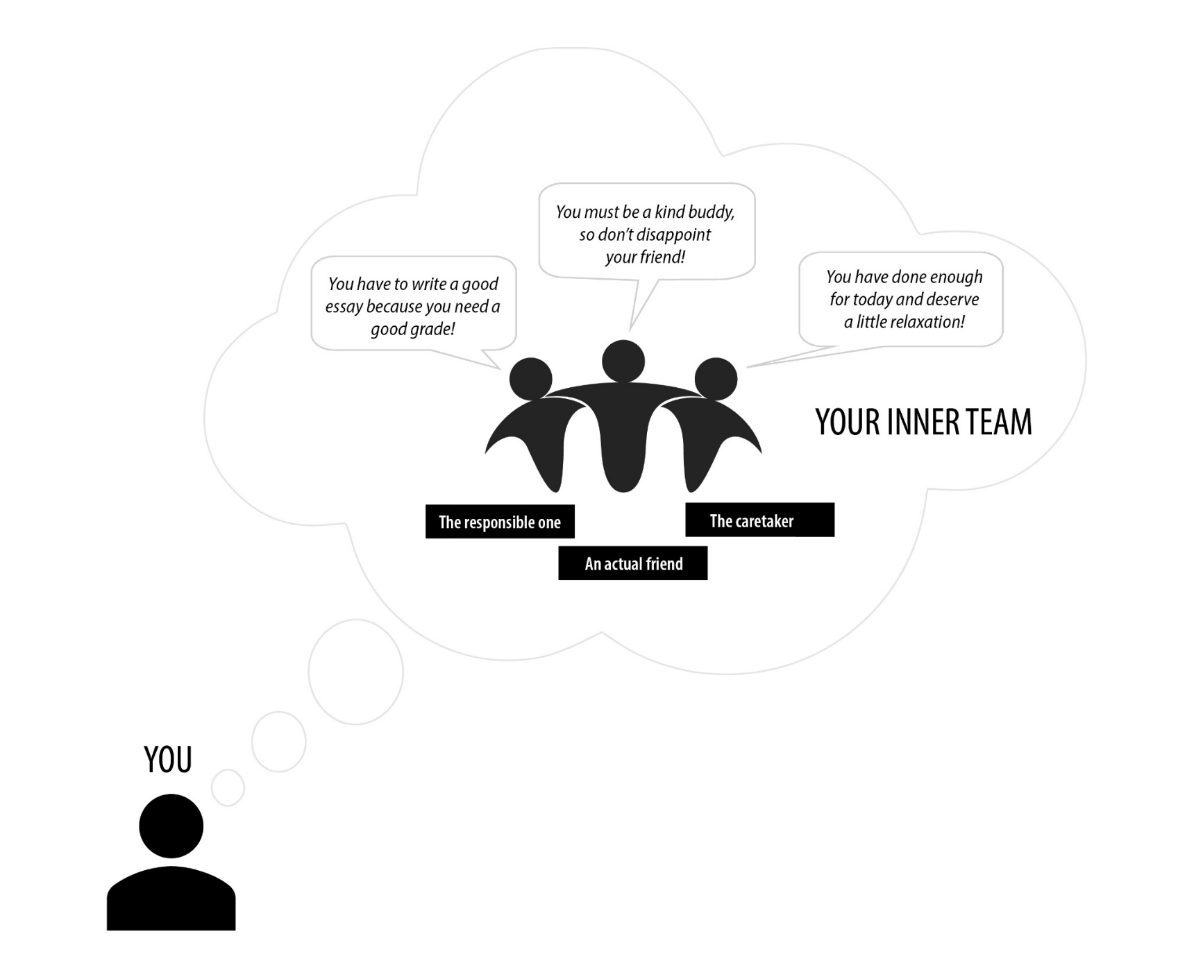
The ‘inner team’ in practice
12

Slide 13
Using the inner team in a cross-cultural context
Four additional voices for
Own cultural background
Interest in other cultures
Stereotypical knowledge
The other culture within oneself
13
Kumbier (2006)

Slide 14
Reactions of the inner voices in relation to a different culture
How would you react in the following situation?
If you come from a culture where it is customary to arrive at the agreed time, imagine that you have arranged to meet for dinner with a person from a country with a more relaxed perception of time. That person arrives half an hour late and doesn’t say a word of apology because they think their behavior is quite normal.
If you come from a culture where time is more of a ‘guideline,’ imagine that you are meeting for dinner with a person with a strict perception of time. You are half an hour late and that person calls you unreliable and is angry with you.
How do your four inner ‘intercultural’ voices react? How can they come to an agreement to make you react authentically in the situation?
Exercise
14

Slide 15
Takeaways – Realize
Knowing our own cultural background helps us better understand other people and groups and to see both similarities and differences between us.
Motives and needs influence whether and how we act. If people collaborate and their actions are based on different needs, this can lead to problems.
Try to organize the joint work of people with different needs in such a way that the needs of all team members are fulfilled to a large extent.
Takeaways
Although work has the same basic functions everywhere, people sometimes interpret the meaning of work differently.
Our basic personality traits are partly inherited, but also socially (and thus culturally) determined.
The ‘inner team’ can help us gain clarity about our own needs and represent our own point of view in communication situations authentically.
15
Photo source: pixabay.com

Slide 16
End of module
Realize
Motivation, personal traits, comparison with others, and the inner team
Photo source: unsplash / Naassom Azevedo

Slide 17
List of references
De Bono, E. (1992). Six Thinking Hats, revised and updated edition. London: Penguin Life.
Kumbier, D. (Ed.). (2006). Interkulturelle Kommunikation: Methoden, Modelle, Beispiele. Hamburg: Rowohlt-Taschenbuch-Verlag.
Maslow, A. H. (1943). A theory of human motivation. Psychological Review, 50(4), 370–396.
McClelland, D. C. (1961). The Achieving Society. New York, NY: The Free Press.
Neyer, F. J., & Asendorpf, J. B. (2018). Psychologie der Persönlichkeit, 6th ed. Berlin/Heidelberg: Springer.
Riemann, F. (2013). Grundformen der Angst, 41st ed. Munich: Ernst Reinhardt Verlag.
Ryan, R. M., & Deci, E. L. (2017). Self-Determination Theory: Basic Psychological Needs in Motivation, Development, and Wellness. New York, NY: The Guilford Press.
Thomann, C., & Schulz von Thun, F. (2003). Handbuch für Therapeuten, Gesprächshelfer und Moderatoren in schwierigen Gesprächen. Hamburg: Rowohlt-Taschenbuch-Verlag.
17
Photo source: pixabay.com

