Slide 1
Cultural Sensitivity Training
Relate
Resolving difficult situations and effective intercultural communication
Photo source: unsplash / Naassom Azevedo

Slide 2
The cultural sensitivity textbook
These slides are based on Chapter 4 of the textbook
Cultural Sensitivity Training: Developing the Basis for Effective Intercultural Communication
Author: Susann Kowalski
© 2023 by econcise publishing
2
Cover illustration (heads): © iStock/Glopphy

Slide 3
Learning objectives – Relate
Familiarize yourself with different models and tools for interpreting and
resolving intercultural conflict situations, as well as their possible areas of
application.
Apply communication and conflict management models and tools to
your own situations.
Learning Outcomes
Evaluate which elements of a communication situation could lead to
misinterpretations and find out how to prevent this.
3
Photo source: pixabay.com

Slide 4
The communication process [Nerdinger (2001)]
culture
medium
4
Photo source: pixabay.com

Slide 5
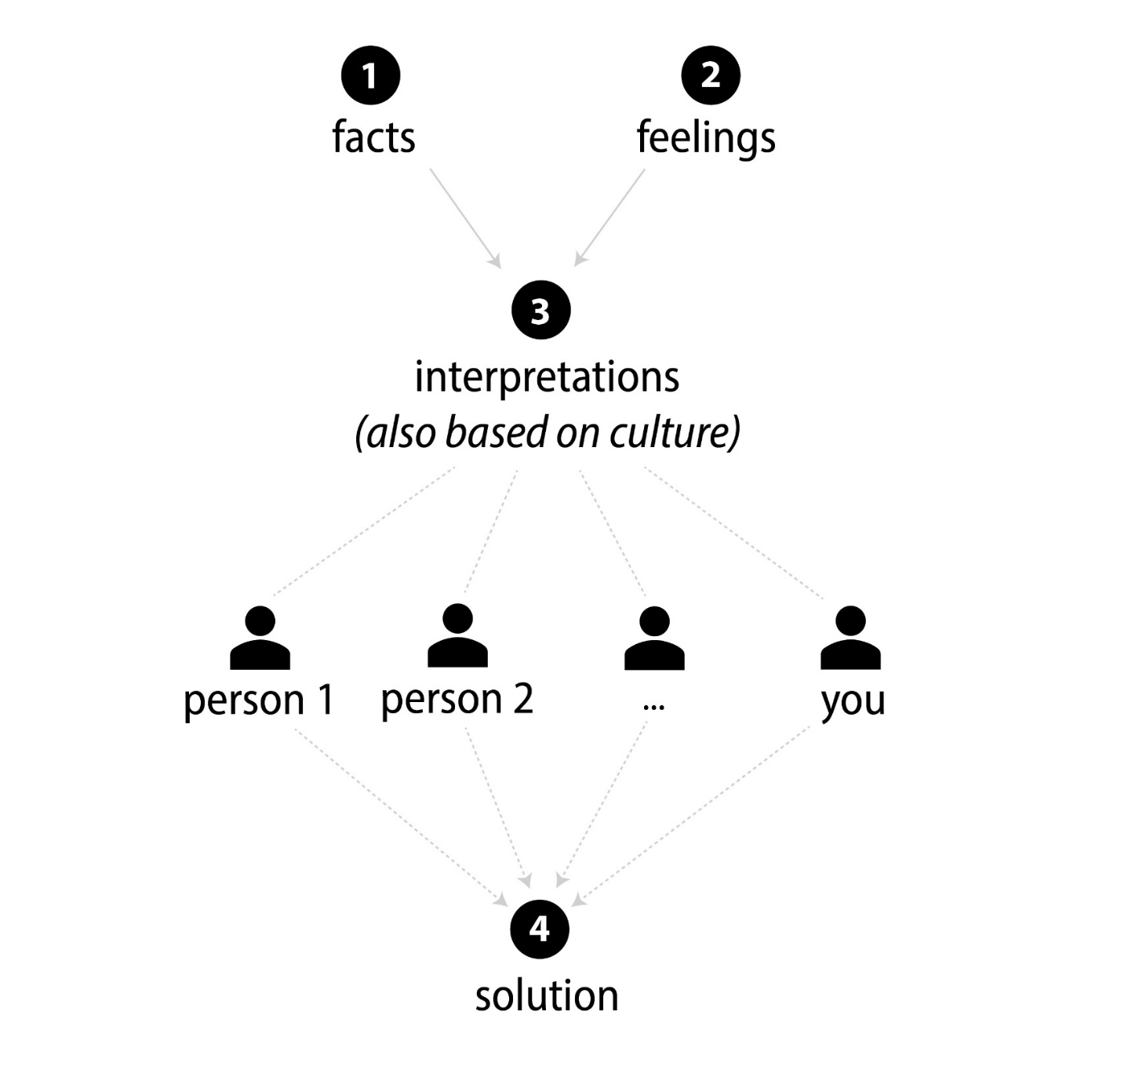
A general framework for analyzing difficult interactions
5

Slide 6
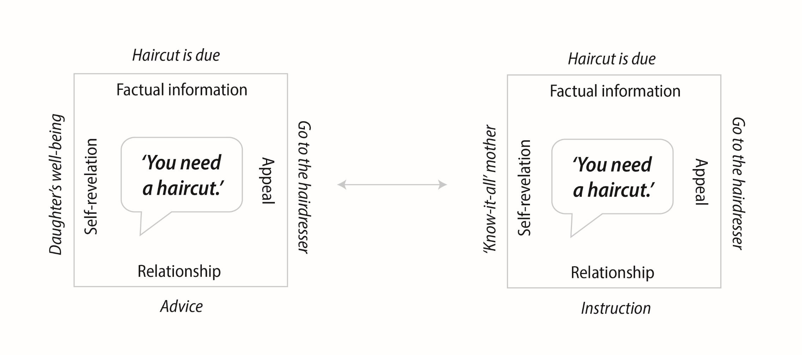
The ‘communication square’ (or ‘four-sides model’)
6

Slide 7
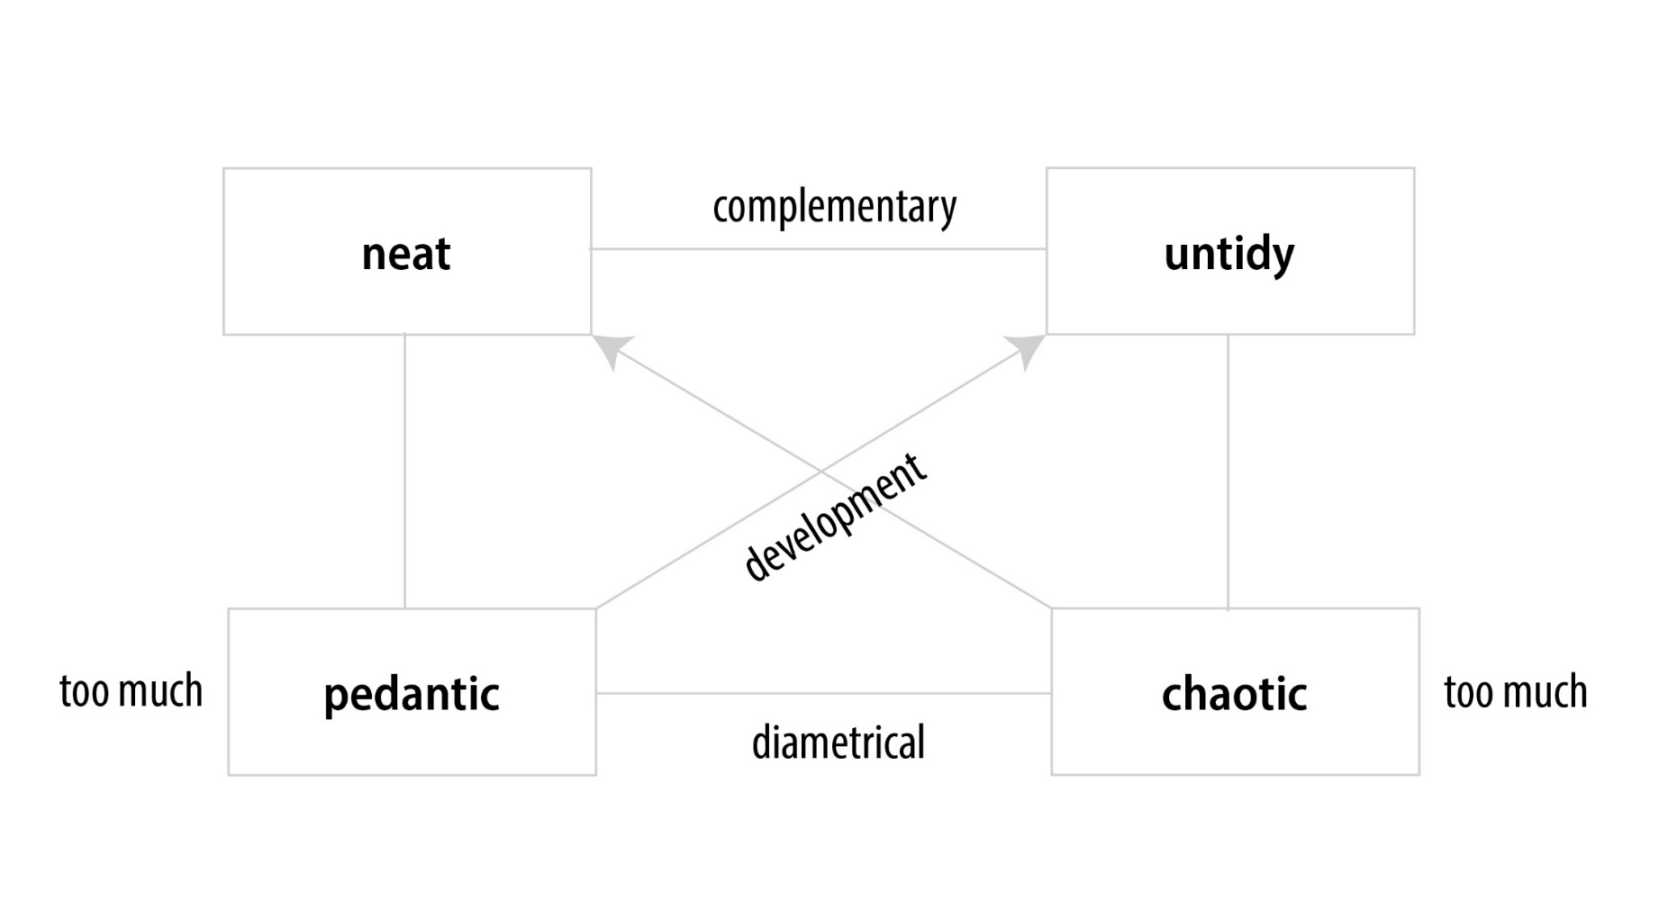
The ‘values and development square’
7

Slide 8
Using the inner team to analyze intercultural conflict situations
Find an authentic mindset
Based on your ‘inner team’ interpret a problematic intercultural situation you faced recently.
→ What impressions and thoughts arise?
→ Which team player felt seen, and who was overlooked?
→ What would they have needed in the situation?
→ Are there ways to satisfy them in the next meeting?
Try to balance your different, supposedly conflicting inner desires and needs.
Exercise
8

Slide 9
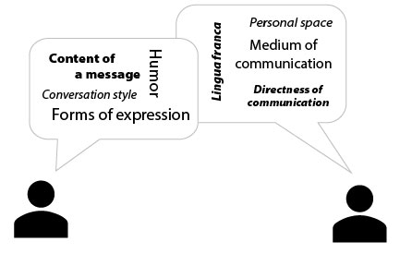
Various aspects of intercultural communication
private
public
high
low
rich
synchronous
asynchronous
interrupting
waiting
direct
indirect
verbal
paraverbal
non-verbal
9

Slide 10
Lingua franca
Problems
What to do?
Different levels of language proficiency
Sensitivity to these problems
Meaning of individual words
can be different even between
regions with the same language
Active listening
Rephrase difficult expressions
Let others repeat what you
have said
‘False friends’ between languages
Language is a means to express
(cultural) identity
Chose a lingua franca which is
a foreign language for all team
members
Effects not directly visible
Your ability to express yourself using a foreign language
Think about something you experienced today. Describe the situation in writing and how you felt about it: (a) in your native language, (b) in your first foreign language and (c) in your second foreign language (if possible). Give yourself two minutes for each language.
Compare your descriptions. How do they vary in length, word choice, and the amount of details you were able to cover?
Exercise
10
Morgan (2022)

Slide 11
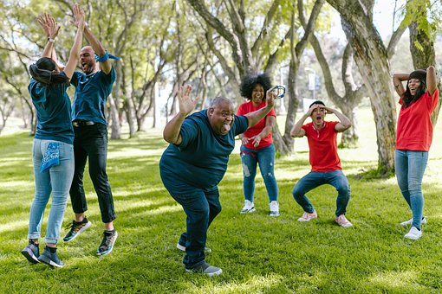
The role of humor
Styles of humor [Martin (2006)]
Affiliated
Self-enhancing
Aggressive
Self-defeating
Self-depreciating
11
Photo source: pixabay.com

Slide 12
General hints for effective intercultural communication
Mutual respect
Be inspired by differences
Inner attitude – mindset
Strategies for coping with crises
Reflect on your own situation
Analyze the situation
Prepare for collaboration
Meta-communication
12

Slide 13
Takeaways – Relate
Appreciating people from other cultures as equals (as equally valuable human beings) is the basis for getting along well with each other.
A first step to solving critical intercultural problems is the analysis of the underlying cultural orientations and value systems of the people involved.
Different communication styles (e.g. directly or indirectly addressing critical issues) can lead to misunderstandings and disagreements.
Takeaways
Different cultural backgrounds can lead to words and/or sentences being understood differently from what the speaker intended. The ‘four-sides model’ can help you to recognize such misunderstandings.
If different value systems seem to clash, the ‘values and development square’ can help you recognize the positive aspects of the supposedly opposing attitudes, and to include them in your own scheme of thought and action.
The more aware you are of what can go wrong in communication, and the better you can prepare for it in advance, the better you will be able to handle unexpected situations. Your ‘inner team’ can help you to be well prepared.
13
Photo source: pixabay.com

Slide 14
End of module
Relate
Resolving difficult situations and effective intercultural communication
Photo source: unsplash / Naassom Azevedo

Slide 15
List of references
Martin, R. A. (2006). The Psychology of Humor: An Integrative Approach. Burlington, MA:
Elsevier Academic Press.
Morgan, A. (2022). Coaching International Teams. Moosburg: econcise.
Nerdinger, F. W. (2012). Grundlagen des Verhaltens in Organisationen. Stuttgart: Verlag W.
Kohlhammer.
15
Photo source: pixabay.com

