Slide 1
Cultural Sensitivity Training
Reach out
Taking your intercultural
competence to the next level
Photo source: unsplash / Naassom Azevedo

Slide 2
The cultural sensitivity textbook
These slides are based on Chapter 5 of the textbook
Cultural Sensitivity Training: Developing the Basis for Effective Intercultural Communication
Author: Susann Kowalski
© 2023 by econcise publishing
2
Cover illustration (heads): © iStock/Glopphy

Slide 3
Learning objectives – Reach out
Assess your intercultural sensitivity according to the developmental
model of intercultural sensitivity (DMIS).
Identify possibilities for developing your cultural sensitivity.
Learning Outcomes
Plan and start to implement concrete steps for taking your cultural
sensitivity to the next level.
3
Photo source: pixabay.com

Slide 4
The developmental model of intercultural sensitivity
DMIS – Bennett (1986; 1993)
Six stages (with hints on how
to transfer to the next level)
Denial of difference
Defense against difference
Minimization of difference
Acceptance of difference
Adaptation to difference
Integration of difference
4
Photo source: pixabay.com

Slide 5
Intercultural sensitivity as part of intercultural competence
Key aspects of intercultural competencies [according to Gertsen (1990)]
Cognitive aspect – thoughts (Chapter 2) Think!
Behavioral aspect – behavior (Chapter 4) Act!
Affective aspect – emotions (Chapters 3 and 4 ) Reflect!
5
Photo source: pixabay.com

Slide 6
Types of intercultural training
Theories
Case studies
Cognitive/trainer oriented
Experience-based
Role plays
Direct contact
Culturally universal
Culture-specific
6
Photo source: pixabay.com

Slide 7
Your network of contacts as a daily training ground
How diverse are your contacts?
Step 1: In one column, make a list of all the people you meet at least once in a while individually.
Step 2: Next to each person’s name, add their gender in a second column and their age group in a third. In a fourth column, note which country this person feels affiliated with.
Step 3: Evaluate your list of contacts. How diverse are they? Are different age groups represented? Do your contacts come from different countries? Where would you maybe need additional contacts to make your list more diverse?
Exercise
7

Slide 8
Culture shock
Culture Shock – Oberg (1960)
Five phases
Honeymoon
Rejection
Crisis
Recovery
Adjustment
Reverse cultural shock after coming home
8
Photo source: pixabay.com

Slide 9
Leadership in an intercultural environment
Consider your own working style and the general attitude.
There are helpful as well as harmful leadership characteristics.
Important leadership skills are [House et al. (2004)]
leading in a team-oriented manner, building effective teams, and setting a team goal
communicating a vision and values, as well as placing trust in employees
9
Photo source: pixabay.com

Slide 10
Negotiations in an intercultural environment
Cultural factors that influence negotiations [Deresky (2016)]
Negotiation goals
Who is a member of the negotiation team and how
much team members prepare for the negotiation
How much trust
Culture-specific aspects of negotiation [Usunier (2003)]
The behavioral preferences of the negotiating partners.
Underlying negotiation concepts.
The negotiation process itself.
10

Slide 11
Conflicts in an intercultural environment
How do you handle conflicts?
Try to find answers to the following questions:
• What does conflict mean to you? Is creating harmony or finding a creative solution more
important to you?
• Are you able and willing to adopt other conflict resolution strategies than your own?
• Do you recognize which conflict resolution strategies other people follow?
• Can you deal with another strategy appropriately if it differs from your preferred one?
Exercise
11

Slide 12
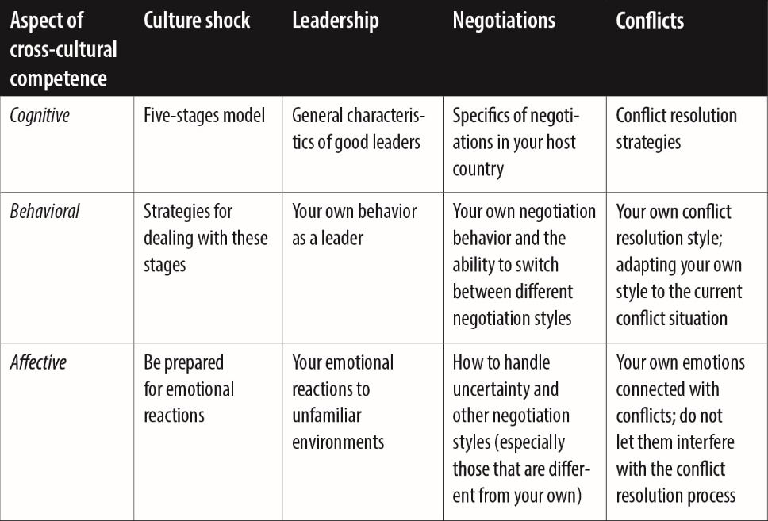
Overview of competencies
12

Slide 13
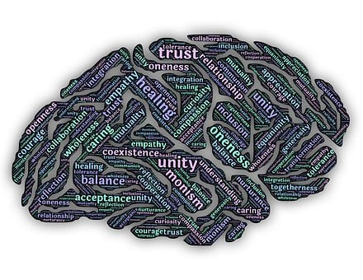
Develop your intercultural mindset
Tips for establishing your intercultural mindset
Treat all people as equals
Be tolerant and try to accept other opinions and ways of acting
Be aware that the observations that you are making come from
your perspective
Don’t let your internal ‘classification machine’ and stereotypes
take over
Remember that all people enter communication situations with
their own specific needs
Don’t give up
13
Photo source: pixabay.com

Slide 14
Create your personal development plan
14

Slide 15
Takeaways – Reach out
Developing cultural and intercultural sensitivity is an ongoing process.
It may be necessary to improve additional aspects of your own cultural sensitivity in order to have positive encounters with an unfamiliar culture.
Being in contact with a diverse network of people provides you with constant training opportunities for developing your cultural sensitivity.
Takeaways
Travel, travel, travel—preferably with intensive direct contact with local people.
Languages implicitly carry cultural interpretations and values. Learning languages enhances your sense of cultural diversity and will help you come into more direct contact with local people.
A sound development plan will help you to further follow your path toward interesting and enriching intercultural encounters.
15
Photo source: pixabay.com

Slide 16
End of module
Reach out
Taking your intercultural
competence to the next level
Photo source: unsplash / Naassom Azevedo

Slide 17
List of references
Bennett, M. J. (1986). A developmental approach to training for intercultural sensitivity. International Journal of Intercultural Relations, 10(2), 179–196.
Bennett, M. J. (1993). Towards ethnorelativism: A developmental model of intercultural sensitivity (revised). In Paige, R. M. (ed.), Education for the Intercultural Experience (pp. 21–72). Boston, MA: Intercultural Press Inc.
Deresky, H. (2016). International Management, 9th ed. Harlow: Pearson Education Limited.
Gertsen, M. C. (1990). Intercultural competence and expatriates. The International Journal of Human Resource Management, 1(3), 341–362.
House, R. J. (eds.) (2004). Culture, Leadership, and Organizations: The GLOBE study of 62 Societies. Thousand Oaks, CA: SAGE Publications.
Oberg, K. (1960). Cultural shock: Adjustment to new cultural environments. Practical Anthropology, 7(4), 177–182.
Usunier, J.-C. (2003). Cultural aspects of international business negotiations. In Ghauri, P. N. & Usunier. J.-C. (eds), International Business Negotiations, 2nd ed. (pp. 91–118). Boston, MA: Pergamon.
17
Photo source: pixabay.com

