Slide 1

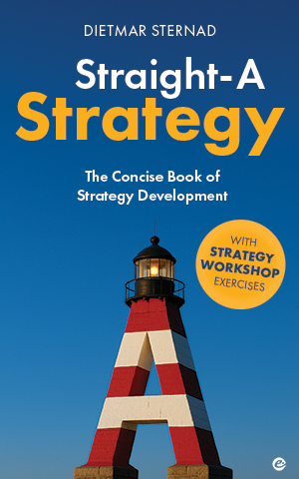
Straight-A Strategy
The essence of strategy|
Five key strategic choices
Picture source: pixabay.com

Slide 2

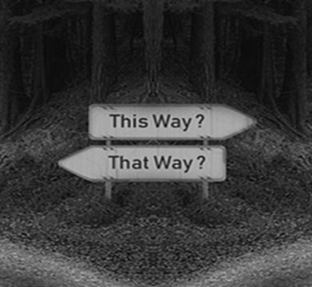

Why do we need a strategy?
A well-developed strategy will help to clarify the organizationʼs purpose
(the “why” ), set the right priority goals (the “what”), and identify the
activities you need to perform to achieve these goals (the “how”).
FOCUS
BETTER DECISIONS
MOTIVATION
Spend time and energy on things that really matter
Making progress,
fulfilling the purpose, achieving goals
Know which options bring you closer to your goals
2
Picture source: pixabay.com

Slide 3
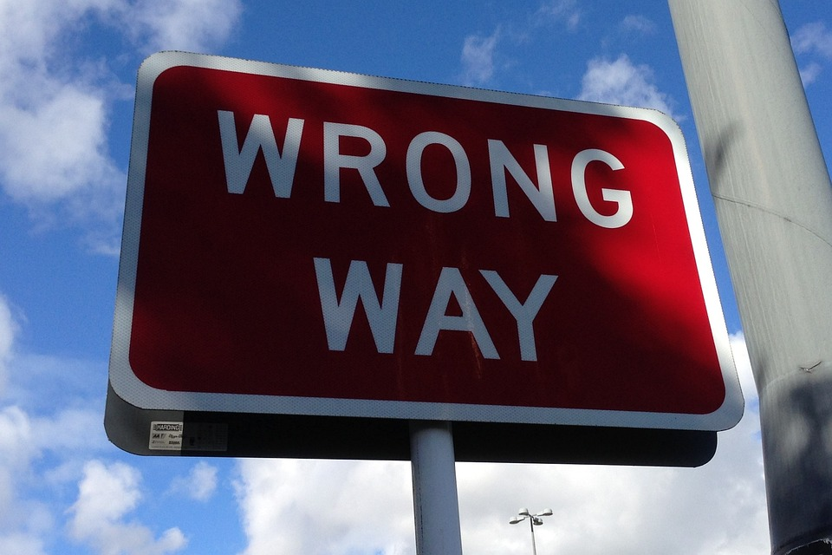
What happens without a strategy?
Lack of direction
Missed opportunities
Reactive decision-making
Wasted resources
Lack of accountability
If you want to achieve something great—on your own or together with your team—and don’t want to take these risks, make sure to develop a good strategy!
3
Picture source: pixabay.com

Slide 4
Strategy| What is it?
“It is a set of choices about winning.”
- A.G. Lafley, former CEO of Procter & Gamble, and Roger L. Martin, former Dean of the Rotman School of Management
“Strategy is an integrated set of choices that uniquely position the firm in its industry so as to create sustainable advantage and superior value relative to the competition.”
- Harvard Professor Michael Porter
“The essence of each strategy are key choices—decisions regarding what the organization wants to achieve and how it wants to achieve it.”
- Kozminski University Strategy Professor Krzysztof Obloj
4

Slide 5
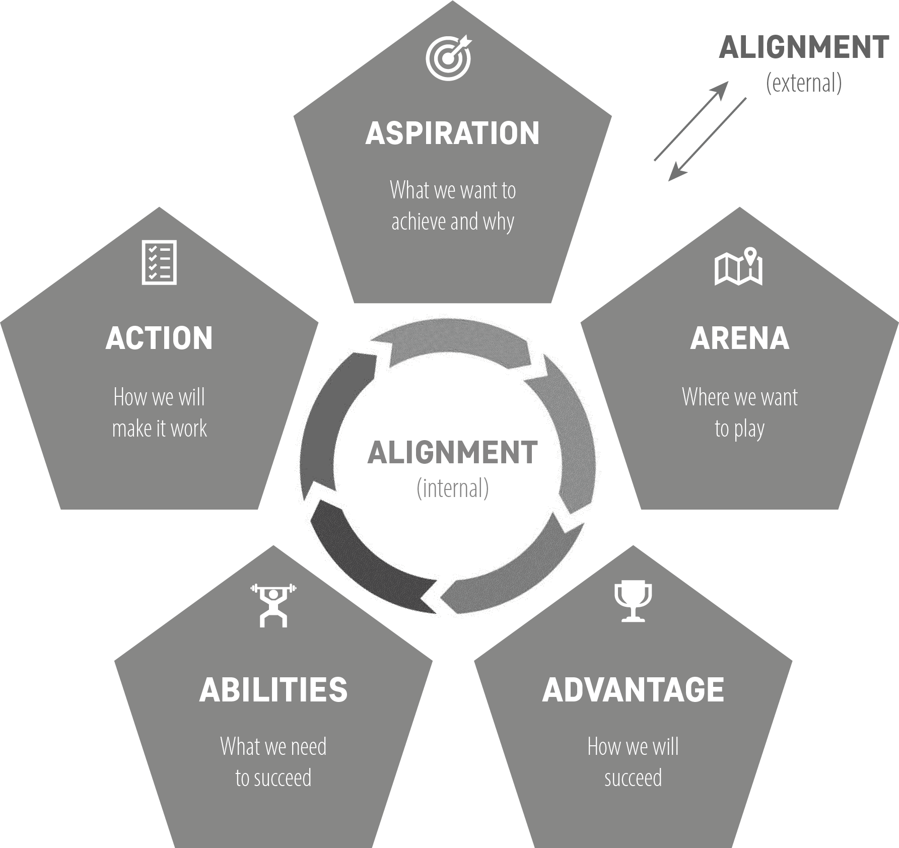
Strategy as choices| The ‟5As” of strategy
A strategy consists of high-level decisions that will have a decisive influence on where your organization is heading, what it considers success, and whether and how it will be able to achieve its goals
5

Slide 6
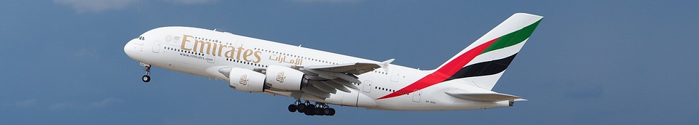
The ‟5As” of strategy | An example
 | “5As” for Emirates (airline)
Aspiration | Emirates’ aspiration is to be a global leader in air travel, providing a premium and luxurious travel experience that connects the world to and though their global hub in Dubai.
Arena | Emirates operates in the global airline industry, specializing in long-haul flights that connect major international destinations with Dubai.
Advantage | Emirates sets itself apart through its commitment to luxury and comfort, state-of-the-art aircraft, exceptional in-flight entertainment, and high-quality service, as well as an extensive network of routes from and to the hub in Dubai.
Abilities | Emirates builds capabilities in aircraft acquisition and innovation, customer service training, international route planning, and advanced passenger experience.
Action | Emirates takes action by expanding its fleet with modern aircraft, offering exclusive lounges and premium cabin classes, investing in innovative in-flight entertainment systems, and establishing strategic partnerships with other airlines.
6
Picture source: pixabay.com

Slide 7
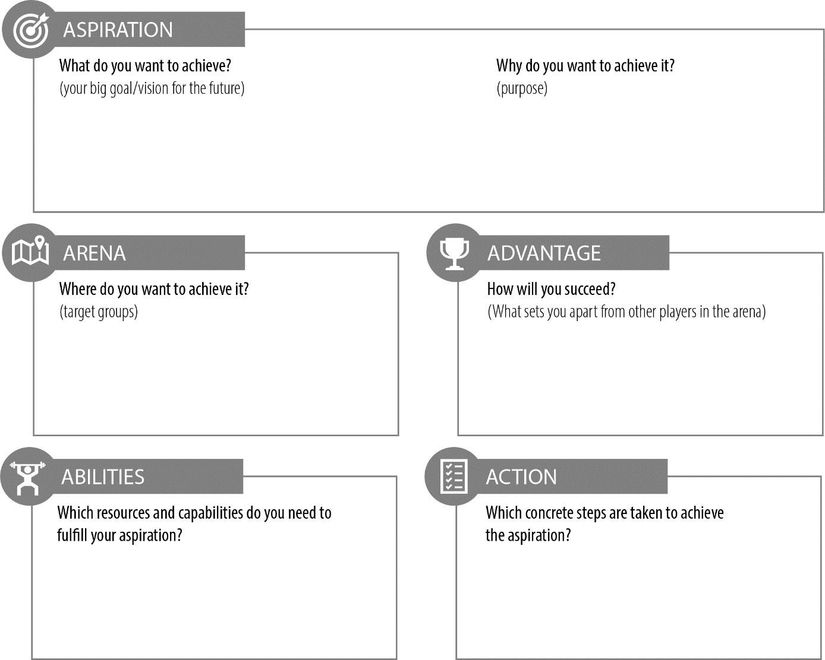
Exercise| The ‟5A Canvas ”
7

Slide 8


Levels of strategy | All with ‟5As” choices
Corporate-level strategy
Business-level strategy
Well aligned; choices at the top
set the context for choices below
Functional strategy
8

Slide 9
Well-aligned strategy| internal & external
Internal alignment
External alignment
The synchronization of the various strategic choices and the organization to ensure that that they will result in coherent, well-coordinated action
Ensuring that your organization’s strategic choices are synchronized with the dynamics of its external environment, including market trends, competition, regulations, and customer preferences
9

Slide 10

Strategy| Definition
Strategy is an integrated set of well-aligned choices that will result in a high-level plan which defines your aspiration (your overall purpose and goals) and outlines where (in which arena) and how you will fulfill your purpose and achieve your goals in a changing environment
DEFINITION
10
Picture source: Dall-E, Chat-GPT 4

Slide 11



What makes a good strategy?
Quality of
analysis
Quality of the
decision process
Effective implementation
PRIORITIES
11

Slide 12
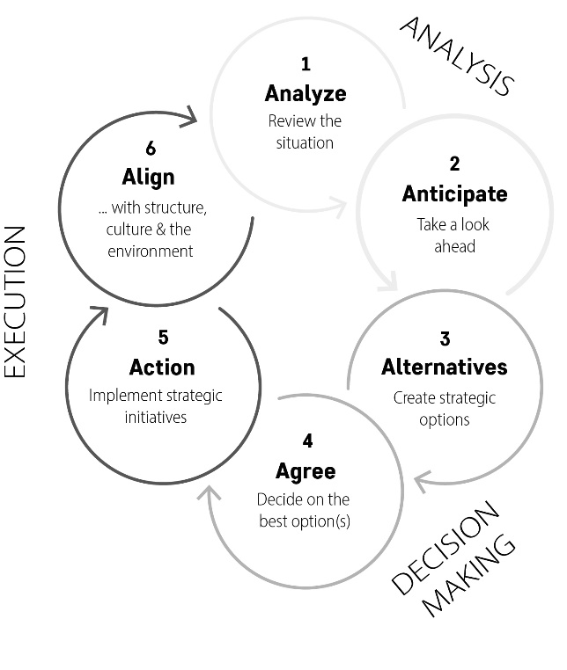
The strategy development cycle
In a fast-changing environment: strategy development cannot be seen as a one-time event; continuous analysis, adaptive decision-making, and iterative execution
→ a cycle rather than a linear process
(ongoing, iterative)
12

Slide 13





Strategy| Different perspectives
Hypothesis testing
Strategy as a social process
Open strategy
Involves people,
colliding interests,
power struggles
(resource distribution), communication needs
Engaging a broader range
of employees and external
stakeholders in strategy development
e.g. internal social network,
internal and external online
contests, ‟strategy jam”,
collectively coting on trends
Hypotheses on the ‟5As”
Guiding the analysis process
Testing the validity of
the hypotheses
Needs to result in
well-coordinated action
Strategy as a process of self-reflection / creating a shared thinking space
13

Slide 14


VUCA| Strategy in a rapidly changing world
Aim: Ensure a good match (‟fit”) between your strategy and the (current and future) environment
Strategy as a hypothesis that you can/should constantly adapt
Emergent strategy (Henry Mintzberg)
Portfolio of strategic experiments (Reeves et al.)
Continuous reconfiguration (of resources and capabilities) from one opportunity to another (Rita McGrath)
Strategy as prototyping (Roger Martin)
Strategy as experimentation
(thought experiments,
real experiments
on the market)
14

Slide 15

Strategy| Why we need it?
To co-create the future
(instead of being a band-wagon
of the circumstances)
15
Picture source: Dall-E, Chat-GPT 4

Slide 16
THANK YOU!
Picture source: pixabay.com

