Slide 1

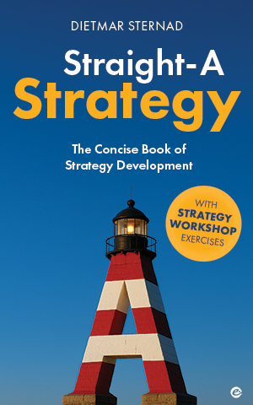
Straight-A Strategy
ASPIRATION | What to achieve (and why)
Picture source: ChatGPT

Slide 2
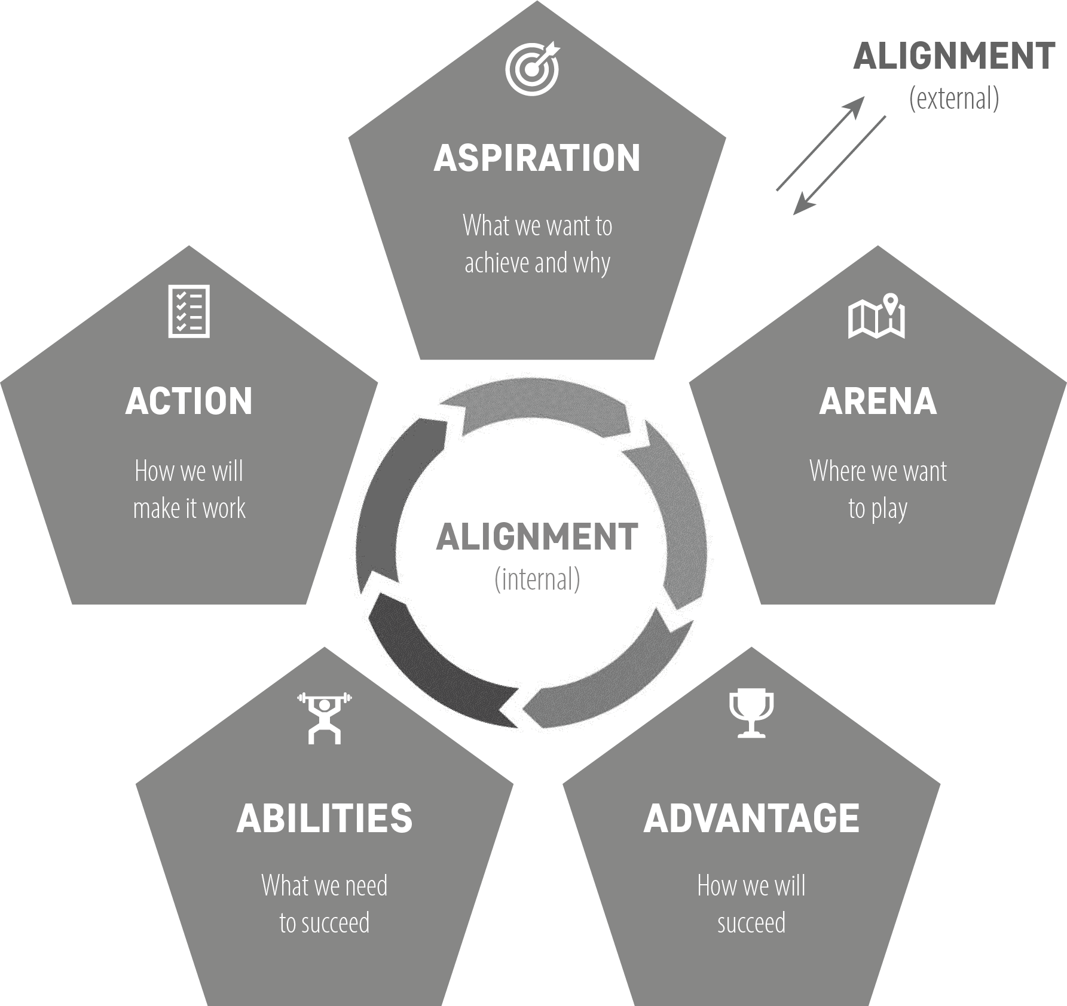
Aspiration | The “5As”
At the top of the “5As” because it is the foundation for all other strategic decisions and guides the overall direction and efforts of your organization
Provides focus (avoiding scattered priorities)
2

Slide 3




Formulating your aspiration
Purpose /
mission statement
Vision
Strategic goals
Values
Explains the fundamental reason why your organization exists and what value it creates (and for whom)
Vividly articulates the ideal future – the ultimate goal, illustrating the ideal long-term outcome your organization strives to achieve
Specific, measurable objectives that your organization aims to achieve in order to fulfill its mission and move closer to realizing its vision
Core principles you would like to adhere to; they guide your organization’s behavior and decision-making
“Who are we—and what do we contribute?”
“What is the desired
future state?”
“What must we achieve to fulfill our mission and move toward our vision?”
“What do we stand for—and what core beliefs shape how we work, lead, and interact with others?”
3
Picture source: ChatGPT

Slide 4


Formulating the mission statement | Tips
Describe for whom you create value (whom do you serve with your organization’s activities, products, and services?). Describe the value/impact you create for your target audience (what problem do you solve?).
Be concise (no more than a few sentences).
Highlight unique aspects—what sets your organization apart from others.
Look ahead—do not only describe the value you create now, but the value you aspire to create for your target audience.
Think about what associations each word evokes—use words that evoke positive feelings rather than “dead” technical terms.
4
Picture source: ChatGPT

Slide 5

Formulating the vision| Tips
Visualize where you see your organization in five to ten years.
What impact will you make?
Be inspirational and ambitious: craft a statement that inspires and motivates your team and other stakeholders, depicting a compelling future for the organization.
Be concise, clear, and concrete: avoid vague general statements, use simple and powerful language, make it succinct and easy to understand.
5
Picture source: ChatGPT

Slide 6

Formulating organizational values| Tips
Think about what really matters to you as a team—what do you really care about?
What attitudes are essential to achieving your purpose, mission, and vision?
Be authentic: ensure that the values are genuine and truly represent what the organization and the people within it stand for.
Keep it short: a few, clearly understandable values that are easy to remember are more likely to shape the culture of the organization than a long list of desired values.
6
Picture source: ChatGPT

Slide 7

Formulating strategic goals| Tips
Align with the vision and mission: ensure that each goal directly contributes to achieving the organization’s vision and mission, and has an impact on creating and sustaining competitive advantage.
Be specific and measurable: clearly define what you want to achieve within a specific timeframe; establish measurable criteria for success.
Formulate challenging yet achievable goals.
Limit the number of strategic goals to a focused few (typically three to five) to ensure clarity of direction, prioritization, and optimal allocation of resources.
Agree on goals: don’t just set them from the top down, but work them out in consultation with the people who will be responsible for achieving them.
Use the “Pyramid Principle” to create a hierarchy of well-aligned goals
7
Picture source: ChatGPT

Slide 8
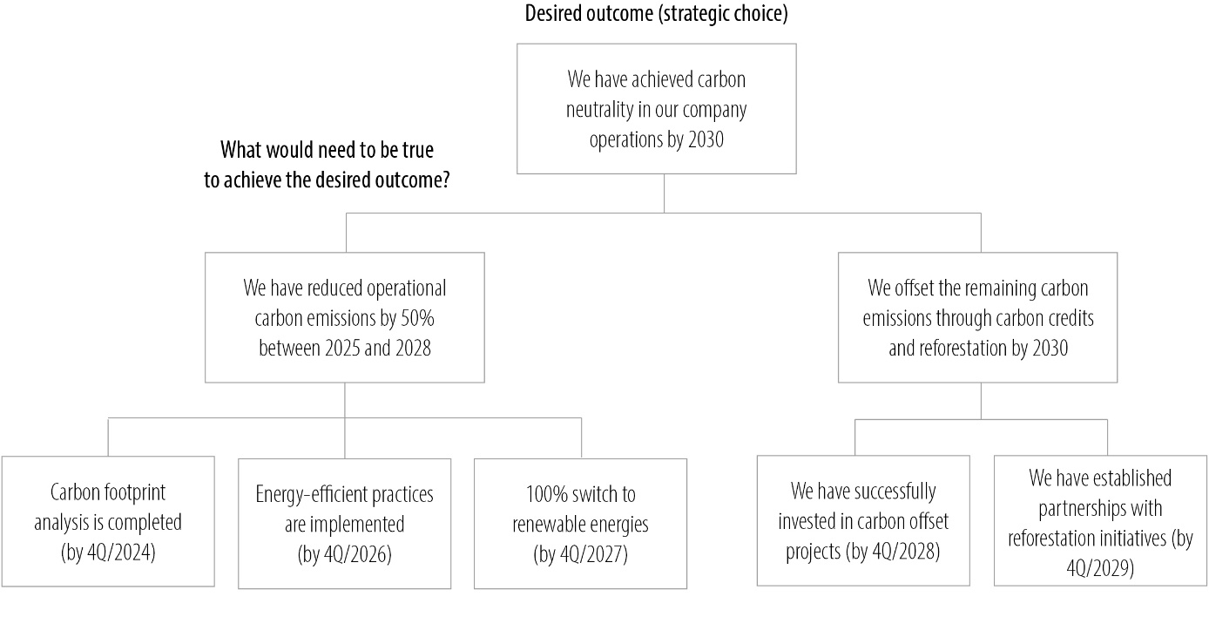
The Pyramid Principle | Barbara Minto (2008)
8
For the concept of the Pyramid Principle, see Minto, B. (2008). The Pyramid Principle, 3rd ed. Harlow: Financial Times Prentice Hall. Picture source: pixabay.com

Slide 9

Straight-A Strategy
ARENA | Where we want to play
Picture source: ChatGPT

Slide 10
Arena| Defining your ‟playing field”
Product/service offering: What value do your products and services provide to your target market?
Target segments: To which customer segments do you want to provide value? At what price point?
Geographic reach: In which countries/regions do you focus your activities?
Distribution channels: What channels do you use to reach your customers?
Position along the value chain: At what stages in the process of producing and delivering products or services to customers (from raw materials to the final product in the hands of the consumer) does your company intend to operate?
Define your core arena first – from there, consider where to expand
(but beware of losing focus)
10
Picture source: ChatGPT

Slide 11
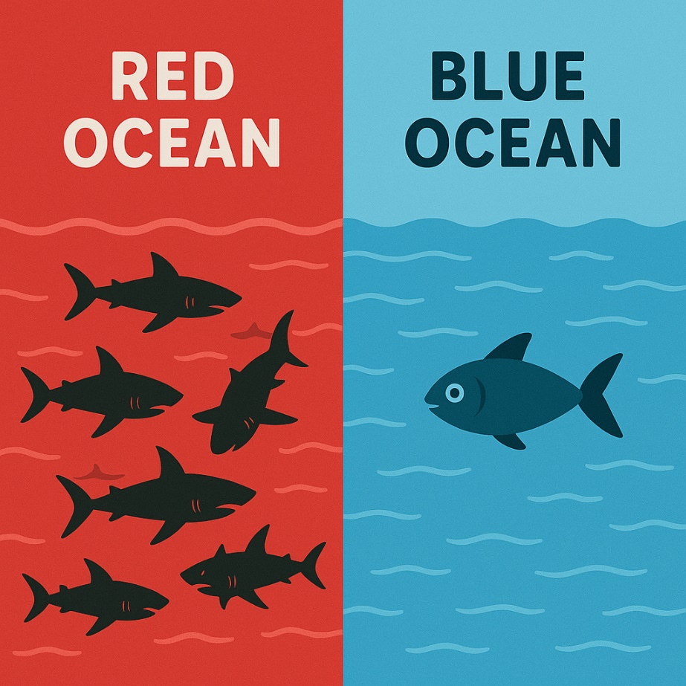
Blue Ocean strategy| Kim & Mauborgne
Untapped market space,
demand is newly created rather than fought over
Based on value innovation
(excelling in certain product or service features while simultaneously reducing costs by focusing only on what truly adds value for customers)
Clearly defined industry boundaries
Intense competition
11
Picture source: ChatGPT

Slide 12
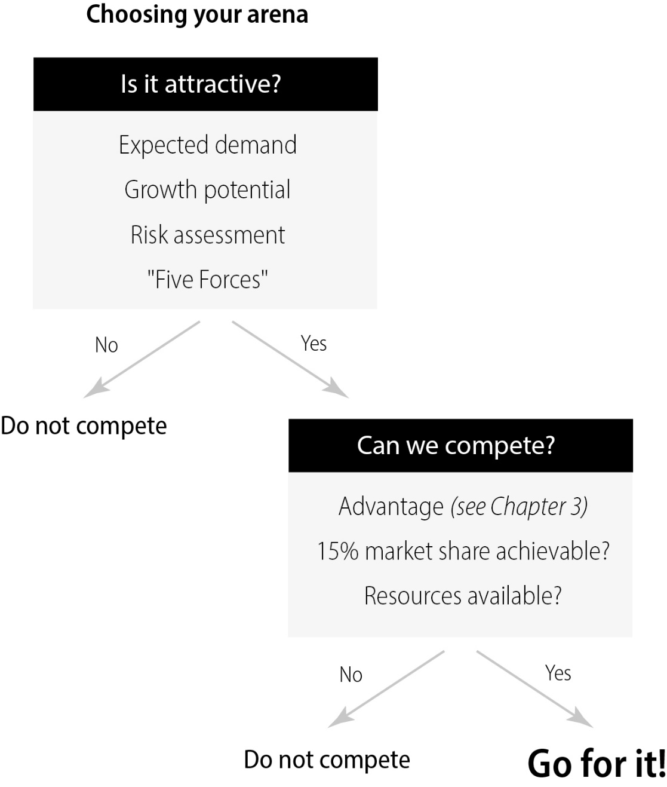
Choosing your arena|Attractiveness & ability to compete
12

Slide 13
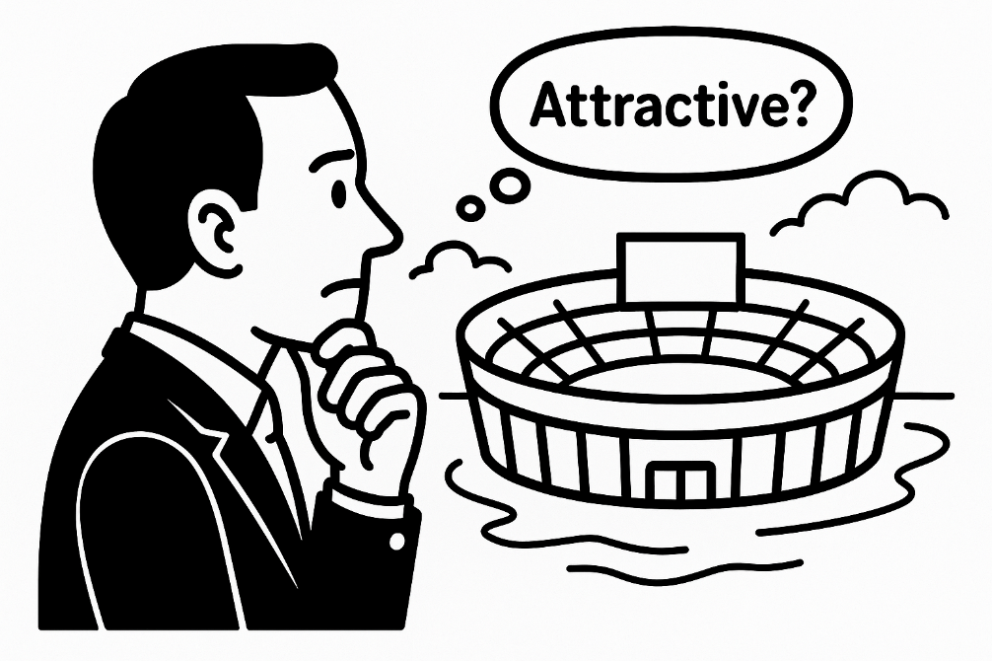
Porter’s Five Forces|Assessing industry attractiveness
Market analysis tools
Threat of new entrants
How easy or difficult is it for new companies to enter the industry? (If it is difficult, the industry is attractive for the incumbents.)
Bargaining power of suppliers
How much influence do suppliers have on the prices of inputs (such as increasing the cost of raw materials) and/or on the supply of the goods or services they provide?
Bargaining power of buyers
How much influence do customers have on the prices and terms of purchase?
Threat of substitute products or services
How easily can customers switch to alternatives that fulfill their needs, if not in the same way then at least in a similar way?
Industry rivalry
How intense is the competition among existing companies in the industry?
13
The Five Forces Model was developed by Harvard Professor Michael Porter (see Porter, M. (2008). The five competitive forces that shape strategy. Harvard Business Review, 86(1), 78–93.). Picture source: ChatGPT

Slide 14
Arena|Market size analysis (selected methods)
Market analysis tools
Method | Example
Estimating with proportions (starting from known numbers) | If the total market for artisanal coffee in a city is $5 million and you estimate (after asking a few coffee bar owners) that cold brew coffee accounts for 20% of this market, you could estimate the market size for cold brew coffee to be around $1 million.
Aggregated customer market sizing | If an average coffee bar in the city spends $15,000 per year on artisanal coffee, and there are 200 coffee bars in the city, you can multiply these figures, resulting in a total market size of $3 million.
Aggregated competitor market sizing | If your own artisanal coffee sales in a particular region are $1 million (index 100), and you estimate your top five competitors have indices of 150, 120, 110, 90, and 80, and add an “Others” index of 50, the total index sum is 600. Dividing 600 by 100 and multiplying the result by your sales of $1 million gives you an estimated market size of $6 million for artisanal coffee in that region.
14

Slide 15
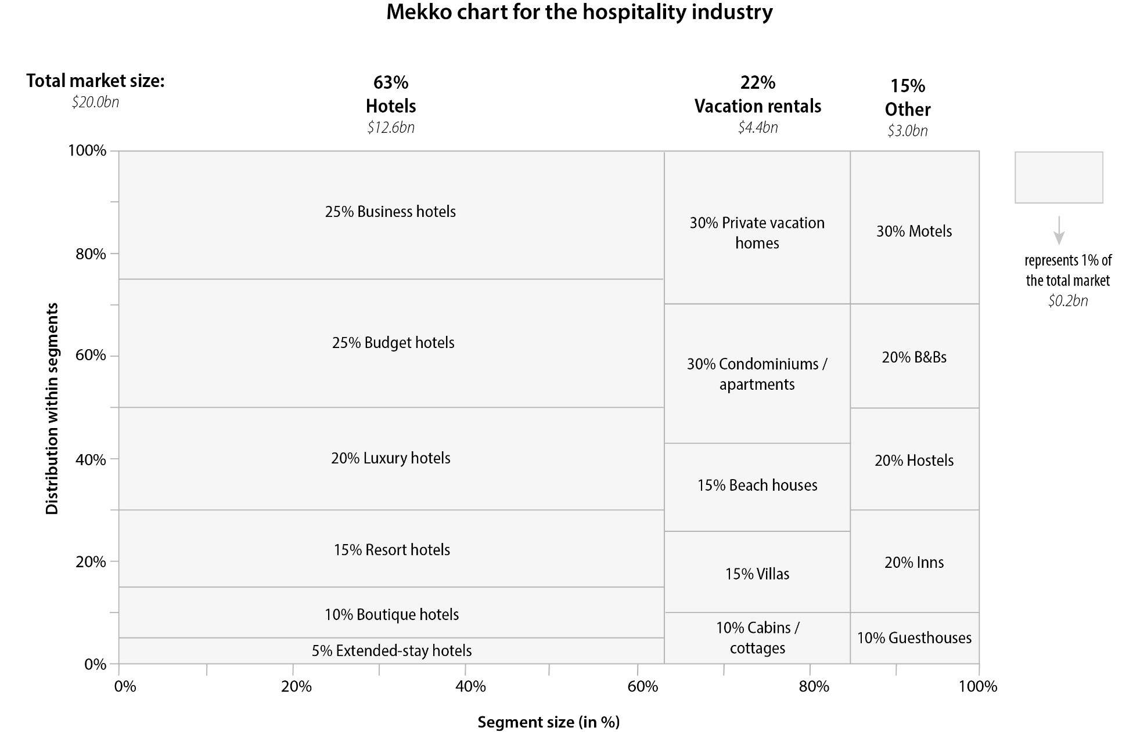
Arena|Market composition analysis
Market analysis tools
15

Slide 16
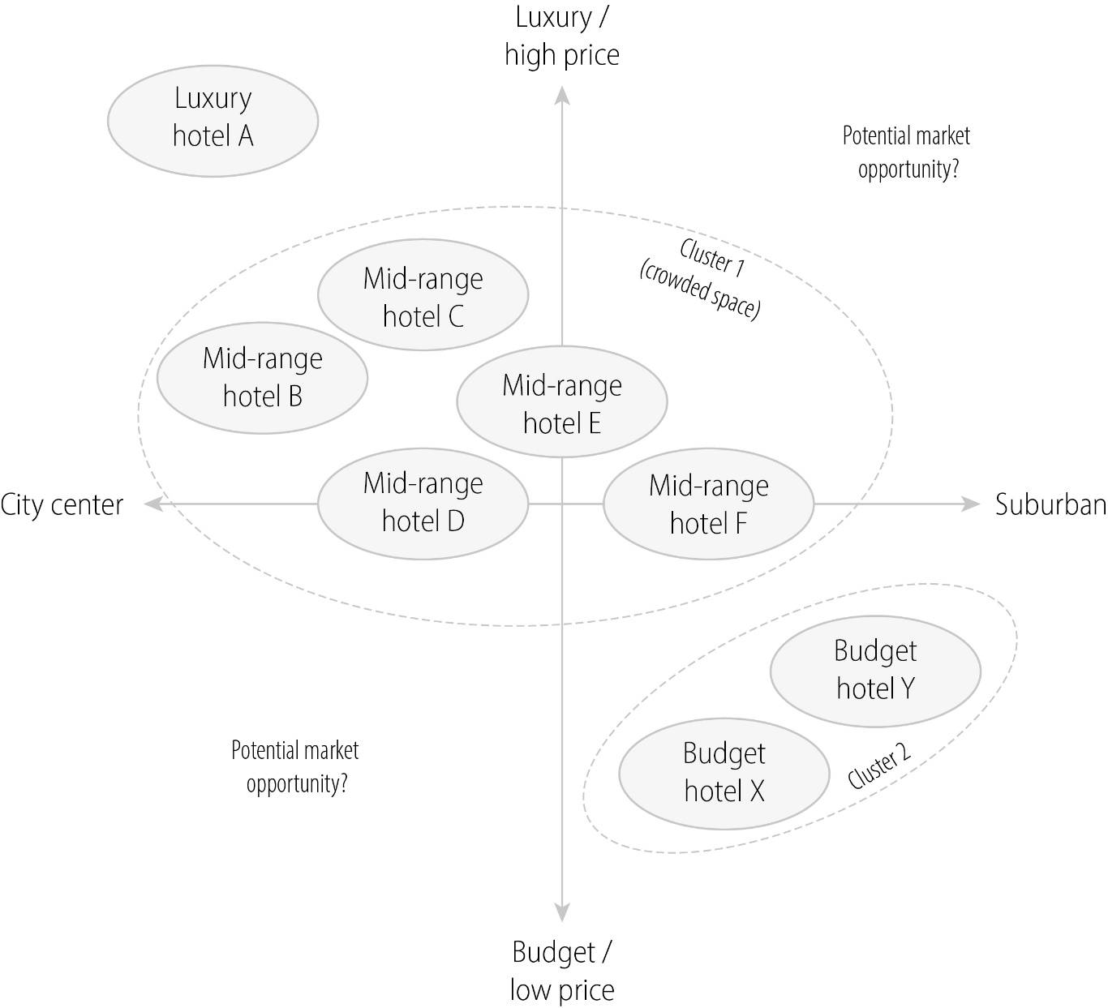
Arena|Competitive map
Market analysis tools
16

Slide 17
Arena|PESTEL analysis (macro environment)
Market analysis tools
PESTEL factor | Examples
Political | Government stability and policies; changes in political leadership; political influence on the industry; relations with other countries
Economic | Macro-economic indicators (e.g. GDP growth rates, inflation, interest rates, savings, investments, unemployment rate …); dependence of the sector on the economic cycle; economic trends
Social | Demographic trends; changes in societal attitudes and values; lifestyle changes; consumption habits; educational trends; distribution of income levels
Technological | New technologies which could impact the industry; R&D activity; advances in automation, digitization, and AI
Environmental | Impact of climate change; environmental regulations; sustainability practices and trends; stakeholder pressure regarding environmental issues
Legal | Developments in key legal areas (e.g. employment law, competition regulations, consumer protection law, taxation law, intellectual property law, data protection, import/export restrictions etc.)
17

Slide 18
Arena|Further market analysis methods
Market analysis tools
CUSTOMERS
COMPETITORS & VALUE CHAIN
Market growth analysis: Identify underlying drivers of growth (e.g. GDP growth, building activity for the construction market, demographic trends …)
Customer insights: Analyzing customer demographics, motivations, buying patterns, preferences, expectations, …
Trend analysis: Trend reports, trade fairs, industry influencer blogs, data analytics, AI-powered trend analysis
Competitor growth – profitability analysis: Place competitors in matrix with growth (in %) and profitability (in %) as axes – analyze what makes the ‟champions” successful
AI-powered competitive analysis: aggregate data from various sources, e.g. websites, social media, financial reports
Industry value chain analysis: profit margin/profitability at each stage of the value chain, key trends at each stage, advantages/disadvantages of expanding into other parts of the value chain
18

Slide 19
Arena selection|Scoring model
19

Slide 20
THANK YOU!
Picture source: ChatGPT

