Slide 1
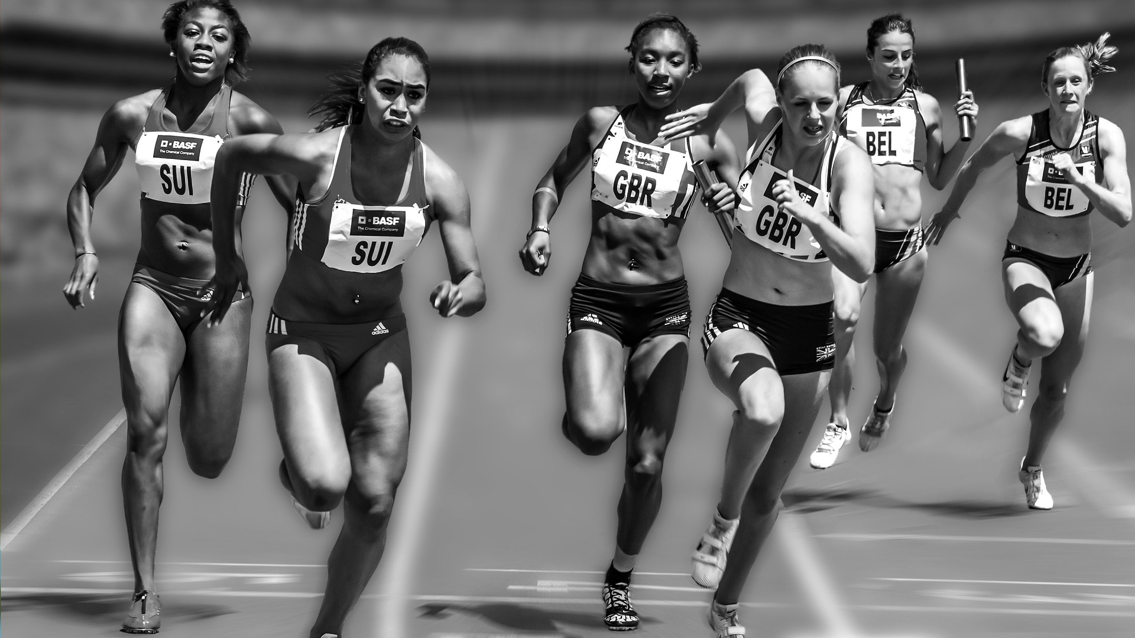
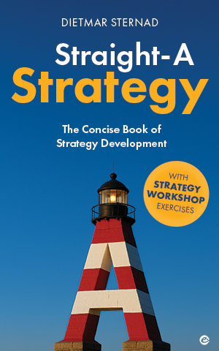
Straight-A Strategy
ADVANTAGE & ABILITIES |
How to create superior value
Picture source: pixabay.com

Slide 2

Competitive advantage
Every good strategy is based on a difference.
You need a competitive advantage.
A a set of unique attributes, strengths, or capabilities that your company possesses (and other companies in your market do not) which (a) persuade customers to buy from you rather than your competitors, (b) are based on a sustainable source of competitive advantage, and (c) result in an economic advantage (in terms of increased profitability and value creation).
2
Picture source: pixabay.com

Slide 3



Competitive advantage| 3 criteria
COMPETITIVE ADVANTAGE
1
2
3
IMPORTANT FOR THE CUSTOMER
BASED ON A SUSTAINABLE SOURCE OF ADVANTAGE
RESULTS IN AN
ECONOMIC ADVANTAGE
3
Picture source: pixabay.com

Slide 4
Start with customers | KPCs
Low price (best value for money)
High product/service quality
Convenience
Relationship/reputation
Social/environmental responsibility
Key purchasing
criteria (KPC)
4
Picture source: pixabay.com

Slide 5
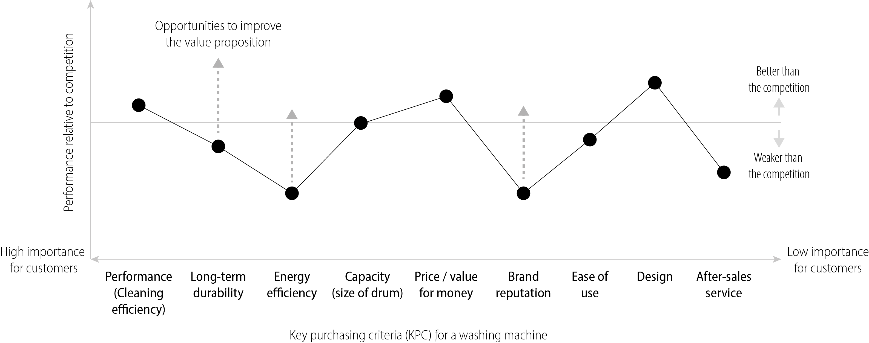
The value map| Ranking KPCs
5

Slide 6
USP| Unique Selling Proposition
USP = A distinctive and compelling aspect of your product, service, or brand that sets it apart from its competitors in the minds of customers
(answers the question “Why should customers choose your product or service over others?”)
“Live like a local in over 200 countries.” (Airbnb)
“Affordable furniture with modern Scandinavian design” (IKEA)
6

Slide 7
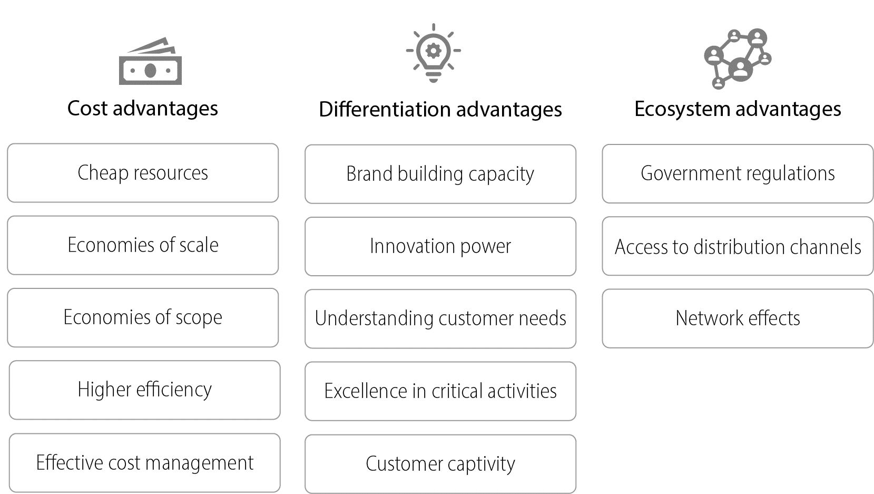
Competitive advantage| Underlying sources
7

Slide 8
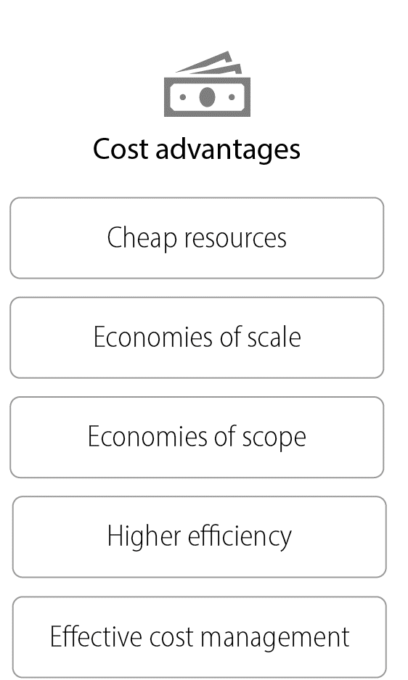
Competitive advantage | Cost advantages
Access to cheaper raw materials, intermediate products, labor, capital
Cost advantages due to large scale (learning curve effects, spread of fixed costs, …);
important relative vs. competitors (→ importance of market share)
Cost advantages due to producing products/services together
(shared resources/capabilities)
Proprietary technology, process know-how
Continual cost analysis, standardization, cost-optimized product/service design etc.
8

Slide 9
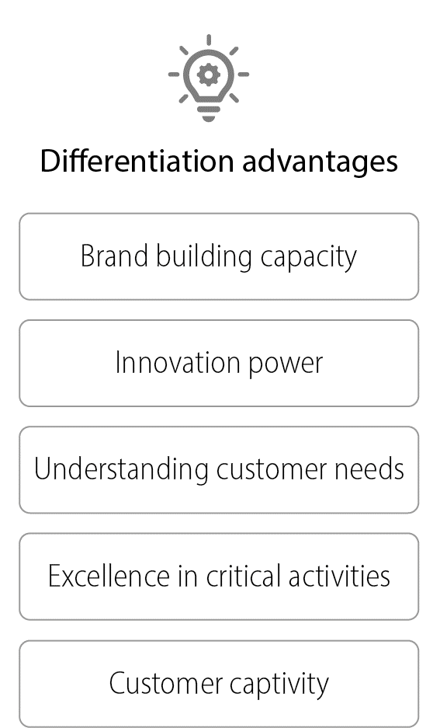
Competitive advantage | Differentiation advantages
Creating a strong, recognizable brand identity
Generate, develop, implement new ideas, products, processes, business models …
Deeper knowledge about what customers need (e.g. Amazon – cross-selling)
Customer service, quality management, talent management, sustainability mgmt …
Habits, switching costs, search costs
9

Slide 10
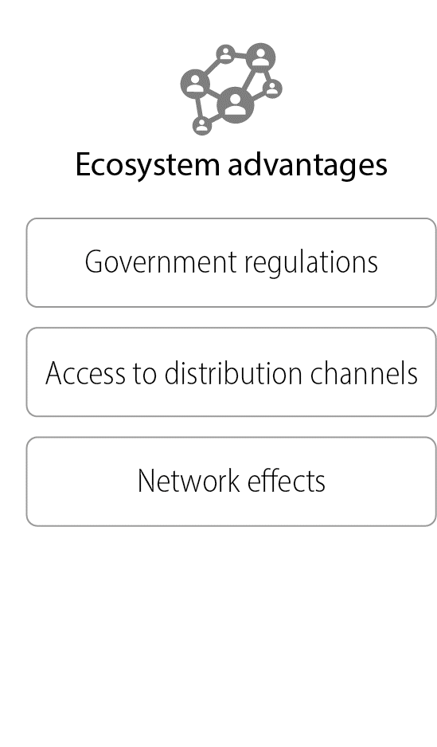
Competitive advantage | Ecosystem advantages
Regulatory requirements, legal barriers – challenges for competitors
Exclusive assess to distribution channels – difficult for competitors to match
Advantage of an existing large customer base
10

Slide 11
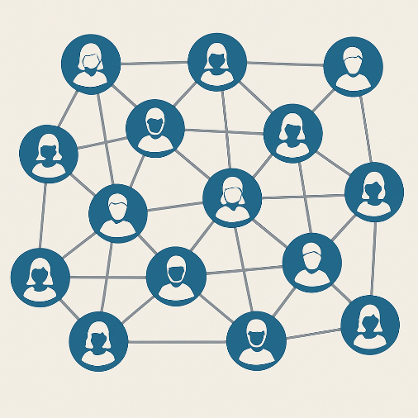

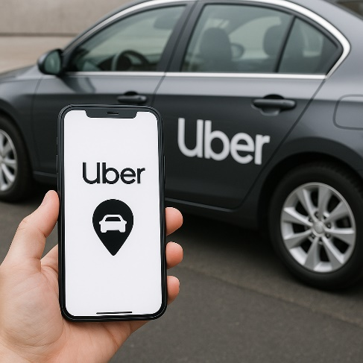
Competitive advantage | Network effects
Direct
network effects
Indirect
network effects
Platform business models
More users,
more value for
each user
Value of a product increases
when the number of
complementary
products grows
Two types of customers
brought together
(more of customer type A =
more value to type B)
e.g. Kindle delivers
more value if there are
more e-books
e.g. airbnb, booking.com,
Uber, Amazon, Etsy …
11
Source of pictures: ChatGPT

Slide 12
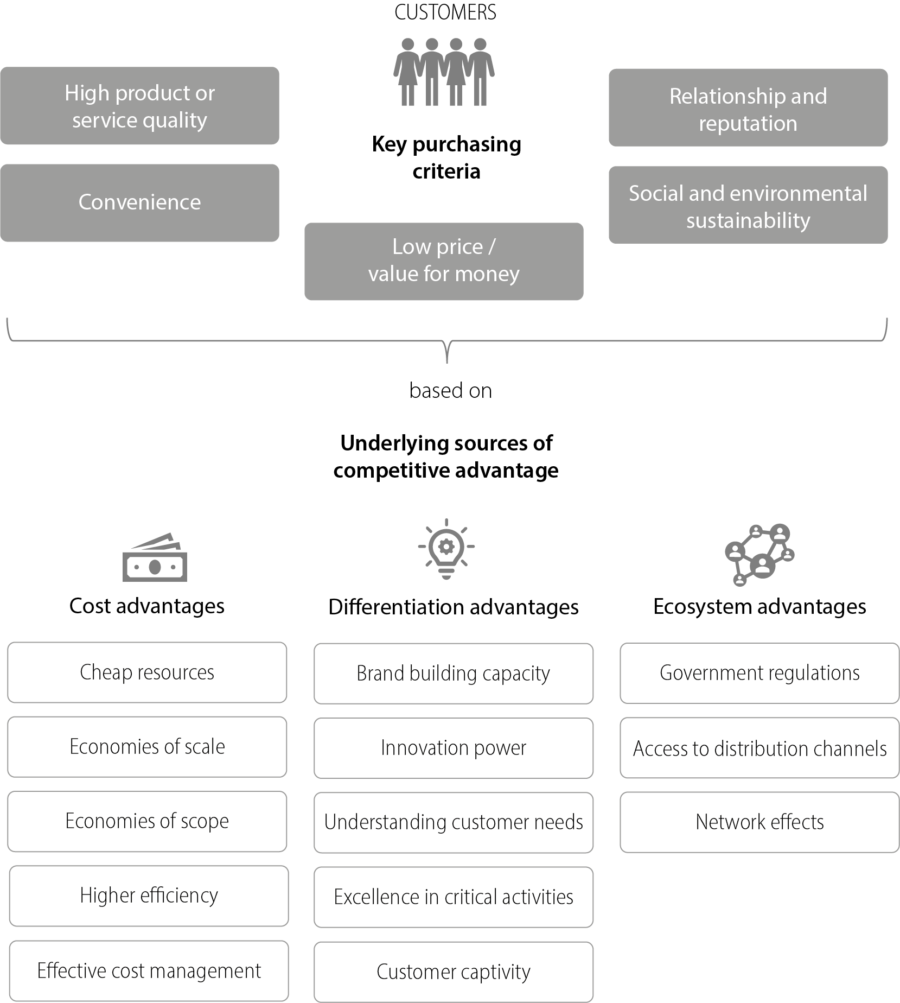
Sources of competitive advantage| Overview
12

Slide 13
Competitive advantage| Choose the right one
Basic choice: generic strategies (Michael Porter)
Unique product/service
Preconditions
  Deep understanding of customer needs
  Focus on exceptional customer experience
  Culture of innovation and creativity
  Highly skilled workforce
  Identify and communicate clear USP
Not necessarily a low price strategy
Keep hidden costs in mind
Preconditions
  efficient operations
  economies of scale
  cost-conscious culture
  access to low-cost inputs
  efficient supply chain
  low overhead
  stable demand
  standardization
Unique offer
Cost advantage
Differentiation
Cost leadership
industrywide
Focus
“Stuck in
the middle”
niche
Chosen strategy must result in lower cost structure and/or
allow you to achieve higher profit margins through creating more value for customers
13

Slide 14
Abilities| Ways to describe an organization’s abilities
Resources
Assets that a company owns (physical and intangible) – What we ‟have”
Capabilities
The organization’s ability to use resouces effectively – What we excel at
Dynamic capabilities
The organization’s ability to adapt, innovate, and renew its resource and capability base to stay competitive in changing markets
Core competencies
Unique resources and capabilities that lie at the heart of your organization’s ability to create value (must (a) help create superior value for customers,
(b) be “extendable” for being used in other product/service offers or markets, and (c) difficult for competitors to copy) (Hamel & Prahalad)
To some extent, missing resources can be substituted by capabilities
(e.g. Uber: technological capabilities instead of a fleet of vehicles)
14

Slide 15
RBV| The resource-based view
According to this view, a company’s unique resources and capabilities are the primary determinants of its ability to achieve and sustain superior performance.
‟VRIN” criteria
‟VRIN” resources & capabilities create entry barriers –
enable sustainable advantage over time (Jay Barney)
V
R
I
N
VALUABLE
RARE
INIMITABLE
NON-SUBSTITUTABLE
Enable the company to create superior value, i.e.
allow it to create a competitive advantage.
Are quite uncommon, not widely held by or available to
competitors.
Are difficult for others to replicate
Do not have readily available alternatives
15

Slide 16

Options for managing abilities
Based on your organization’s aspiration
and dependent on how developed
your core competencies are
Invest in strengthening existing core competencies
Leverage your
existing abilities
Develop new resources and capabilities
e.g. Apple further strengthening its design and innovation capabilities
e.g. Disney leveraging its strong brand and vast library of content
to expand into streaming services
e.g. Toyota investing into
hydrogen fuel cell technology
with the aim of gaining a competitive advantage in the future
16
Picture source: ChatGPT

Slide 17


Limits of advantage| Local & temporal
Every advantage is always both local and temporal.
Buyers and their needs differ from region to region.
Buyer preferences change over time.
Competitors notice good opportunities and make progress.
Unforseen events occur.
Remain adaptable!
Start with an attractive niche!
17

Slide 18
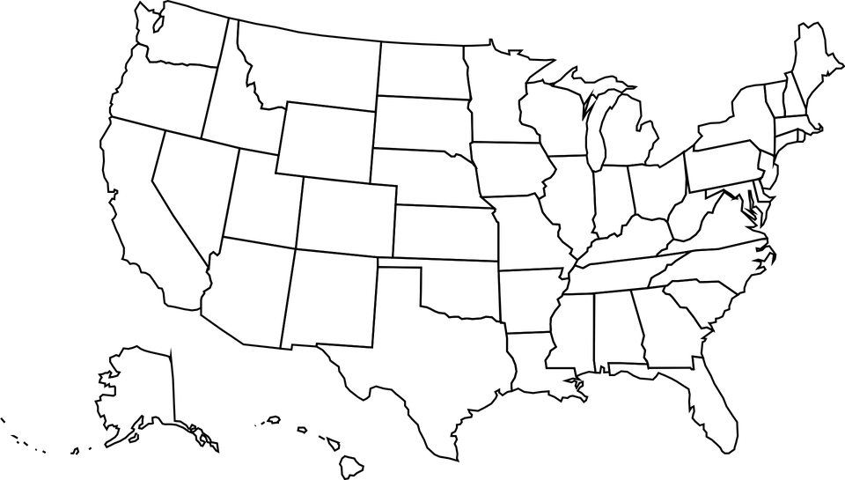
Establish local advantage| Then expand from there
EXAMPLE: FACEBOOK
Universities
UK
Particularly attractive niche,
ideally with high profit potential/
low competition
4
Other
Universities
USA/CAN
Local unis/
Ivy league
3
HARVARD
UNIVERSITY
5
2
1
Worldwide expansion
6
Instagram, Whatsapp → Meta
18
Maps: Pixabay.com

Slide 19


Sustainable advantage| Barriers to entry
How to create a sustainable advantage?
Barriers to entry
Become a moving target
Isolating mechanisms:
Legal (patents, copyrights …)
Strong brand
Customer loyalty
Staff loyalty
…
Continuously deepen advantage
Innovation/improvement
19

Slide 20

Competitive advantage| The essence
‘In order to be irreplaceable,
one must always be different.’
-
Coco Chanel
Source: Haedrich, M. (1972). Coco Chanel: Her Life, Her Secrets. Boston, MA: Little Brown. Picture source: ChatGPT
20

Slide 21
THANK YOU!
Picture source: pixabay.com

