Slide 1


Straight-A Strategy
ACTION & ALIGNMENT | How to make it work
Picture source: unsplash.com/Brett Jordan

Slide 2
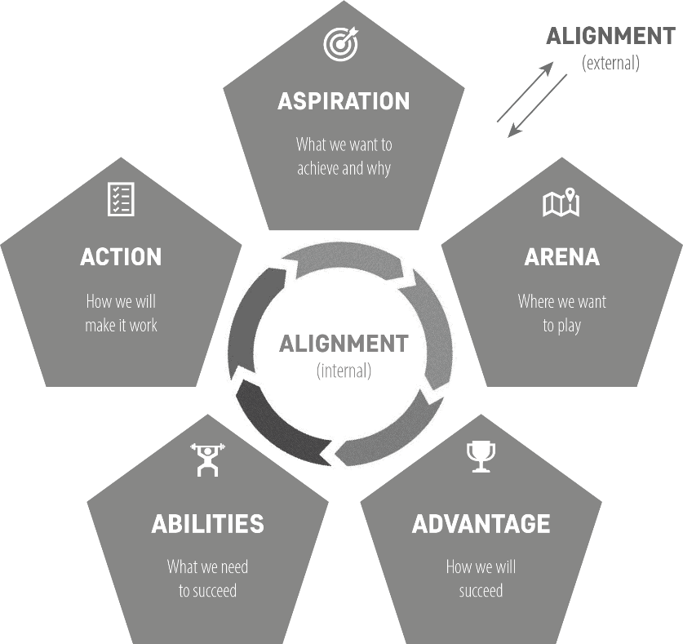
How to get it done? | Implementation
2

Slide 3

Without action, strategy is useless
PPT presentations won’t achieve anything
unless they manifest themselves in action.
rategy
Strategic choices
Concrete objectives
Local decisions
Action
(on an individual level)
3
Picture source: ChatGPT

Slide 4
Objectives and action| Difference
Concrete objectives
Action
Measurable goals you want to achieve
What you really do
to identify the specific needs and requirements of your organization that the new system must address,
to allocate the necessary financial resources for the project,
to select an appropriate system and vendor,
to customize and integrate the system with other existing software, and
to train the team members so that they can understand and use the system.
EXAMPLE
“To introduce a new customer relationship management (CRM) system by [a certain date]”
4

Slide 5
The job of a strategic leader
Ensure that daily decisions on all levels are well aligned with the overall
strategic direction
Translate strategic choices into concrete, measurable objectives
Not necessarily: to lay specific action steps for others to follow
5
Picture source: pixabay.com

Slide 6
Concrete objectives | Working backwards
Start with your vision /
strategic choices
Which goals could we set ourselves for the next year?
Which concrete/measurable objectives for the next quarter?
Who is the best person to be responsible for the goal?
6
Picture source: pixabay.com

Slide 7
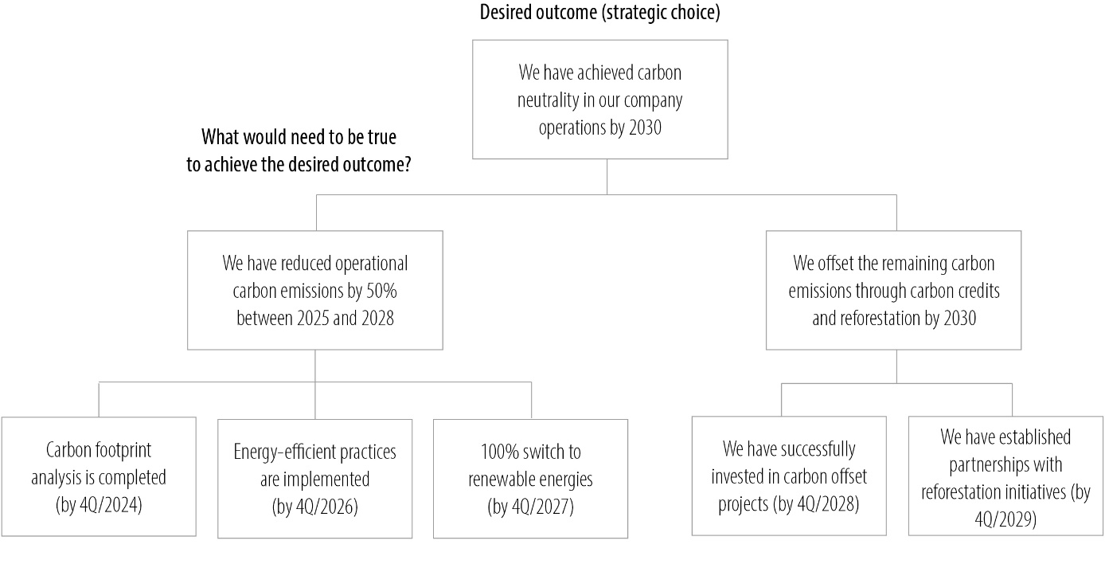
The Pyramid Principle | Minto (2008)
7
Picture source: pixabay.com

Slide 8

Taking action| Business strategy level [1]
Market penetration and development | increasing marketing and promotional efforts in existing markets exploring new sales and distribution channels entering new markets with current or modified products
Product and service innovation | developing new products or services enhancing existing offers to meet changing customer needs
Improving operational efficiency | streamlining processes to reduce costs and improve quality adopting lean management practices utilizing technology and automation using digital tools to improve processes, customer experiences, and data-driven decision-making enhancing supply chain management standardizing processes across the organization
8
Picture source: ChatGPT

Slide 9
Taking action| Business strategy level [2]
Strengthening customer relations | developing strong customer service and support implementing loyalty programs and personalized marketing introducing a CRM system
Strategic partnerships and alliances | forming alliances to share resources or knowledge collaborating for cross-promotion and co-branding opportunities entering into a supply chain partnership entering into technology and R&D partnerships
Pricing strategies | adopting new competitive pricing models implementing dynamic pricing based on market demand
9
Picture source: ChatGPT

Slide 10
Taking action| Business strategy level [3]
Sustainability and environmental strategies | developing eco-friendly products and practices investing in sustainable technologies and renewable resources
Adapting the organizational structure | changing the structure of the organization in a way that is focused more clearly on the strategic priorities more centralization or decentralization to improve efficiency and/or responsiveness outsourcing non-core activities improving communication processes adopting agile practices
10
Picture source: ChatGPT

Slide 11

Taking action| Corporate strategy
Diversification (new markets/industries)
Joint ventures
Develop new
product lines
(unrelated)
Investing in promising
start-up businesses
Entering
international markets
Allocating resources to high-potential areas
Divesting / spinning off non-core businesses
Mergers &
acquisitions
New ways to organize the corporation (synergies)
11
Picture source: ChatGPT / pixabay.com

Slide 12
Strategy implementation| 6 pillars
Strategy implementation
Risk managegement
Allocation of resources
Monitoring & adjustment
Leaderhip / culture-building
Clear responsibilities
Change management
12

Slide 13

Strategy as coherent action
Effective collaboration & communication
are essential!
Strategic coordination is work, too
→ the work of managers
Clarity objectives
Clarify roles & responsibilities
Communicate strategic aspirations & objectives
Recognize performance with strategic relevance
Provide regular feedback
Foster a collaborative work culture
13
Picture source: pixabay.com

Slide 14
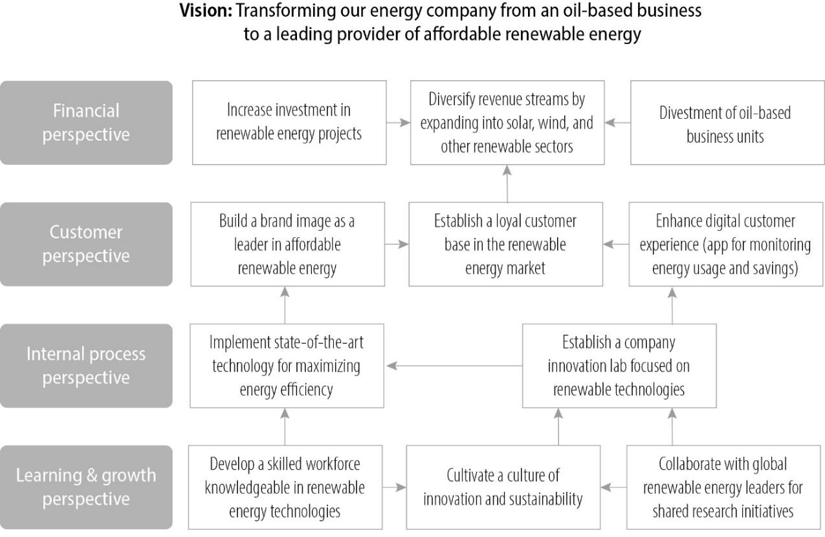
Strategy map| Kaplan & Norton (2001)
14

Slide 15


Empowerment vs. enforcement | What works?
Empowerment
vs.
Enforcement
Encouraging employees
to take ownership
of their work and make
decisions within their
area of responsibility
Exercise of
centralized power
(‘orders’)
15
Picture source: pixabay.com

Slide 16

Strategic alignment| internal & external
Internal
strategic alignment
External
strategic alignment
Adjusting strategic decisions to meet the demands and expectations of an ever-changing external environment
(keeping your company’s strategies aligned with external factors such as market dynamics, customer needs, and competitive forces)
ensuring that all aspects of an organization (strategic decisions, objectives, resources, organizational structures and processes, culture, and actions) are closely integrated and harmonized to fulfill the organization’s overall purpose
Strategic choices should
reinforce each other!
16
Picture source: pixabay.com

Slide 17

Strategic alignment| Example ALDI
Focus on private
label brands
Limited product
assortment
Long-term supplier relationships
Minimalist design,
store layout, efficiency
Global expansion
Reliable high quality products at low prices
17
Picture source: ChatGPT

Slide 18
Assessing the degree of internal alignment
To what degree do the “5As” choices support the achievement of the organization’s overall purpose and strategic aspirations?
Do the individual strategic choices reinforce each other or could they potentially come into conflict with each other?
How well does your organizational structures and processes support the implementation of your strategic choices?
How well does your organizational culture support the implementation of your strategic choices?
1
2
3
4
18

Slide 19


Alignment| Structure & culture
Aligning the organizational structure
A strong and compatible organizational culture
Ensuring that efforts and resources are focused on the right tasks and objectives
Clearly defined roles and responsibilities
e.g. low-cost strategy → culture focused on efficiency, cost control, continuous improvement
Clear communication of values
‘Culture is the behavior of management.’
(Hirst, 2019, p. 75)
19
Picture source: pixabay.com

Slide 20




External strategic alignment
Ensuring that the organization remains relevant and competitive in its market
Staying aligned with
Market trends
Regulatory environment
Technological
developments
Economic developments
20
Picture source: pixabay.com

Slide 21
Staying aligned| As a multinational
‘Clever corporations give their
local leaders space to build
external coherence with the
local market.’
-
Krzysztof Obloj
Chair of Strategy,
Kozminski University
21
Source: Obloj (2013), p. 141.; Picture source: https://www.kozminski.edu.pl/en/community/card/prof-krzysztof-obloj

Slide 22
Shaping the ecosystem | Active alignment
Actively shaping the ecosystem as a form of aligning the environment with the corporation
How to shape the environment
Influence industry standards
Influence opinion leaders
Redefine market expectations
Create an ecosystem
SPOTIFY
Artists
Music labels
Podcast creators
22

Slide 23
THANK YOU!
Picture source: pixabay.com

