Slide 1

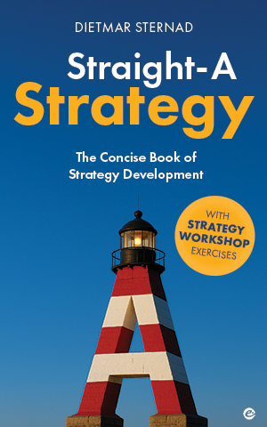
Straight-A Strategy
The Strategy Development Cycle|
How to find your strategic direction
Picture source: ChatGPT

Slide 2
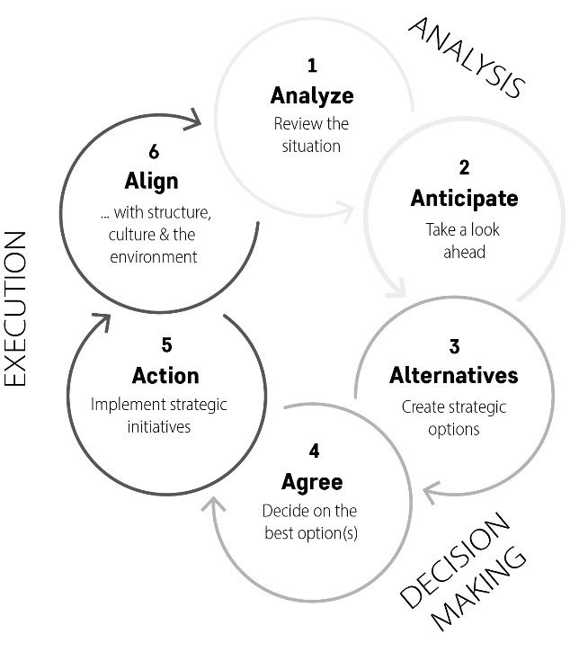
The strategy development cycle
It is not always necessary to move through all these stages in a linear fashion (e.g. you can also start with hypotheses about alternatives)
In a rapidly changing environment: check in more frequently and adjust strategic
choices
Stategy meetings: Clarify which stage of the cycle you are working on
2

Slide 3

Analyze: Review the situation
Good strategic decisions are based on a thorough analysis of the current
situation and possible future scenarios. Do your homework first by
gathering and analyzing relevant data.
Identify the critical issues (internal and external) to which your organization must respond to be well prepared for the future
3
Picture source: ChatGPT

Slide 4








Areas of strategic analysis
Trends in the
wider environment
Customers
Supply chain
Competitive
situation
Which problem do you solve for customers? Customer needs/preferences? (changing?)
Main trends in suppliers’
businesses? Efficiency/ resilience of your supply chain? Risks/opportunities?
What are key PESTEL trends – and the most important challenges & opportunities?
Main competitors, their strengths, weaknesses, and strategies
Internal
capabilities
Financial
health
Stakeholders
Risk analysis
Who are the key stakeholders? What are their interests?
What are the key strategic
risks for your organization?
Key resources, capabilities, core competencies; main strengths/weaknesses
Current financial status;
financial risks,
opportunities
4
Picture source: ChatGPT

Slide 5
Strategic analysis tools [1]
Trends in the wider environment
Customers
PESTEL analysis
Technological landscape (What emerging technologies could affect your industry? How could you leverage technology?)
Analyze the regulatory environment (relevant laws and regulations, upcoming changes in legislation)
Out of all external trends and developments, try to distill the ones that are the most important opportunities or threats
Ask customers directly (firsthand insights)
Consult market research reports (if available)
Use methods for collecting primary data (such as surveys, interviews, focus groups)
Use AI for sentiment analysis, web scraping for online reviews, and social media monitoring
Analyze big data trends in customer/market data
Identify key purchasing criteria
5
Picture source: ChatGPT

Slide 6
Strategic analysis tools [2]
Supply chain
Competitive situation
Supplier performance analysis: assess supplier reliability, quality, and performance over time
Supply-chain mapping: Create visual maps of the supply chain (flow of goods, and bottlenecks)
Supply-chain risk assessment: Conduct risk assessments to identify vulnerabilities and potential disruptions in the supply chain.
Make-or-buy analysis: assess the costs, benefits, and strategic implications of producing goods or services in-house versus purchasing them
Competitor analysis: Competitor growth‒profitability analysis, competitive map, AI-powered competitive analysis tools, benchmarking, value map, critical success factors, customer survey about strength/weaknesses vs. competition
Conduct a competitive advantage test: Are there competitors with sustained, very high after-tax returns combined with a stable or growing market share? Why?
Conduct a Porter’s Five Forces analysis
Analyze published market share data (if available).
Monitor competitors’ marketing strategies and product and service offerings.
6
Picture source: ChatGPT

Slide 7
Strategic analysis tools [3]
Internal
Financial
What are your sources of competitive advantage
and core competencies?
Value map – strengths and weaknesses
Strategic bottleneck analysis: key constraints or limitations within your organization’s capabilities that hinder higher performance and growth
Use benchmarking to identify potential areas for improvement
Talk to people “on the ground”
Income statement analysis: Evaluate revenue, expenses, and profitability over time to understand overall performance
Balance sheet analysis: Assess assets, liabilities, and equity over time to determine financial stability / capital structure
Cash flow statement analysis: Examine operating, investing, and financing cash flows over time (liquidity)
Ratio analysis: Liquidity ratios measure the organization’s ability to meet short-term obligations, profitability ratios evaluate financial efficiency and profitability, and leverage ratios assess financial leverage and risk
7
Picture source: ChatGPT

Slide 8
Strategic analysis tools [4]
Stakeholders
Risk analysis
Use stakeholder mapping to identify key stakeholders and understand their expectations and influence
Engage directly with stakeholders through interviews, surveys, and focus groups
Create a risk map to visually plot the likelihood and impact of identified risks (such as market, competitive, supply-chain, financial, reputational, environmental, or HR-related risks)
Assess the risk of dependence on individual customers or suppliers
8
Picture source: ChatGPT

Slide 9
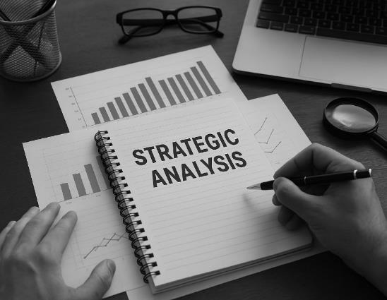
What to consider in your strategic analysis
Form hypotheses about key factors affecting your organization – focus your analysis (which data do you need?)
Consider data quality (source, method of data collection and analysis)
SWOT analysis: focus on critical issues instead of creating long lists
Identify core challenges and opportunities
Will your organization create signifiantly more value (or avoid loss of value) if this challenge/opportunity is addressed?
Does your organization has the necessary resources, capabilities & culture to address the challenge/opportunity?
9
Picture source: ChatGPT

Slide 10

Anticipate| Take a look ahead
Trend analysis
1. Identify key area of interest (e.g. market dynamics, consumer preferences, technological innovation),
2. Gather data (e.g. market research, web scraping, customer feedback, experts)
3. Uncover trends & correlations (AI, statistical tools)
4. Assess: Trend or fad / tipping point? What does the trend mean for us?
Scenario planning
1. Assumptions about key drivers for change (e.g. technology, economic shifts, regulatory change)
2. What would happen if key drivers developed in different directions (e.g. scenario with AI help)
3. How would you react to these scenarios?
Situational awareness
Examine situations from different angles to really understand them (include people from diverse backgrounds to create alternative scenarios)
10
Picture source: ChatGPT

Slide 11
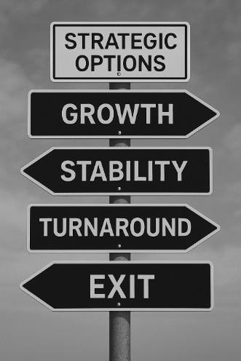
Alternatives| Create strategic options
Savvy strategist understand the power of having options (respond effectively to uncertainty, pivot as needed) – avoid falling into the ‟first solution trap”
Questions that can help to create strategic options:
What are the biggest opportunities on the marketplace? How can we capitalize on them?
What are common assumptions in our industry? How could we challenge them?
What additions/complements/combinations could add value to our offering?
What would your ‟nightmare competitor” look like?
What if we did something completely new? (customers, products, partnerships, channels, arenas …)
What constraints could we turn into strengths?
What can we learn from companies outside our industry?
5As: What arenas would be attractive to play in in the future? Which aspirations could we set in the
face of new opportunities? How could we leverage our strength to develop a sustainable advantage?
Which resources/capabilities do we need win? Which actions could we take?
11
Picture source: ChatGPT

Slide 12
Alternatives| Design your business model
Business model: a comprehensive framework that outlines how an organization creates, delivers, and captures value
– a blueprint for how the business operates
Value proposition
Target market | What specific customer group(s) does the company want to serve?
Customer needs | What needs are being addressed?
Product and service offerings | What solutions are offered to the target market, and how do they provide unique value compared to competitors?
Value creation
Core processes | What key activities and operations are necessary to create and deliver the product or service?
Resources and capabilities | What assets and skills does the company need to execute its core processes?
Cooperation partners | Which external partners can enhance value creation and provide additional resources or market access?
Distribution channels | How will the company efficiently deliver its products or services to the target market?
Customer contact | How does the company interact with customers to build and maintain relationships?
Value capture
Revenue streams | How does the company generate revenue from its customers? (Direct sales, licensing fees, subscription model, usage fees, freemium model, advertising, or other monetization methods?)
Profit model | How does the company convert revenue into profit, and what pricing strategy, cost structure, and margins ensure sustainable financial success?
12
Inspired by contents in Clauss, T. (2017). Measuring business model innovation: conceptualization, scale development, and proof of performance. R&D Management, 47(3), 385–403; Johnson, M. W., Christensen, C. M., & Kagermann, H. (2008). Reinventing your business model. Harvard Business Review, 86(12), 50–59; Osterwalder, A., & Pigneur, Y. (2010). Business Model Generation: A Handbook for Visionaries, Game Changers, and Challengers. Hoboken, NJ: John Wiley & Sons.

Slide 13
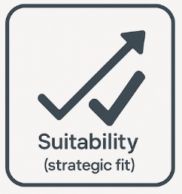
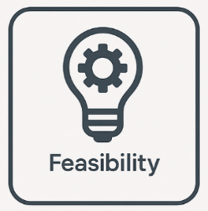
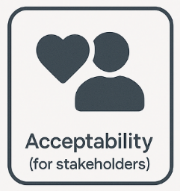
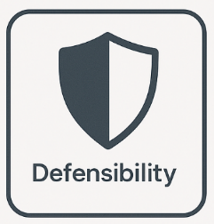
Agree| Decide on the best option(s)
Give the people responsible for implementing a strategy a voice.
Encourage diverse perspectives, but prioritize strategic clarity over consensus.
Criteria for deciding between strategic options
Helps achieve the aspiration
Aligned with vision/mission/values
Capitalize on key opportunities
Focused on attractive arenas
Based on strengths/competencies
Availability of resources (financial, HR,
time, skills, management capacity)
If not available, can the resources
be acquired (e.g. through collaboration)
Investment/returns for shareholders
Risks involved
Acceptance by other key stakeholders
Easy to protect against the competition
Robustness under different future scenarios
13
Source: The Suitability‒Acceptability‒Feasibility framework was proposed by Whittington, R., Angwin, D., Rengnér, P., Johnson, G., & Scholes, K. (2023). Exploring Strategy: Text and Cases, 13th ed. Harlow: PearsonPicture source: ChatGPT

Slide 14

Agree| Avoid thinking traps
The status quo trap
The sunk-cost trap
The overconfidence trap
The tendency to overvalue and prolong what
already exists
The tendency to continue to invest in a decision based on past invetment rather than future value
The tendency to overestimate your abilities or predictions about what your organization can achieve
Conduct a premortem
(imagine that a strategy has failed, then
work backward to identify possible reasons)
14

Slide 15
Agree| Compare investment opportunities
15

Slide 16

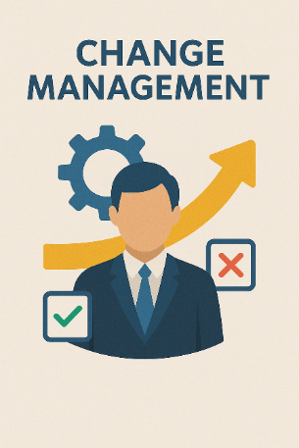
Act| Implement strategic initiatives
COORDINATION
COMMUNICATION
CHANGE MANAGEMENT
Project management
Communication plan for all major stakeholder groups
Guide and support individuals and teams through the transition
Managing tasks, resources, schedules, and risks
Securing buy-in
Managing resistance
Providing training
Communicating reasons, benefits and expected outcomes of the change
Balanced Scorecard
KPIs in four perspectives: financial, customer, internal processes, learning & growth
The OKR method
Why do we need to change?
What will change?
What will change improve?
What does it mean for us?
Agree on objectives & key results,
track process regularly,
review and reflect
16
Picture source: pixabay.com; ChatGPT

Slide 17
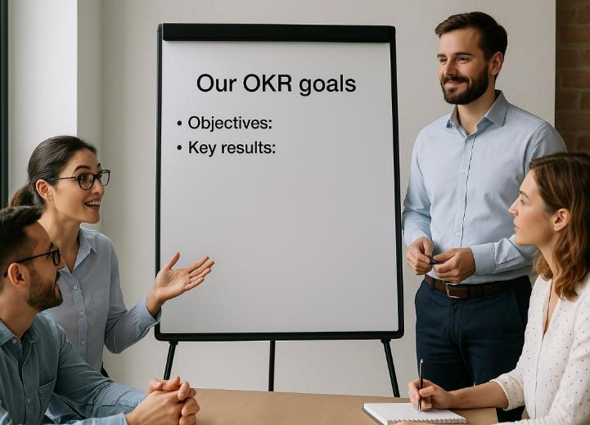
Act| The OKR method
Objective
A clearly defined, inspiring goal that sets direction and focus
e.g., "Improve customer satisfaction“
Key characteristics
Ambitious yet achievable goals
Focus on outcomes, not activities
Transparent across the organization
Reviewed regularly (usually quarterly)
Key results
3–5 measurable outcomes that track progress toward the objective
e.g., "Increase Net Promoter Score from 60 to 75 by the end of June“
Purpose: Align teams, increase accountability, and drive performance
17
Picture source: ChatGPT

Slide 18

Act| Good practices in change management
Ensure that your team and key
stakeholders recognize the
critical need for change
Secure early wins
(quick, visible successes that
help to create momentum)
Engage key stakeholders
early
Communicate,
communicate,
communicate
Involve your team members in
co-creating the future
Foster a culture of support
and collaboration
See change as an investment
Frame change as an experiment
18
Picture source: ChatGPT

Slide 19
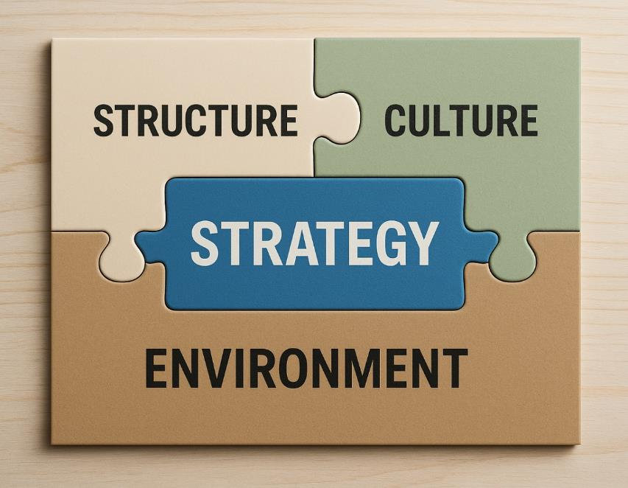
Align| … with structure, culture, the environment
Remain aligned with a changing environment: periodic “5A Quick Checks”
Does the current structure and culture foster or hinder the implementation of your strategy?
Which cultural behaviors do you need to succeed?
Clear roles and responsibilities for strategy implementation
Allocating resources, budgets, people
19
Picture source: ChatGPT

Slide 20

THANK YOU!
Picture source: ChatGPT

