Slide 1

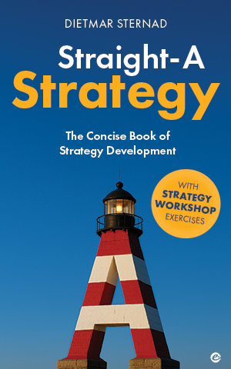
Straight-A Strategy
COMPETITIVE STRATEGY |
How to play strategic games
Picture source: unsplash.com/GR Stocks

Slide 2
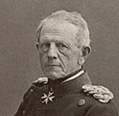
Do not underestimate the competition
‘No plan of operations reaches any certainty beyond the first
encounter with the
enemy’s main force.’
-
Field Marshal Helmuth von Moltke
2
Source: https://www.oxfordreference.com/display/10.1093/acref/9780191826719.001.0001/q-oro-ed4-00007547

Slide 3



Competitive interaction| Approaches
Analyzing competitive situations
1
2
3
Game theory
Competitive simulation
Explore options for cooperation
3
Picture source: pixabay.com

Slide 4

Competition| Competing on price
PetSmart
PetCo
ca. 1500 stores
ca. 1500 stores
In the same area:
Both high prices
High profitability for both
One lowering prices
Shift in market share, more volume, economies of scale
Both lowering prices
Low profitability for both
4
Picture source: ChatGPT

Slide 5
Competition| Competing on other factors
PetSmart
PetCo
Other competitive moves:
Increase marketing spendings
Strengthen the sales force
If competitors match it,
it could againg lead to a
decrease of profitability
Enhancing product quality
Adding new features
…
5
Picture source: ChatGPT

Slide 6


Game theory| Prisoner’s dilemma game
confess
PLAYER 2
don’t confess
confess
(-6, -6)
(0, -10)
PLAYER 1
(-10, 0)
(-3, -3)
don’t
confess
6
Picture source: pixabay.com

Slide 7

Tactics | 1 Keep a distance
PetSmart
Petco
Focus on separate niches:
Geographical location
Product & service specialization
Time of the day
…
7
Picture source: ChatGPT

Slide 8

Tactics | 2 Customer loyalty programs
Reward cumulative purchases or
offer additional benefits that might
outweigh low prices
8
Picture source: ChatGPT

Slide 9
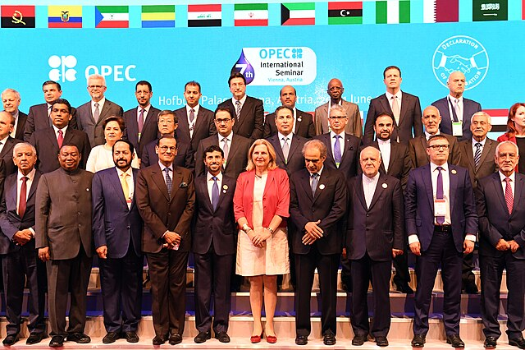
Tactics | 3 Joint output limitations
Limit the output of an industry to discourage price wars (e.g. governments auctioning off licenses in mobile telecommunication)
9
Photo source: Wikimedia Commons/Mahmoud

Slide 10
Tactics | 4 Pricing agreements
Pricing agreements that discourage discounting (e.g. most-favored nation clause, MFN – a buyer is entitled to receive the best terms, prices, or conditions that a seller offers to any other buyer)
10
Picture source: pixabay.com

Slide 11


Tactics | 5 Pricing tactics
Matching price changes immediately or automatically while at the same time signaling that you would be willing to return to higher price levels again if the competitor does the same
Consider anti-trust laws, e.g. through publicly stating that you are highly interested in the welfare of the industry as a whole is an option; announcing price increases.
11
Photo source: unsplash.com/Artem Beliaikin; unsplash.com/Tamanna Rumee

Slide 12




Tactics | 6 Selective responses
Standard
customers
Normal / high price
Very profitable repeat customers
Getting the best customers from the competition
Special offers
12
Illustration source: pixabay.com

Slide 13

Tactics | 7 Reciprocal responses
Petco
PetSmart
Cut prices in a market segment
where your competitor is large
and you are small
Imposing assymetric costs on
the competition
13

Slide 14

Tactics | 8 Explore legal options
Check if the competitor engages in unfair practices
or violates regulations → sue them
14
Picture source: pixabay.com

Slide 15

The best strategy | More than tactics
Become the most cost-efficient producer in your industry
15
Picture source: ChatGPT

Slide 16


The market entry game
A new competitor aggressively tries to enter a market
which is currently dominated by an incumbent
2 options
Accept market share loss
Fight (price, advertising …)
Ideally fight back where it
hurts the most
(their home territory)
(both options can be very costly)
16
Picture source: pixabay.com

Slide 17

Entering a competitor’s market
Try not to provoke a harsh reaction from the competitor
Choose a different niche
Open lines of communication (no intention to undermine position, contribute to overall growth …)
Step-by-step (try to stay
‘under the radar’)
Explore collaborative opportunities
Limit your capacity,
make small inroads first
(e.g. only part of the territory)
Show respect for the competitor in communication
17
Picture source: ChatGPT

Slide 18
Simulation| Analyze competitive interactions
(also known as business wargaming)
Put one part of your team into the shoes of a competitor
(consider their motives)
In several simulation rounds, analyze which impact the choices of competitors have on your business (record gains/losses for both sides)
Play in several
iterations
How would you react?
18

Slide 19
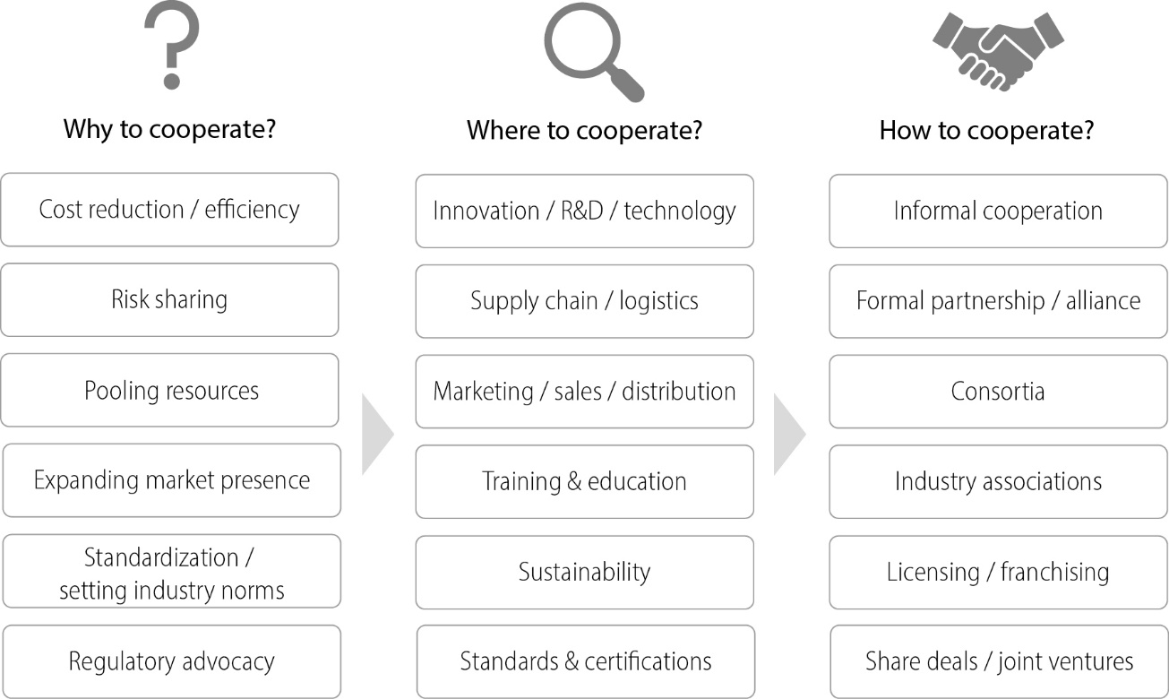
Cooperating with competitors| Options
19

Slide 20

Be prepared | Motto
‘Failure in preparation
leads to disaster on the
battlefield.’
-
The United States Marine Corps,
Warfighting (1994)
WATERLOO
Picture source: pixabay.com
20

Slide 21

Be prepared| What you should know
Understanding the competition is key!
Strategic intentions & motives
Strategic options
C O M P E T I T O R
Most likely strategic moves
Moves outside the arena in which you compete
21
Picture source: pixabay.com

Slide 22

Don’t reveal your own strategic moves
‘A good road is only a
good road as long as the
enemy does not identify it as
the most likely route.’
-
Martin Kornberger,
Systemaufbruch (2020), p. 53.
Picture source: pixabay.com
22

Slide 23

THANK YOU!
Picture source: pixabay.com

