Slide 1


Straight-A Strategy
CORPORATE STRATEGY | Managing
the multi-business enterprise
Picture source: pixabay.com

Slide 2

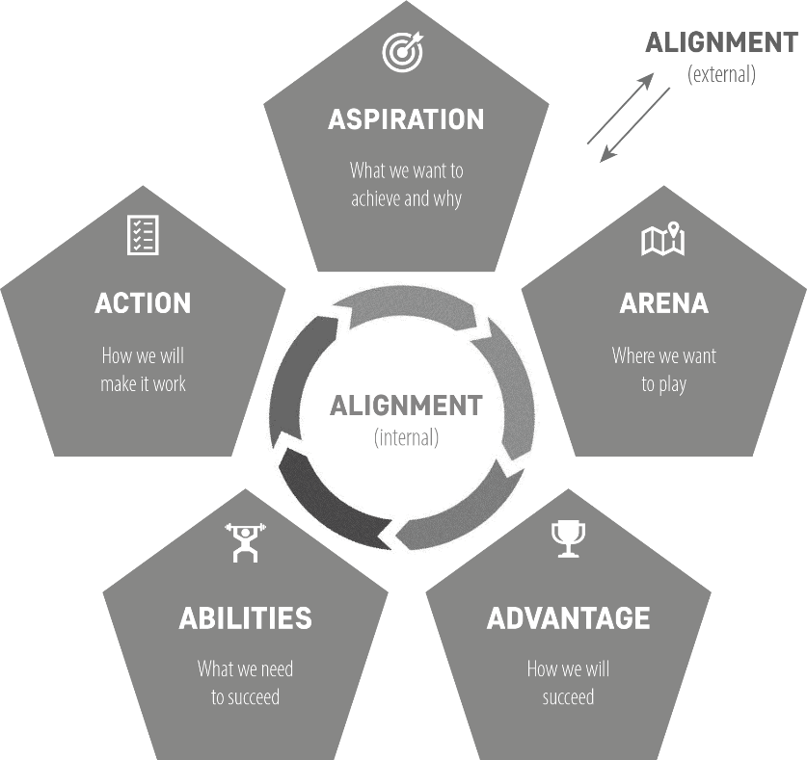
What is corporate strategy?
Setting the overall strategic direction
for a multi-business enterprise
‘5A’ decisions for the
corporation as a whole
2
Picture source: pixabay.com

Slide 3



Corporate strategy| Agenda
CORPORATE STRATEGY
1
2
3
PORTFOLIO & GROWTH STRATEGIES
CREATING AND LEVERAGING SYNERGIES
CORPORATE-LEVEL STRATEGIC INITIATIVES
3
Picture source: pixabay.com; DALL-e/ChatGPT

Slide 4




Generating shareholder value
Profitability
Profit margin / efficient asset utilization)
Revenue growth
Profitable growth
Low risk
Stabilizing earnings and protecting assets
Capital structure
Balancing debt and equity financing to minimize the
cost of capital while supporting growth and
maintaining financial flexibility
4

Slide 5
Portfolio strategy| What is it?
Portfolio strategy refers to the management and optimization of a company’s collection of business units to achieve its overall strategic aspiration
It involves decisions about which businesses (or assets) to invest in, divest from, or maintain
Goal: to maximize the company’s long-term profitability, growth, and competitive advantage at an acceptable level of risk
5

Slide 6

Business unit| Definition
A business unit is a self-contained division within a larger organization, functioning more or less independently with its own goals, strategies, and management. These units are often created to manage specific products, services, or functions, catering to distinct markets or customer segments.
DEFINITION
Business unit
MEDTECH
Business unit
PHARMACEUTICALS
Business unit
VISION
Surgery
Orthopaedics
Medical devices
Vaccines
Oncology
Cardiovascular
…
Contact lenses / vision care
Surgical vision
6
Source: https://jnj.co.uk/our-business

Slide 7
Portfolio | The BCG Matrix
50%
Lifecycle
‘Norm strategies’
Question marks
Stars
10%
Market growth
Dogs
Cash cows
0
0
0,1x
1x
4x
10x
Relative competitive position
7

Slide 8
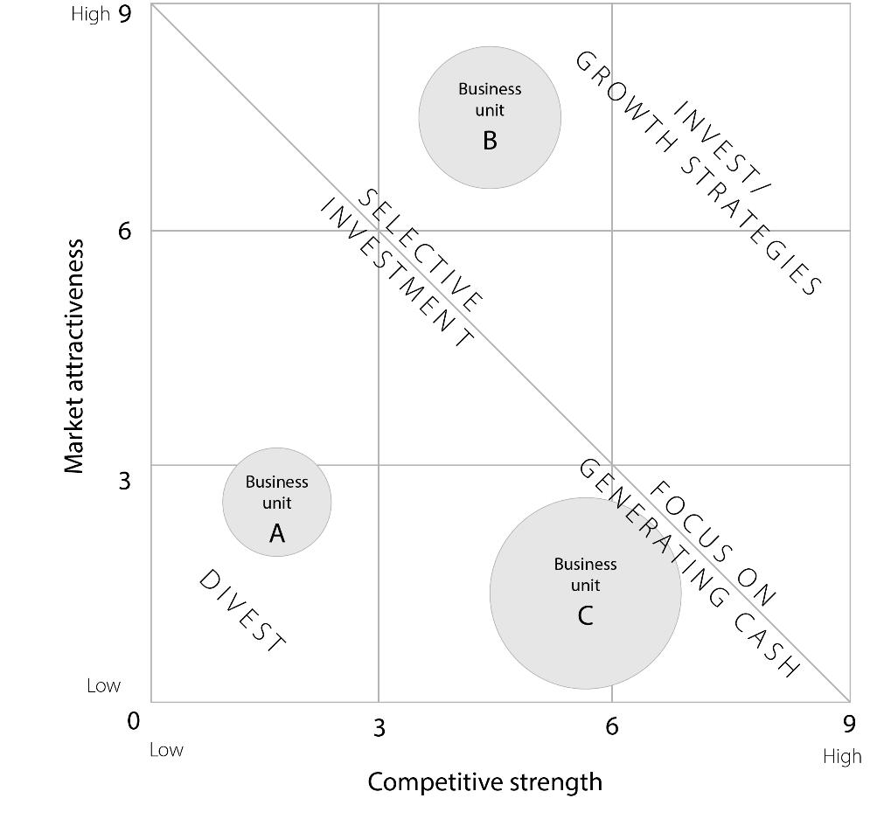
Portfolio| The GE-McKinsey Matrix
Basis for strategic discussion
(rather than ‘exact results’)
8

Slide 9
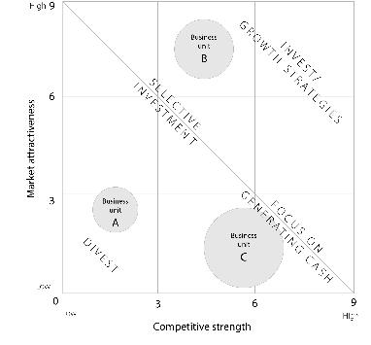
GE-McKinsey Portfolio|Base data
Market attractiveness
Competitive strength
Business unit:
Nr. | Criteria for assessing market attractiveness | Weight of the criteria (in %) | Attractiveness score (from 1=low to 9=high) | Remarks
1 | Market size | 10%
2 | Long-run market growth rate | 20%
3 | Average profitability | 20%
4 | Competitive situation | 10%
5 | Supply chain resilience | 10%
6 | Customer behavior | 10%
7 | Barriers to entry | 10%
8 | Threat of substitution | 5%
9 | Regulatory environment | 5%
 | Overall market attractiveness | 100%
Business unit:
Nr. | Criteria for assessing competitive strength | Weight of the criteria (in %) | Competitive strength score (from 1=weak to 9=strong) | Remarks
1 | Relative market share | 20%
2 | Financial performance | 20%
3 | Relative cost structure | 20%
4 | Relative quality | 10%
5 | Brand strength | 10%
6 | Technology | 5%
7 | Management expertise | 5%
8 | Customer access | 5%
9 | Innovation power | 5%
 | Overall competitive strength | 100%
9

Slide 10
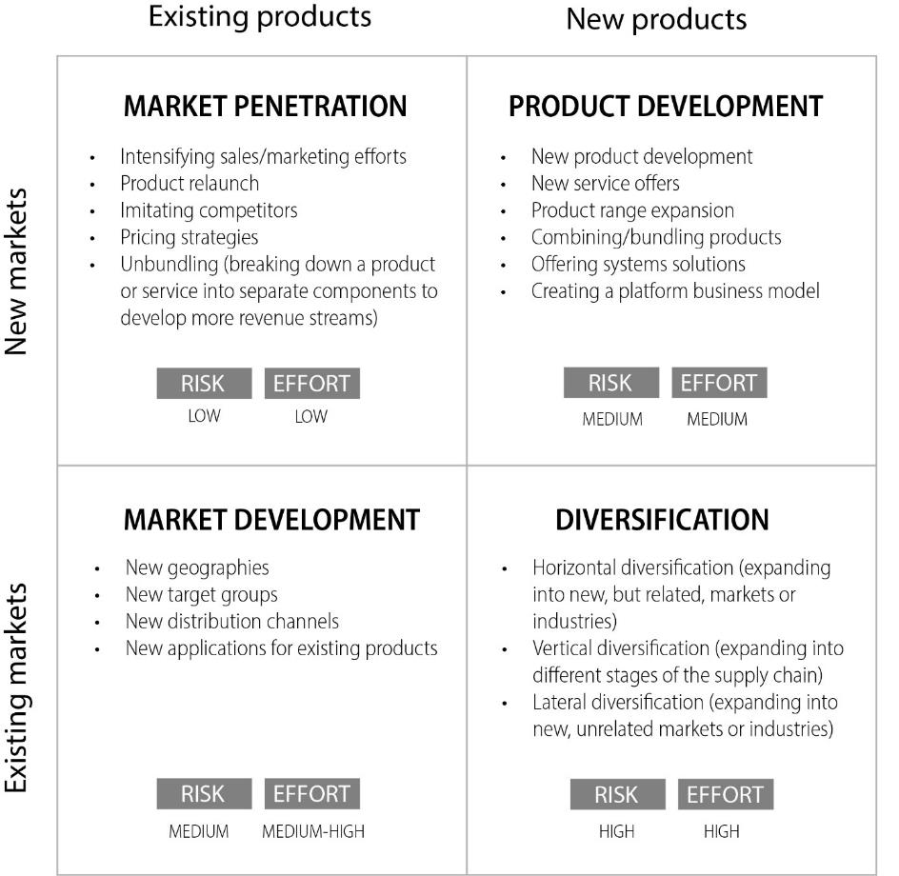
Growth grid| The Ansoff Matrix
Existing markets
New markets
10

Slide 11



Growth strategies| Methods to pursue them
Organic growth
Mergers &
acquisitions (M&A)
Strategic
partnerships
11
Picture source: pixabay.com

Slide 12

Synergy| Definition
Synergy occurs when two or more parts of an organization combine forces—for example, by sharing resources, or aligning their activities or positions—in a way that allows them to create more value than they could independently
DEFINITION
12
Picture source: DALL-e/ChatGPT

Slide 13




Corporate synergies| Categories
Operational synergies
Financial synergies
Strategic synergies
Economies of scale
(e.g., purchasing, production)
Risk diversification
Joint R&D, product development
Shared functions / services
Access to capital (size, reputation)
Using brand power
Shared expertise
Tax advantages
Joint positioning
Cross-selling opportunities
Liquidity management
Local expertise /
geographical expansion
Beware of coordination costs and over-optimism
13

Slide 14
Example| Salesforce acquires Slack
Developing more competitive products
Workplace communication features of Slack can be integrated into the Salesforce platform. This integration promised to foster a more interconnected and flexible workspace.
Cross-selling opportunity
Slack has a wide enterprise customer base.
Strategic positioning
Similar cross-selling strategy employed by Microsoft’s use of MS Teams to drive growth across its product suite.
14

Slide 15

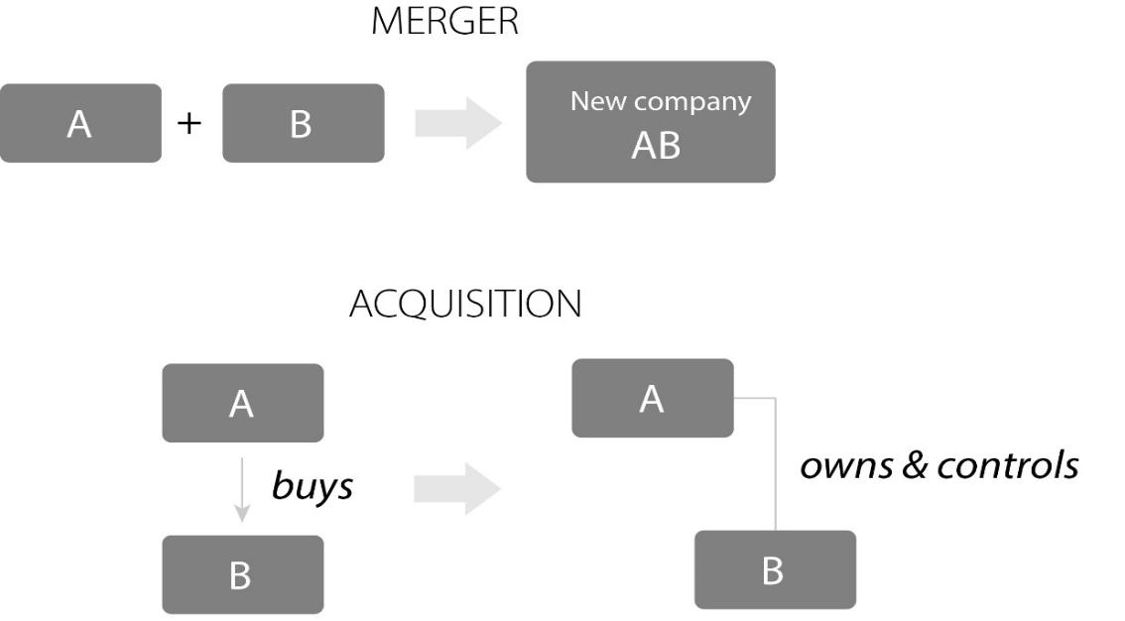
Mergers & acquisitions| (M&A)
Mergers and acquisitions involve the consolidation
of companies through financial transactions
15
Picture source: pixabay.com

Slide 16
M&A| Types of acquisitions
Type of transaction
Friendly of hostile?
Type of combination
Cash payment
Friendly takeover
Horizontal acquisition
Share deal
Hostile takeover
Vertical acquisition
Shares in the acquiring
company
Congeneric acquisition
Conglomerate acquisition
Tender offer
(public offer to shareholders
at a premium price)
Proxy fight
(persuading shareholders
to vote for a new board
of directors)
16

Slide 17

Mergers & acquisitions| The M&A process
1
M&A strategy development
2
Target identification
3
Initial content & information exchange
4
Valuation analysis and indicative offer
5
Due diligence
Consider
regulatory
Issues!
6
Negotiations and deal closure
7
Post-merger integration
17
Picture source: unsplash.com/Max Harlynking

Slide 18
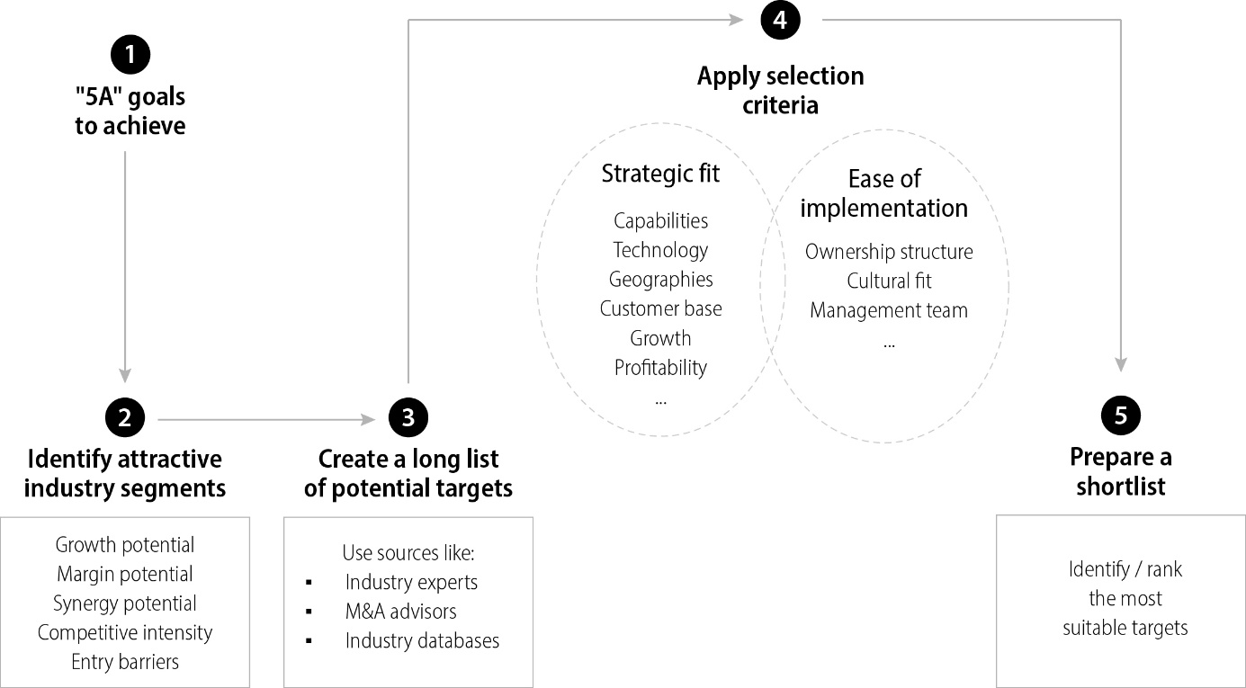
M&A| The target identification process
18

Slide 19
M&A| Valuation methods for M&A deals
Discounted cash flow
(DCF) method
Replacement cost valuation method
Current earnings
power value method
Price-to-Earnings
(P/E) valuation method
Estimate future cash flows
Apply an appropriate discount rate that reflects the cost of capital
Calculate the net present value of the projected cash flows by discounting them back to their current value, adding a terminal value for cash flows beyond the projection period
Cost of reproducing a company’s assets and operations from scratch at current market prices for the assets
Assume the same level
of earnings in the future
(without growth and cyclical
variation)
Current price per share divided by the most recent earnings per share (EPS) – compare with other P/E ratios in the industry
19

Slide 20



M&A| Attention!
Lots of mergers and acquisitions fail!
Poor strategic alignment
Integration challenges
Lack of synergies
No shared goals
Financial issues
(overvaluation, excessive debts)
20
Picture source: DALL-E/ChatGPT

Slide 21

Other forms of strategic collaboration
Venture capital
investment activities
(International)
Joint ventures
Strategic
partnerships
Investing in start-ups
Two or more parties jointly own a company
Combining strengths, sharing risks and resources, accessing new markets or technologies
(in some regions local
partners are mandatory)
Collaborative agreements between independent entities
Early access to innovative technologies, products, people, and business models that have the potential to change or disrupt their industry
Sharing resources such as technology, distribution channels, manufacturing capabilities, or marketing efforts to pursue mutual goals
Licensing agreements
Align goals & cultures
Clear governance
21
Picture source: DALL-E/ChatGPT

Slide 22
THANK YOU!
Picture source: pixabay.com

