Slide 1
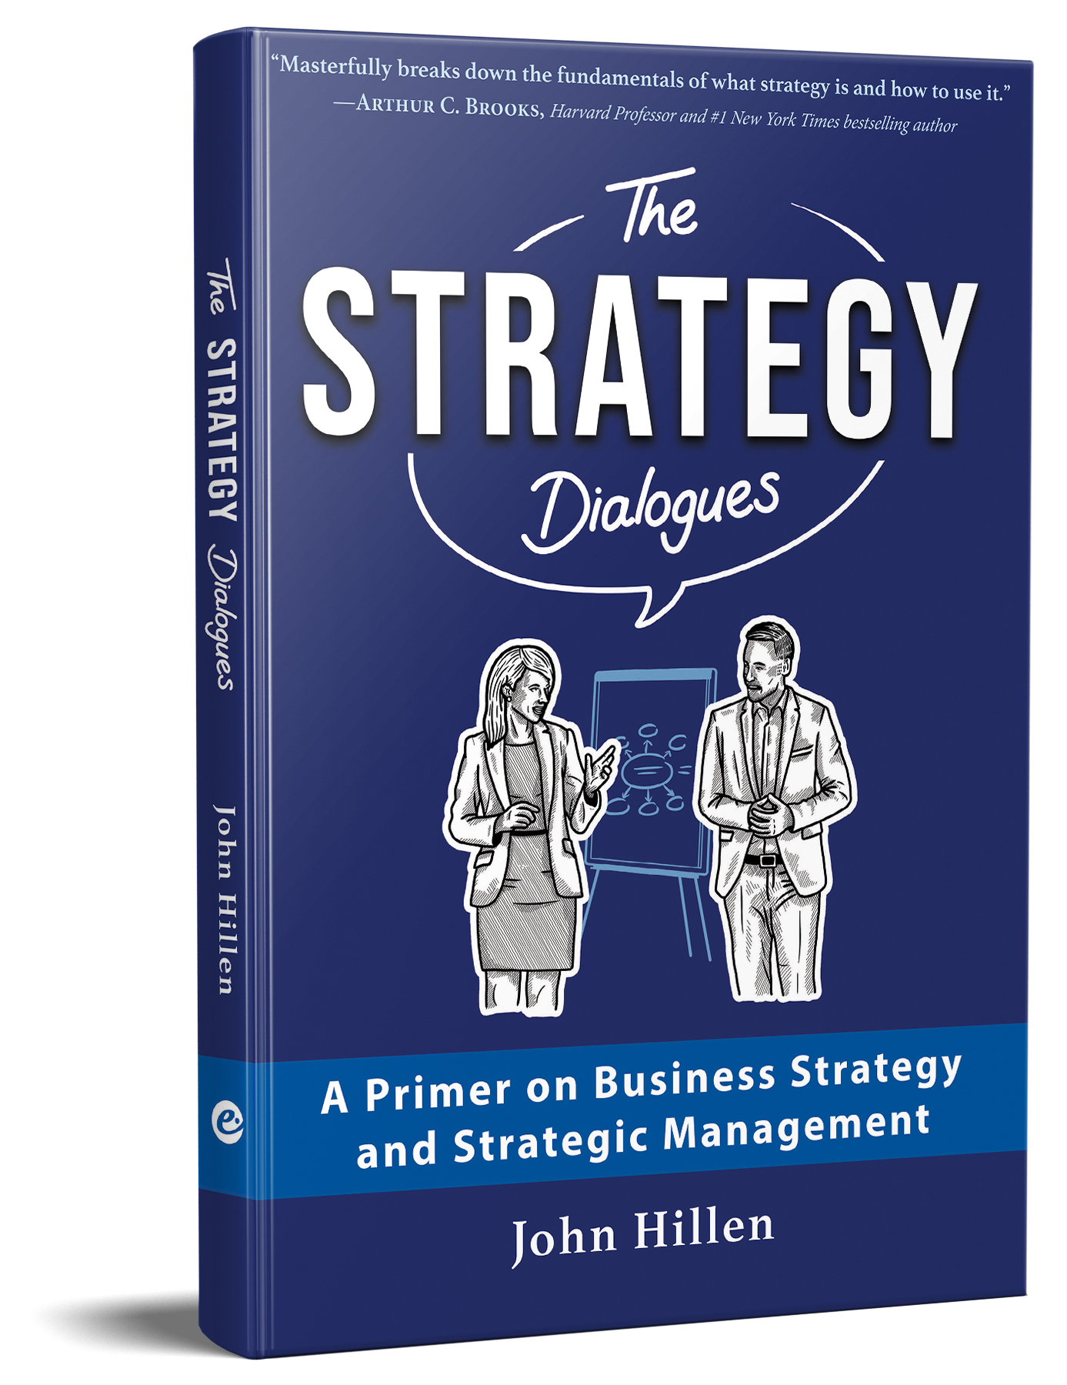
The Strategy Dialogues: A Primer on Business Strategy and Strategic Management
by Dr John Hillen
Slides for strategy courses
Source: Hillen, J. (2025). The Strategy Dialogues: A Primer on Business Strategy and Strategic Management. Moosburg: econcise.
llustrations by Amber Anderson. © 2025 econcise GmbH. For educational use only. Do not copy or post.
1

Slide 2
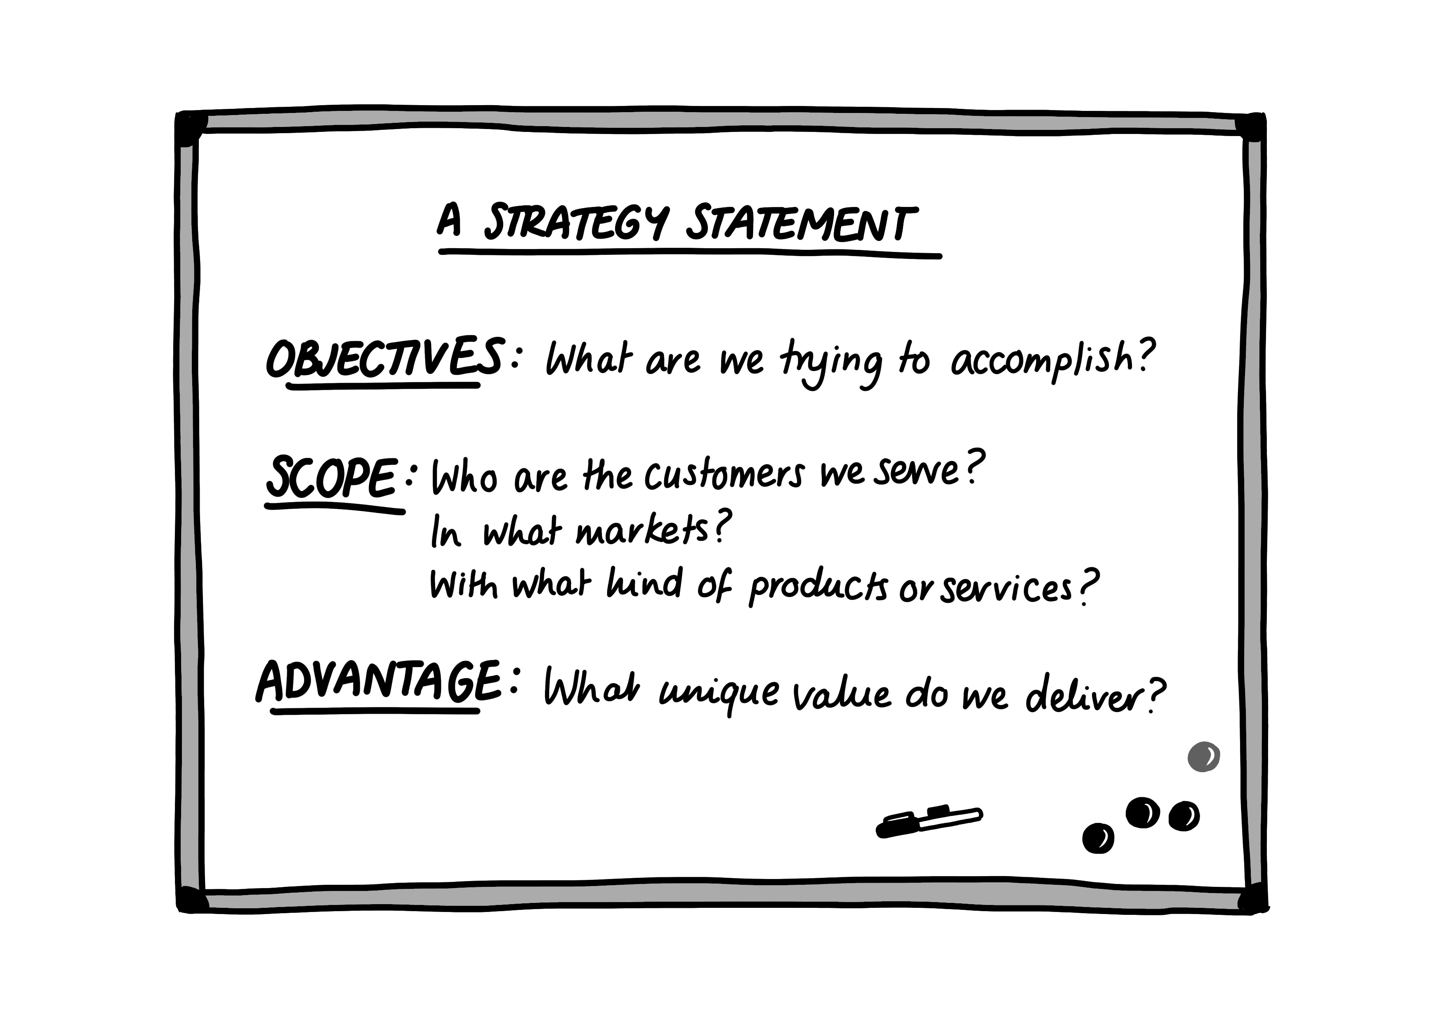
A strategy statement
Source: Hillen, J. (2025). The Strategy Dialogues: A Primer on Business Strategy and Strategic Management. Moosburg: econcise, p. 14. © 2025 econcise GmbH. For educational use only. Do not copy or post.
2

Slide 3
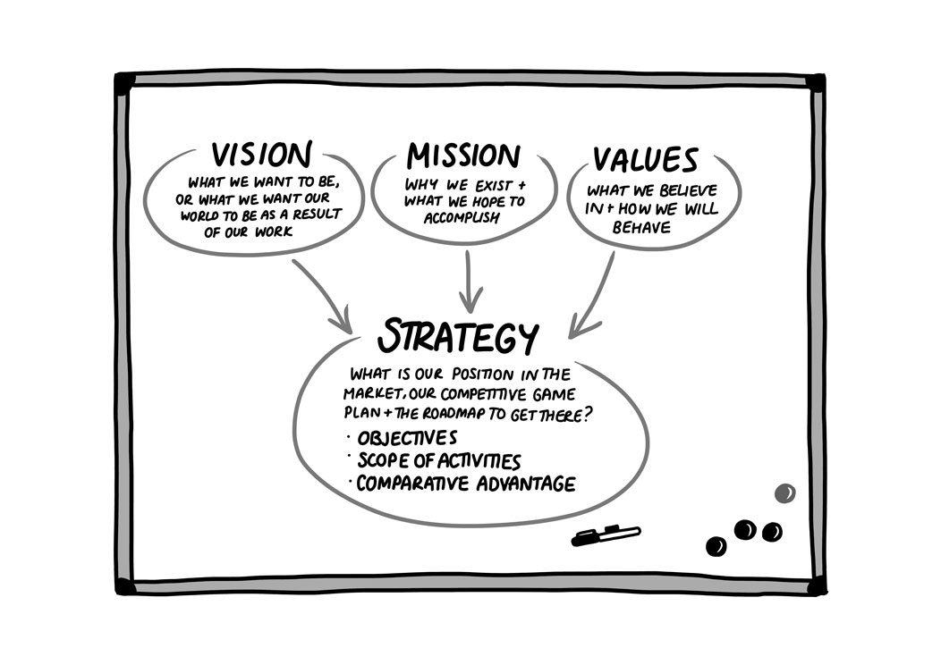
Vision, mission, values & strategy
Source: Hillen, J. (2025). The Strategy Dialogues: A Primer on Business Strategy and Strategic Management. Moosburg: econcise, p. 17. © 2025 econcise GmbH. For educational use only. Do not copy or post.
3

Slide 4
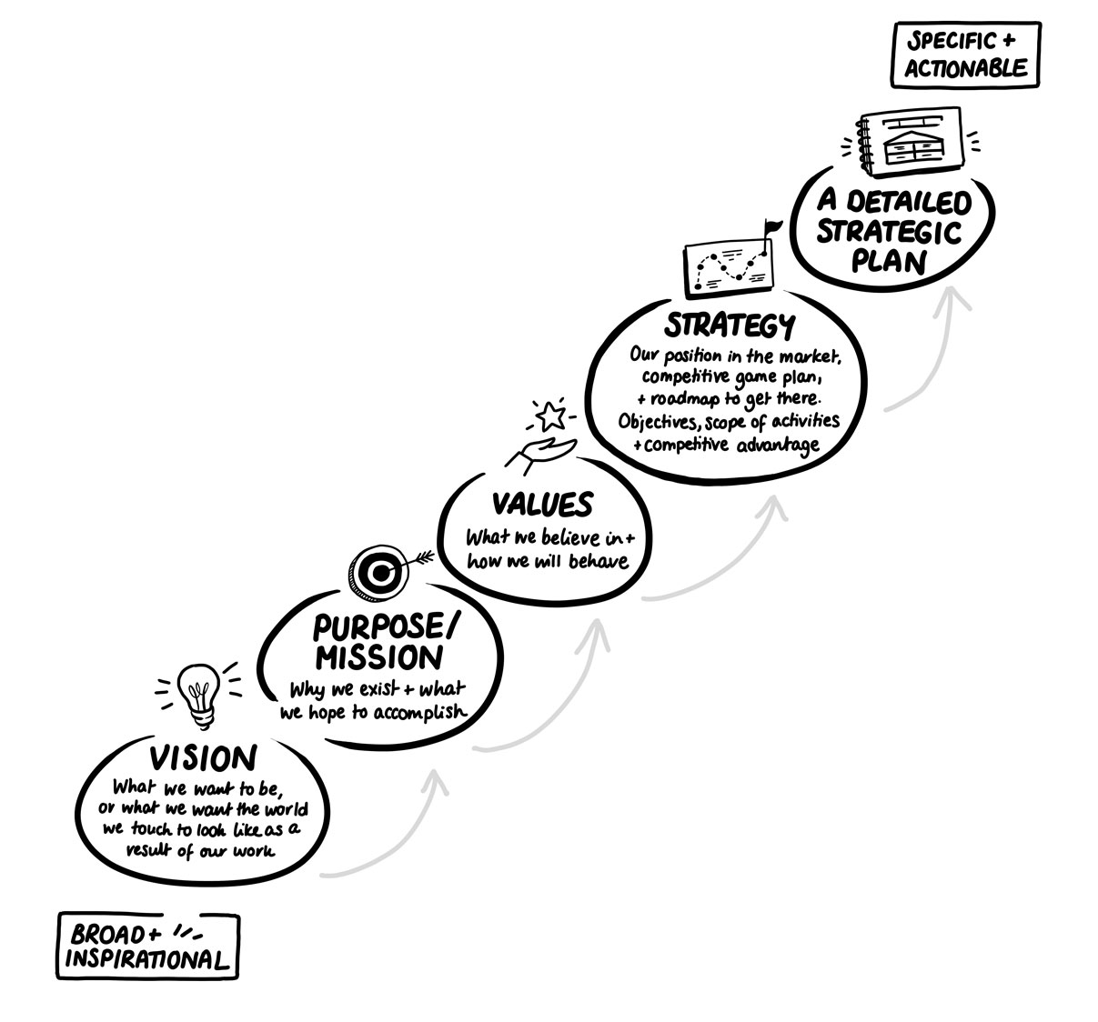
The hierarchy of elements shaping and informing a strategy
Source: Hillen, J. (2025). The Strategy Dialogues: A Primer on Business Strategy and Strategic Management. Moosburg: econcise, p. 18. © 2025 econcise GmbH. For educational use only. Do not copy or post.
4

Slide 5
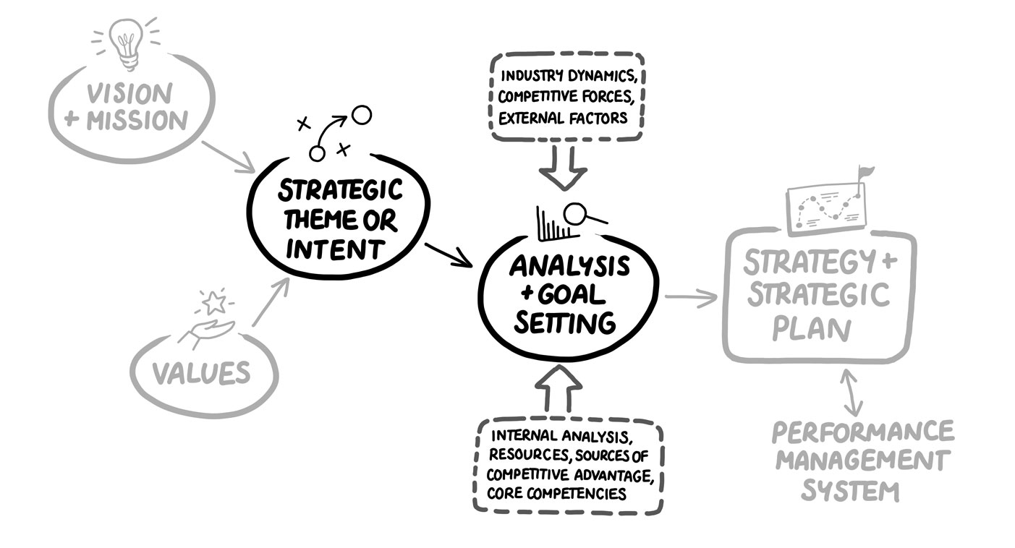
How the strategy pieces fit together
Source: Hillen, J. (2025). The Strategy Dialogues: A Primer on Business Strategy and Strategic Management. Moosburg: econcise, p. 22. © 2025 econcise GmbH. For educational use only. Do not copy or post.
5

Slide 6
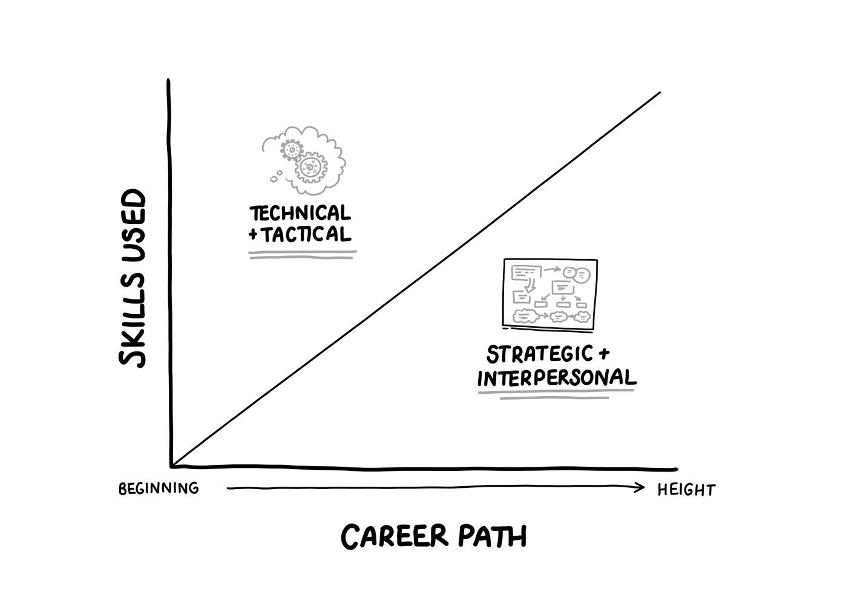
Why having a strategic mindset is necessary for executive development
Source: Hillen, J. (2025). The Strategy Dialogues: A Primer on Business Strategy and Strategic Management. Moosburg: econcise, p. 37. © 2025 econcise GmbH. For educational use only. Do not copy or post.
6

Slide 7
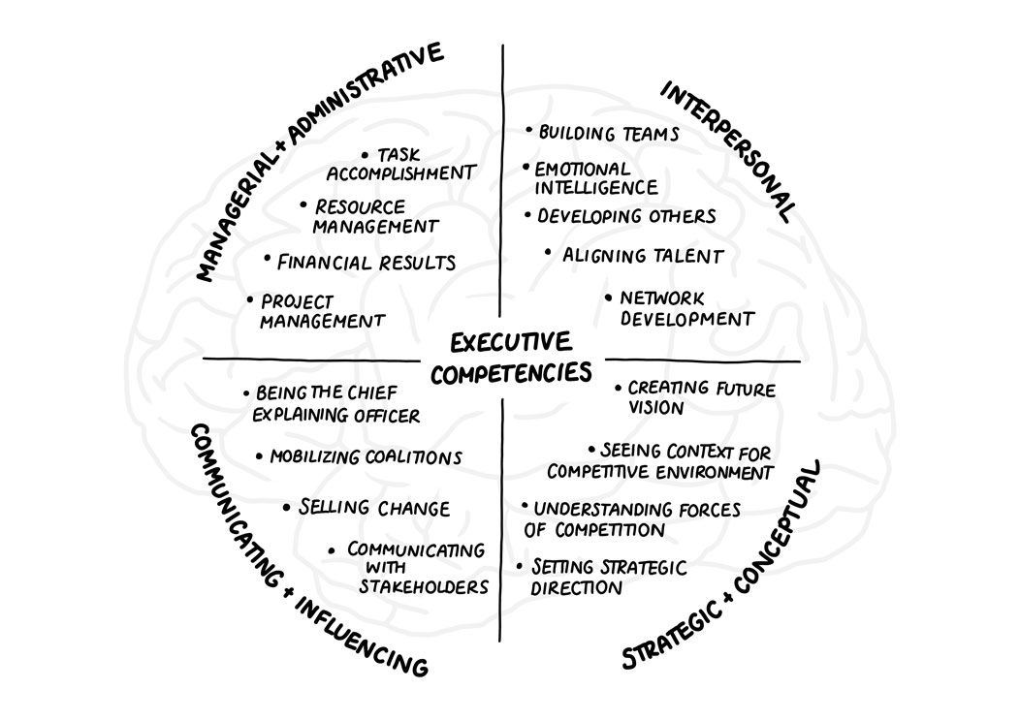
The four categories of executive competencies
Source: Hillen, J. (2025). The Strategy Dialogues: A Primer on Business Strategy and Strategic Management. Moosburg: econcise, p. 38. © 2025 econcise GmbH. For educational use only. Do not copy or post.
7

Slide 8
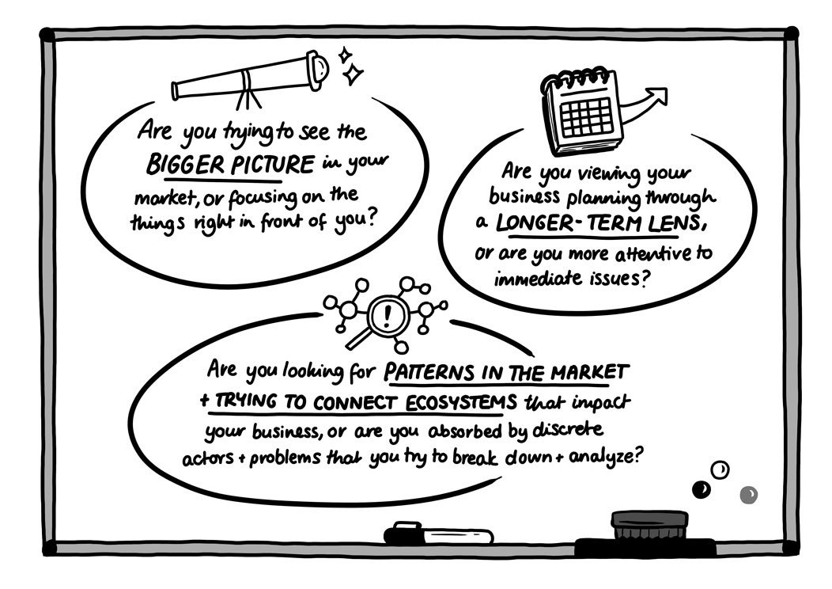
Key criteria for thinking strategically
Source: Hillen, J. (2025). The Strategy Dialogues: A Primer on Business Strategy and Strategic Management. Moosburg: econcise, p. 39. © 2025 econcise GmbH. For educational use only. Do not copy or post.
8

Slide 9
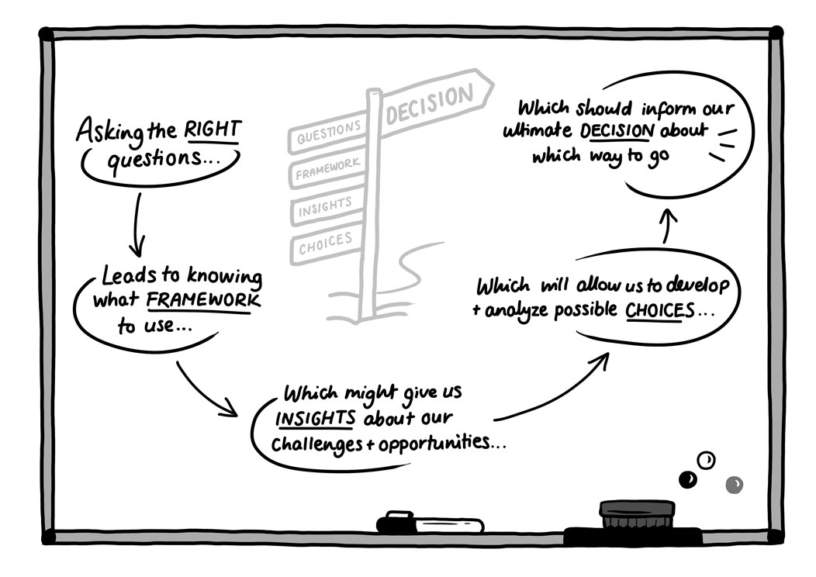
Stategic decision making
Source: Hillen, J. (2025). The Strategy Dialogues: A Primer on Business Strategy and Strategic Management. Moosburg: econcise, p. 46. © 2025 econcise GmbH. For educational use only. Do not copy or post.
9

Slide 10
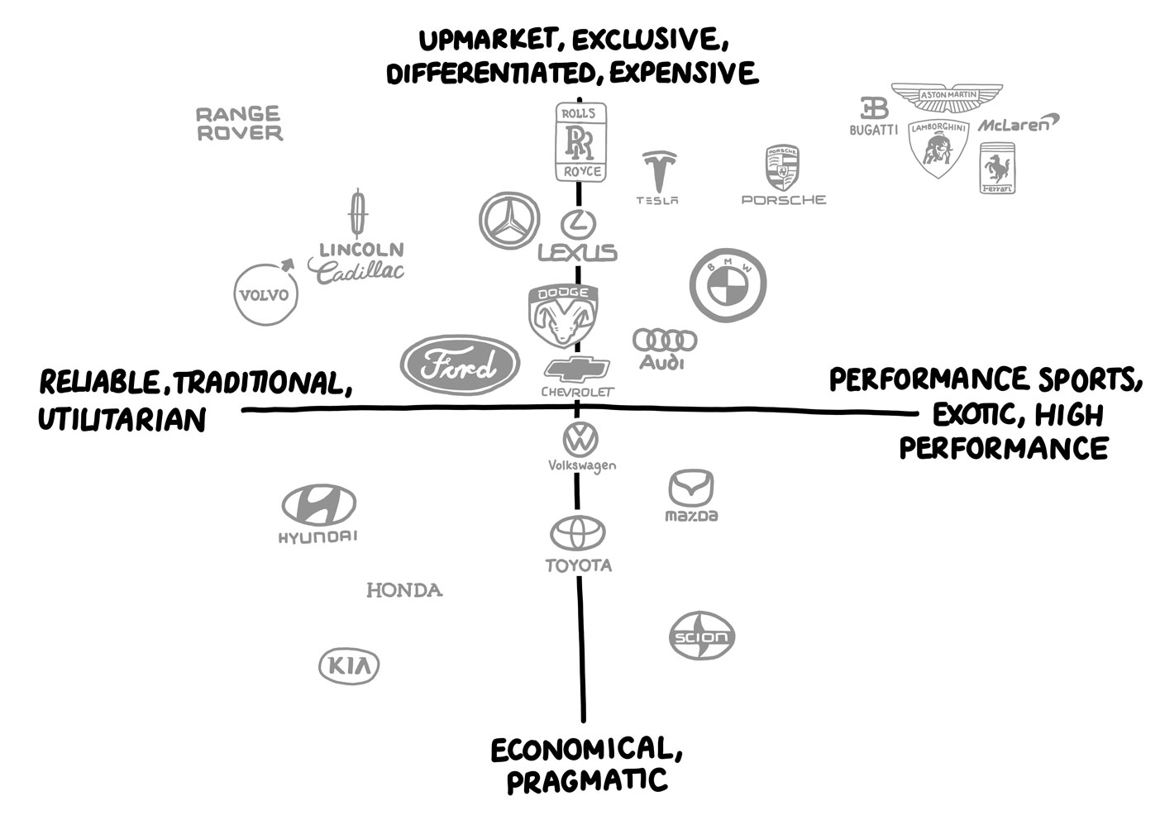
Example of a strategic positioning map
Source: Hillen, J. (2025). The Strategy Dialogues: A Primer on Business Strategy and Strategic Management. Moosburg: econcise, p. 58. © 2025 econcise GmbH. For educational use only. Do not copy or post.
10

Slide 11
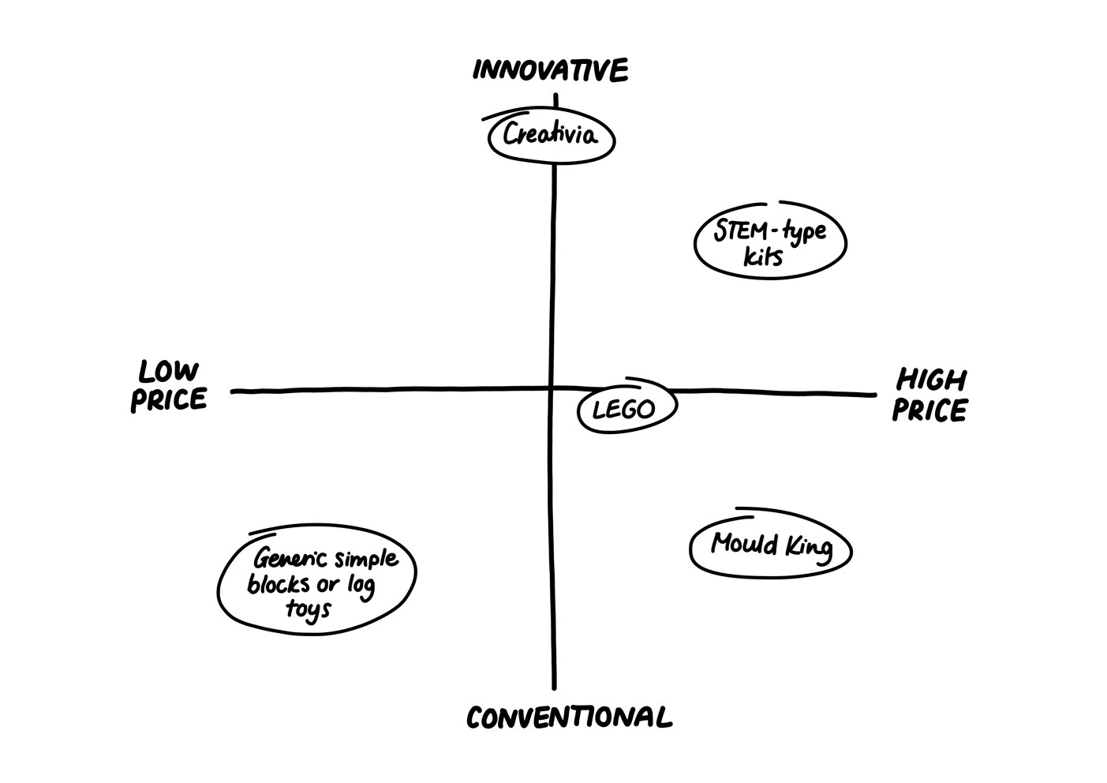
A competitive landscape map for playsets
Source: Hillen, J. (2025). The Strategy Dialogues: A Primer on Business Strategy and Strategic Management. Moosburg: econcise, p. 59. © 2025 econcise GmbH. For educational use only. Do not copy or post.
11

Slide 12
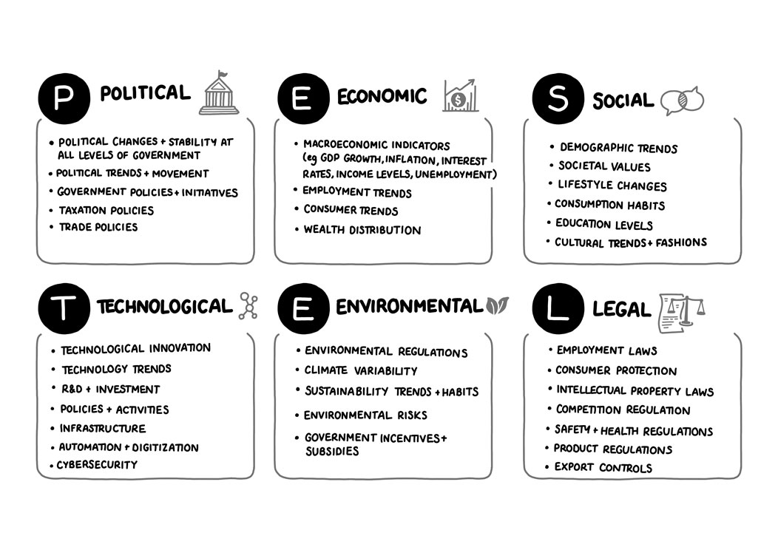
The PESTEL framework
Source: Hillen, J. (2025). The Strategy Dialogues: A Primer on Business Strategy and Strategic Management. Moosburg: econcise, p. 61. © 2025 econcise GmbH. For educational use only. Do not copy or post.
12

Slide 13
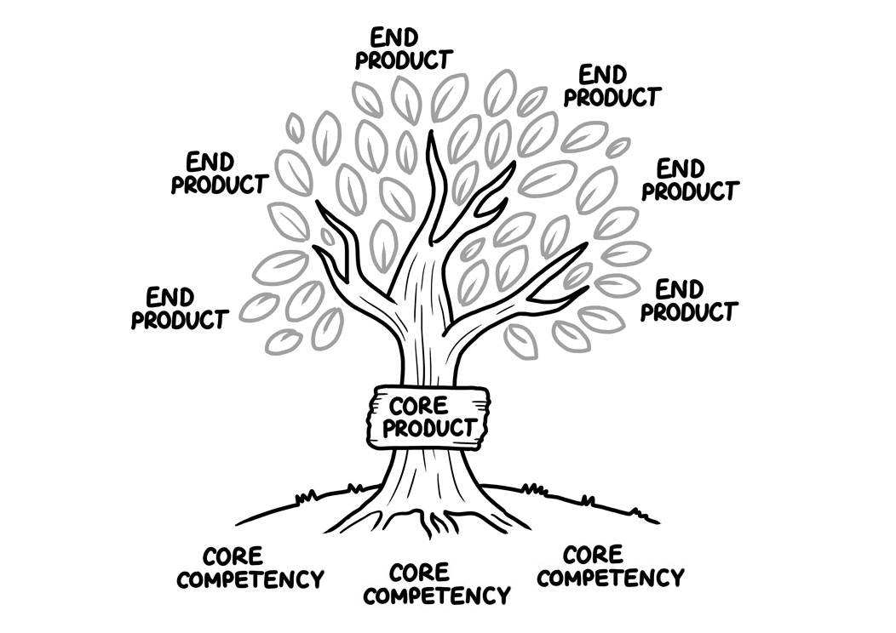
Core competencies are the roots of a firm’s activities and advantage
Source: Hillen, J. (2025). The Strategy Dialogues: A Primer on Business Strategy and Strategic Management. Moosburg: econcise, p. 77. © 2025 econcise GmbH. For educational use only. Do not copy or post.
13

Slide 14
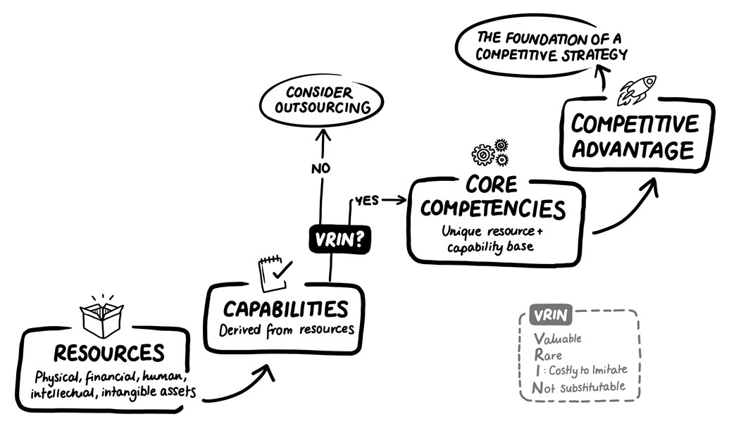
The Core Competencies framework
Source: Hillen, J. (2025). The Strategy Dialogues: A Primer on Business Strategy and Strategic Management. Moosburg: econcise, p. 81. © 2025 econcise GmbH. For educational use only. Do not copy or post.
14

Slide 15
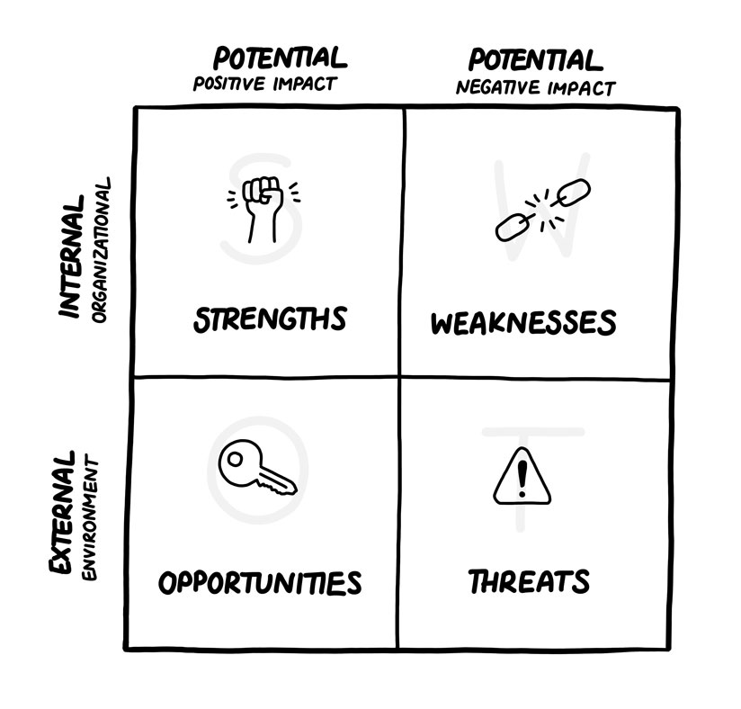
The SWOT analysis
Source: Hillen, J. (2025). The Strategy Dialogues: A Primer on Business Strategy and Strategic Management. Moosburg: econcise, p. 84. © 2025 econcise GmbH. For educational use only. Do not copy or post.
15

Slide 16
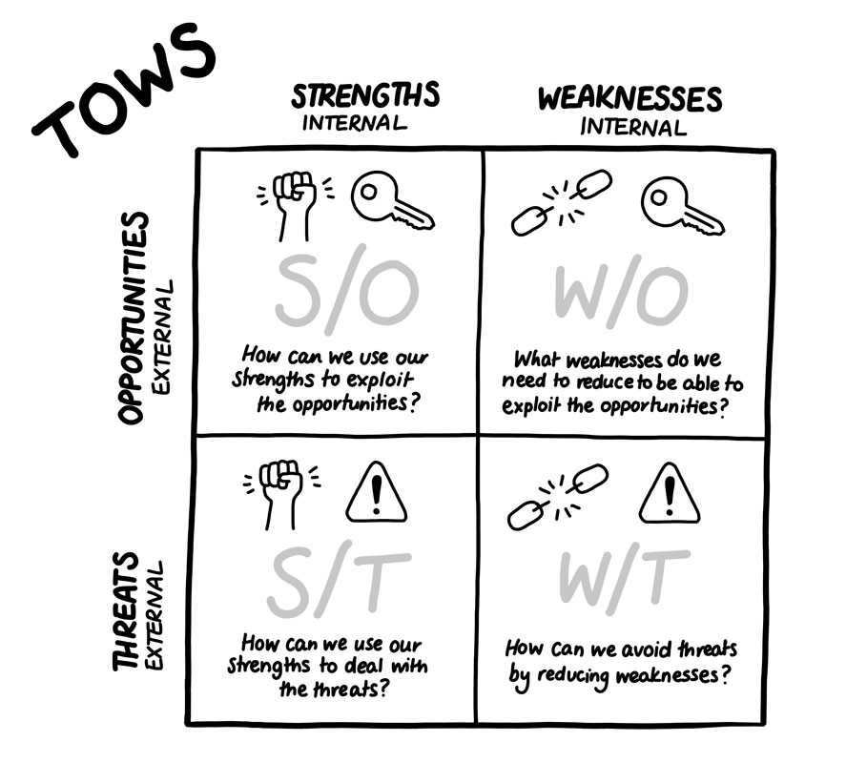
The TOWS framework for different strategies
Source: Hillen, J. (2025). The Strategy Dialogues: A Primer on Business Strategy and Strategic Management. Moosburg: econcise, p. 86. © 2025 econcise GmbH. For educational use only. Do not copy or post.
16

Slide 17
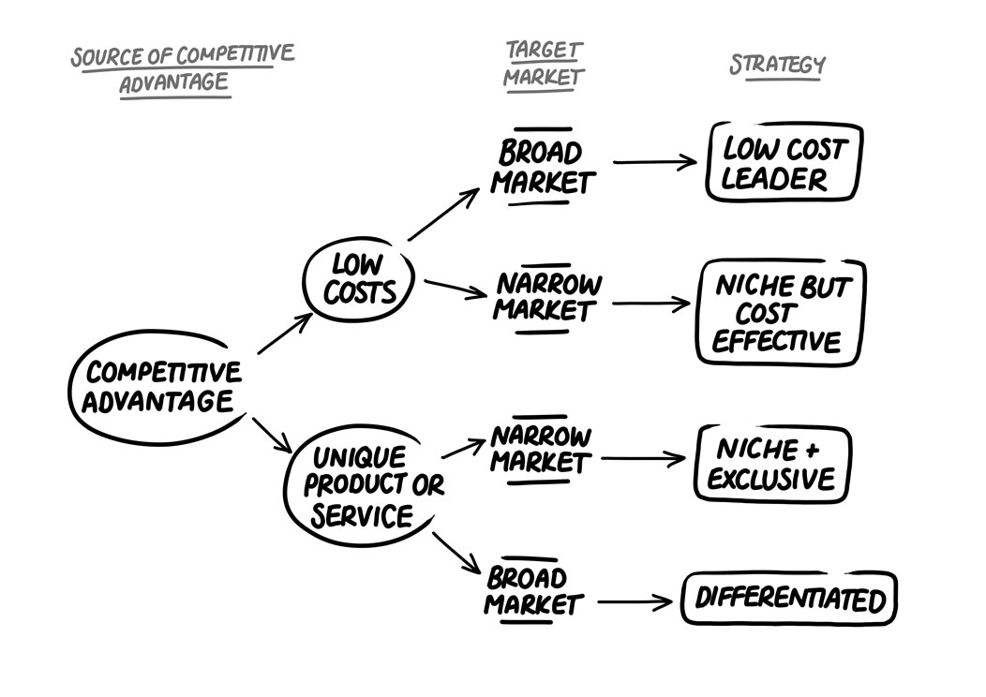
A Generic Strategies framework
Source: Hillen, J. (2025). The Strategy Dialogues: A Primer on Business Strategy and Strategic Management. Moosburg: econcise, p. 88. © 2025 econcise GmbH. For educational use only. Do not copy or post.
17

Slide 18
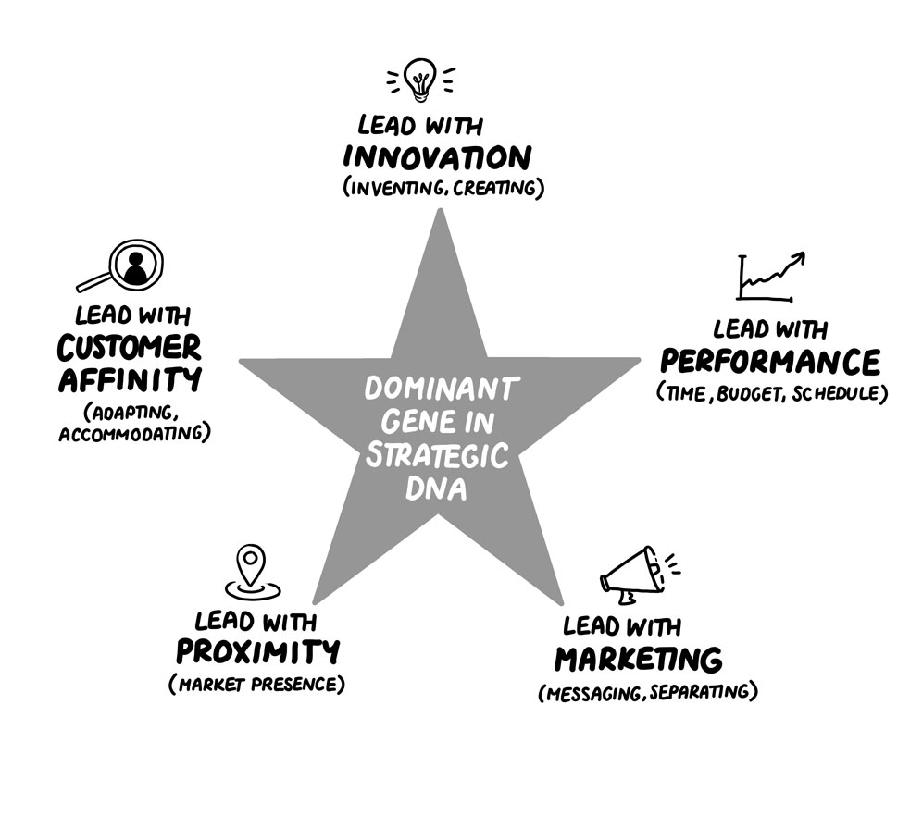
The dominant gene in an enterprise’s DNA
Source: Hillen, J. (2025). The Strategy Dialogues: A Primer on Business Strategy and Strategic Management. Moosburg: econcise, p. 90. © 2025 econcise GmbH. For educational use only. Do not copy or post.
18

Slide 19
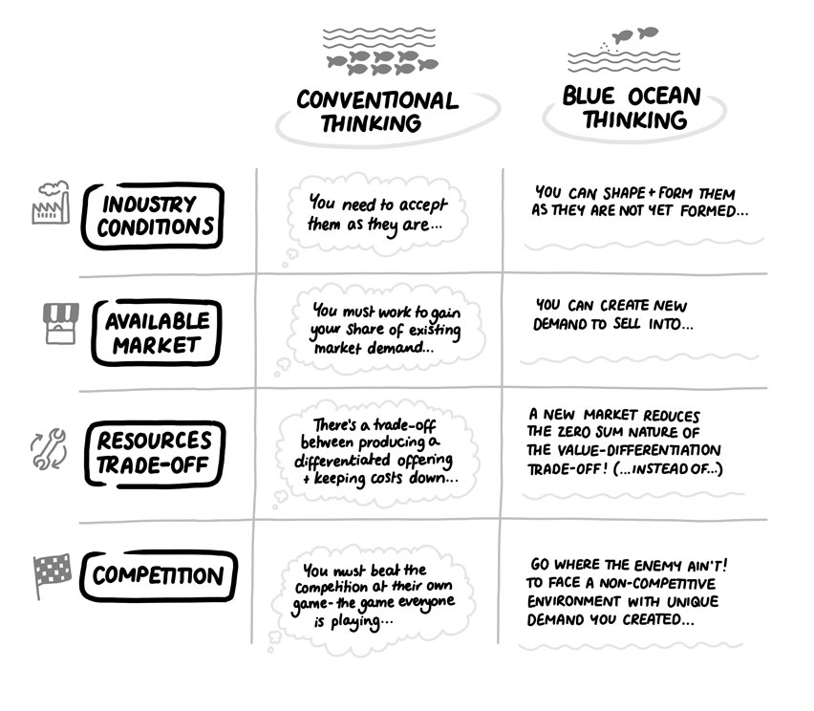
The Blue Ocean framework
Source: Hillen, J. (2025). The Strategy Dialogues: A Primer on Business Strategy and Strategic Management. Moosburg: econcise, p. 109. © 2025 econcise GmbH. For educational use only. Do not copy or post.
19

Slide 20
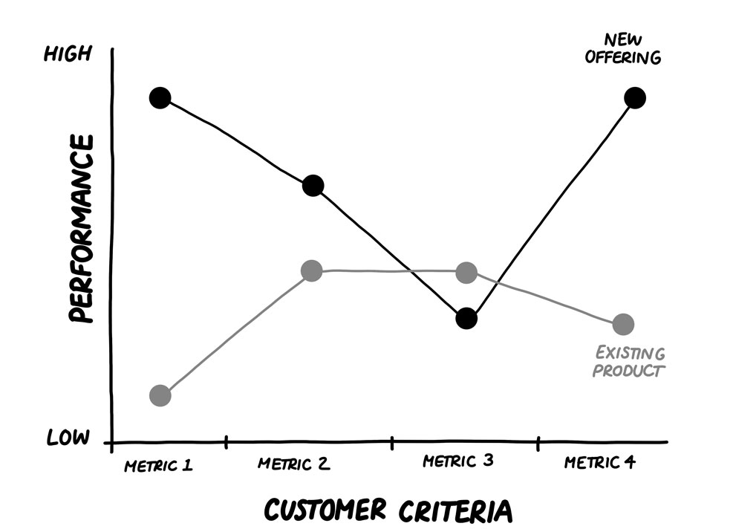
The generic Strategy Canvas framework
Source: Hillen, J. (2025). The Strategy Dialogues: A Primer on Business Strategy and Strategic Management. Moosburg: econcise, p. 111. © 2025 econcise GmbH. For educational use only. Do not copy or post.
20

Slide 21
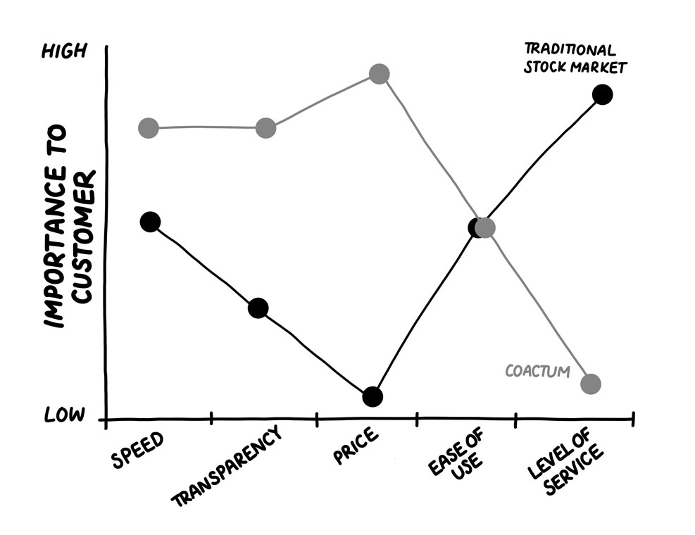
The Coactum Technologies Strategy Canvas framework
Source: Hillen, J. (2025). The Strategy Dialogues: A Primer on Business Strategy and Strategic Management. Moosburg: econcise, p. 112. © 2025 econcise GmbH. For educational use only. Do not copy or post.
21

Slide 22
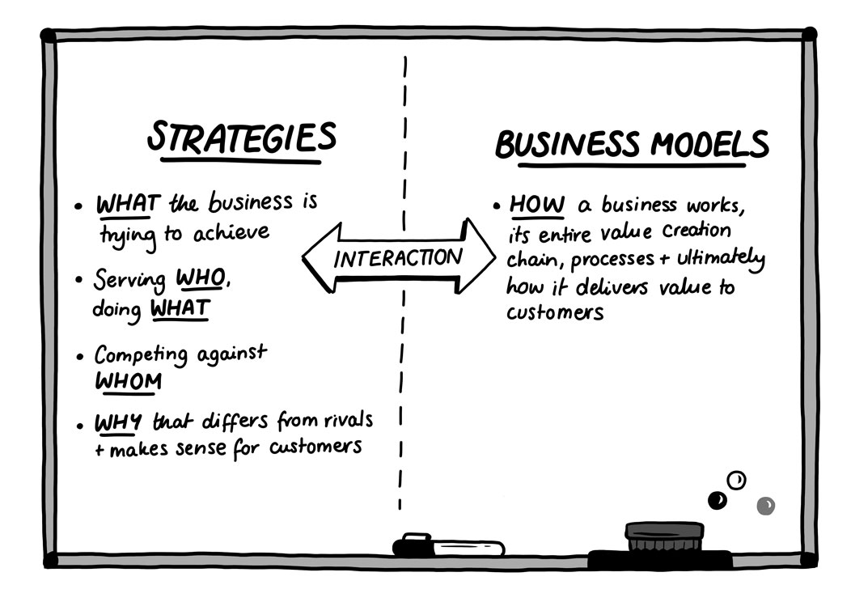
Strategies vs. business models
Source: Hillen, J. (2025). The Strategy Dialogues: A Primer on Business Strategy and Strategic Management. Moosburg: econcise, p. 128. © 2025 econcise GmbH. For educational use only. Do not copy or post.
22

Slide 23
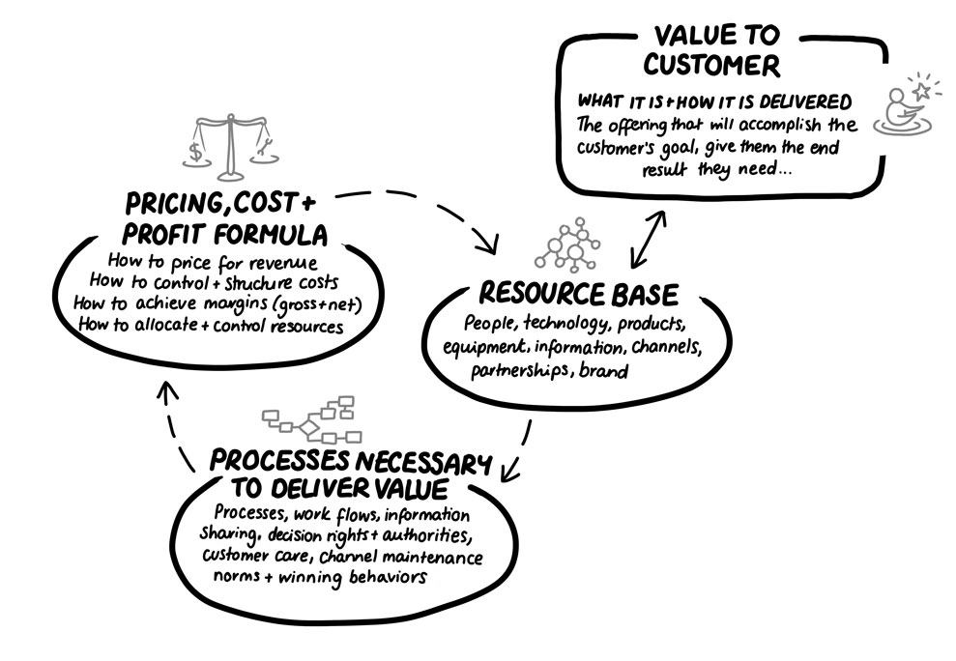
Designing Your Business Model framework
Source: Hillen, J. (2025). The Strategy Dialogues: A Primer on Business Strategy and Strategic Management. Moosburg: econcise, p. 133. © 2025 econcise GmbH. For educational use only. Do not copy or post.
23

Slide 24
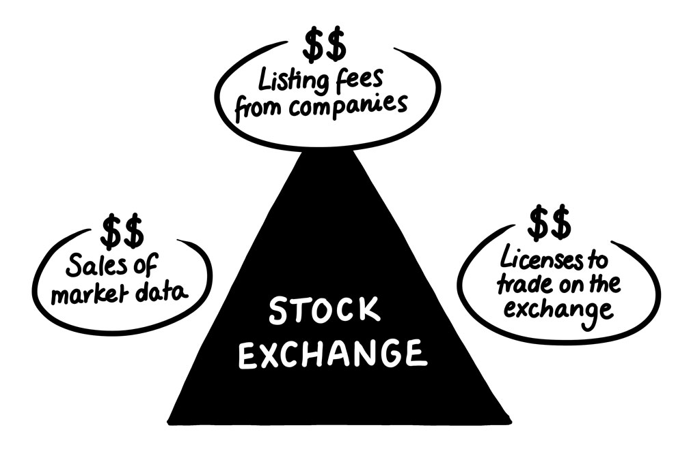
Stock-exchange revenue streams
Source: Hillen, J. (2025). The Strategy Dialogues: A Primer on Business Strategy and Strategic Management. Moosburg: econcise, p. 134. © 2025 econcise GmbH. For educational use only. Do not copy or post.
24

Slide 25
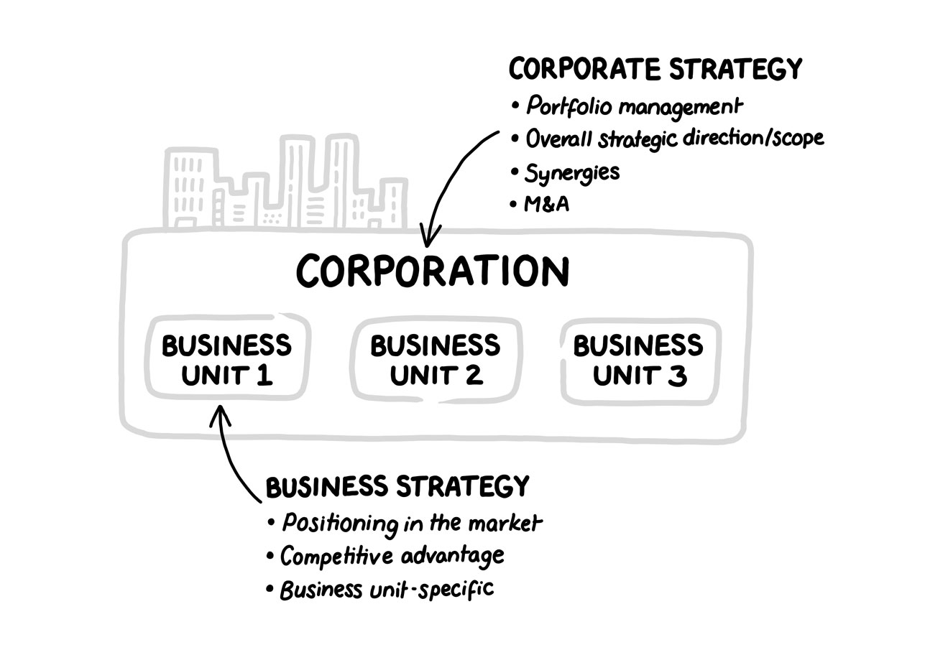
Corporate vs. business strategy
Source: Hillen, J. (2025). The Strategy Dialogues: A Primer on Business Strategy and Strategic Management. Moosburg: econcise, p. 151. © 2025 econcise GmbH. For educational use only. Do not copy or post.
25

Slide 26
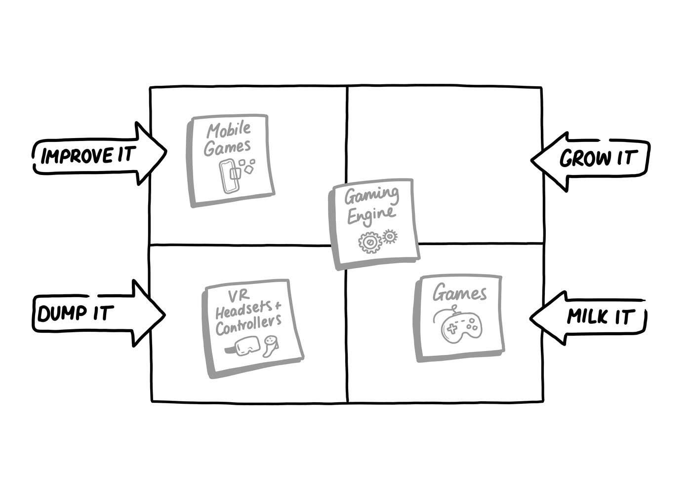
Andromeda’s BCG matrix and possible strategies
Source: Hillen, J. (2025). The Strategy Dialogues: A Primer on Business Strategy and Strategic Management. Moosburg: econcise, p. 154. © 2025 econcise GmbH. For educational use only. Do not copy or post.
26

Slide 27
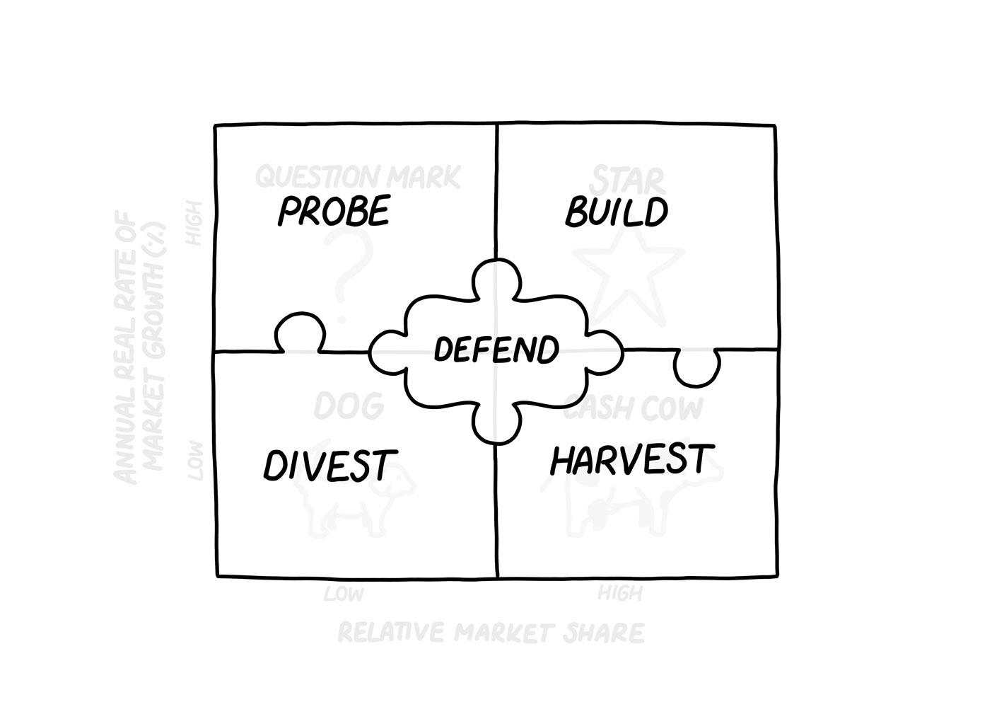
Strategic options for portfolio analysis
Source: Hillen, J. (2025). The Strategy Dialogues: A Primer on Business Strategy and Strategic Management. Moosburg: econcise, p. 155. Based on an idea by Ronald C. Jones. © 2025 econcise GmbH. For educational use only. Do not copy or post.
27

Slide 28
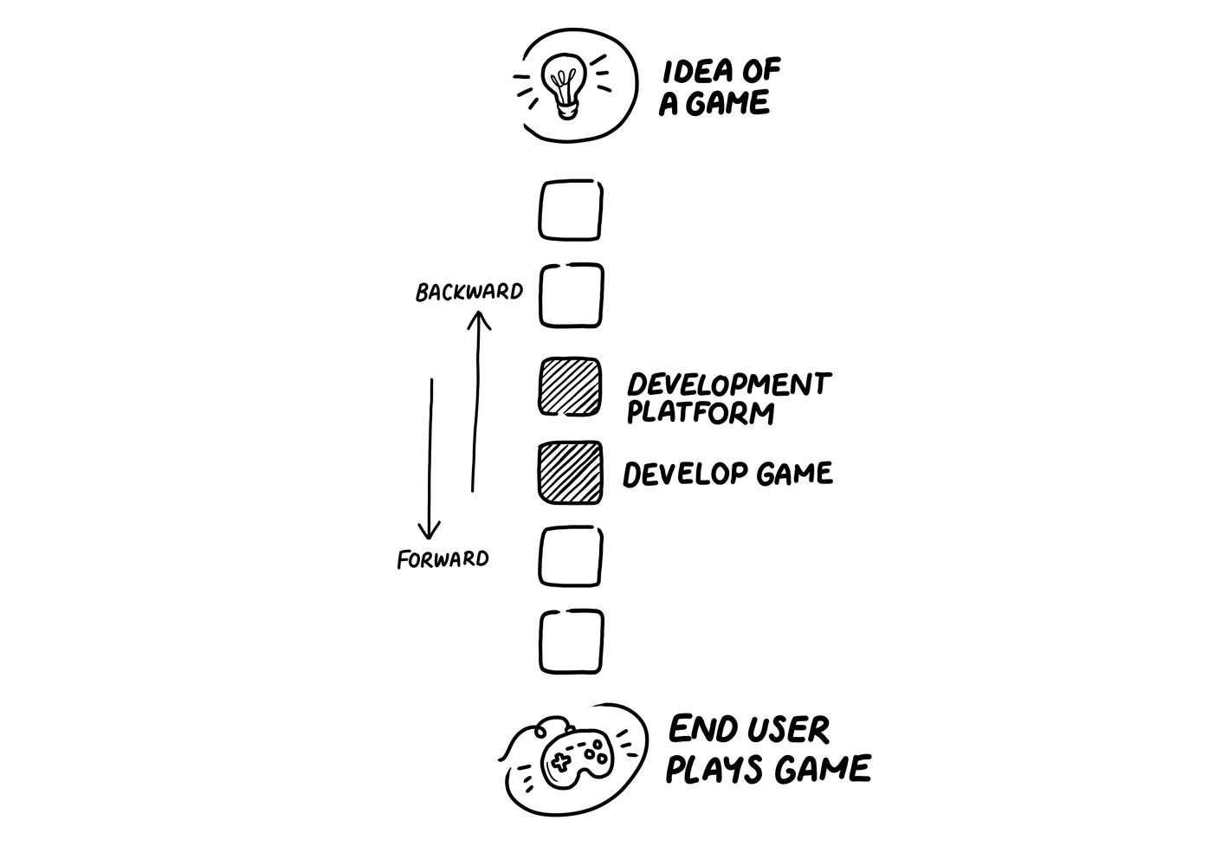
The value chain in the gaming industry
Source: Hillen, J. (2025). The Strategy Dialogues: A Primer on Business Strategy and Strategic Management. Moosburg: econcise, p. 158. © 2025 econcise GmbH. For educational use only. Do not copy or post.
28

Slide 29
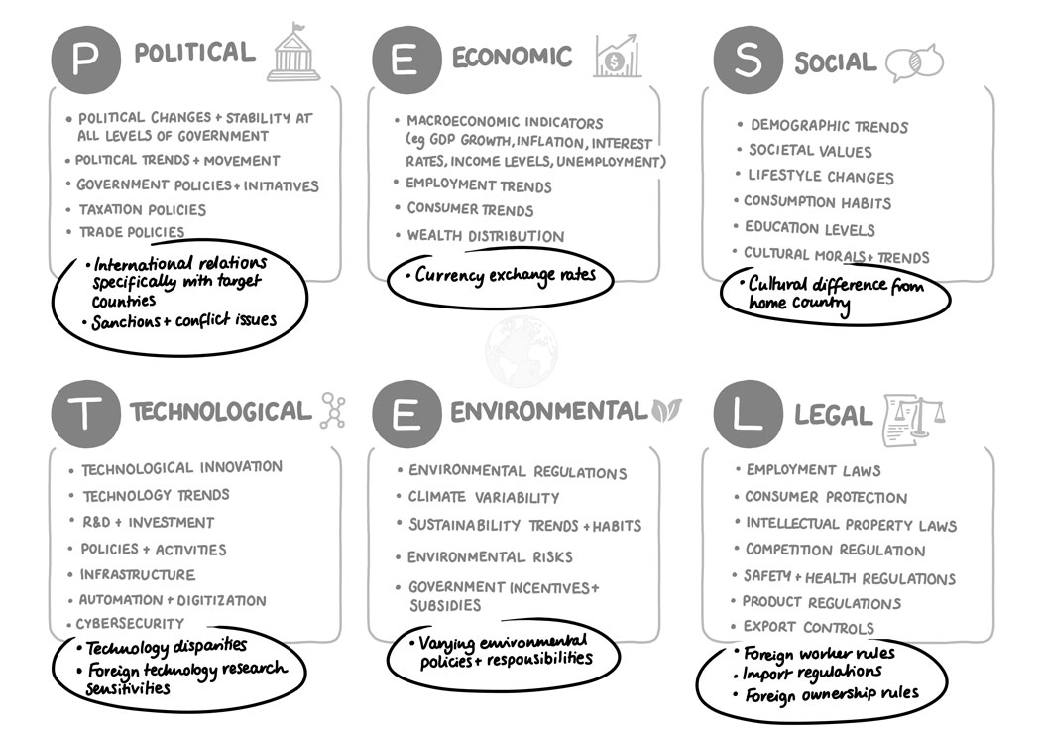
International PESTEL framework
Source: Hillen, J. (2025). The Strategy Dialogues: A Primer on Business Strategy and Strategic Management. Moosburg: econcise, p. 188. © 2025 econcise GmbH. For educational use only. Do not copy or post.
29

Slide 30
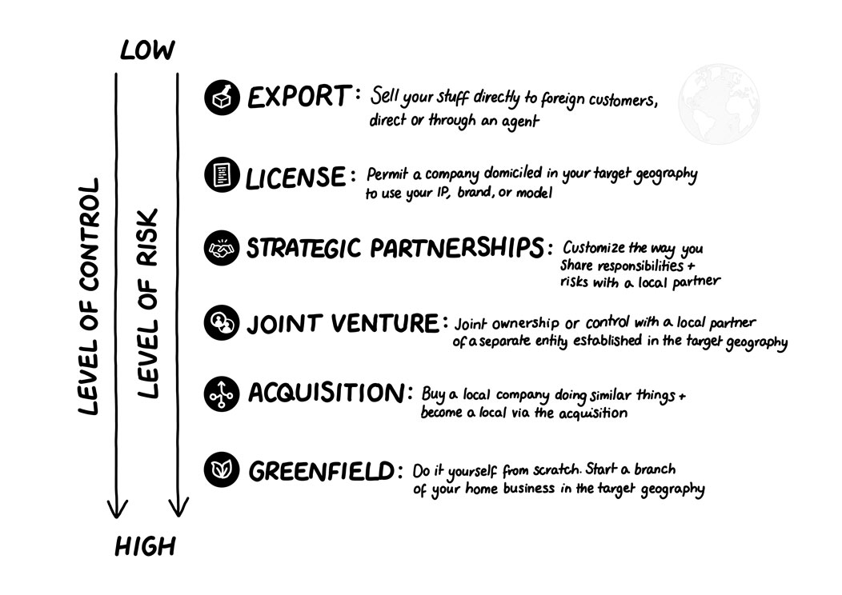
Models of market entry in international business
Source: Hillen, J. (2025). The Strategy Dialogues: A Primer on Business Strategy and Strategic Management. Moosburg: econcise, p. 194. © 2025 econcise GmbH. For educational use only. Do not copy or post.
30

Slide 31
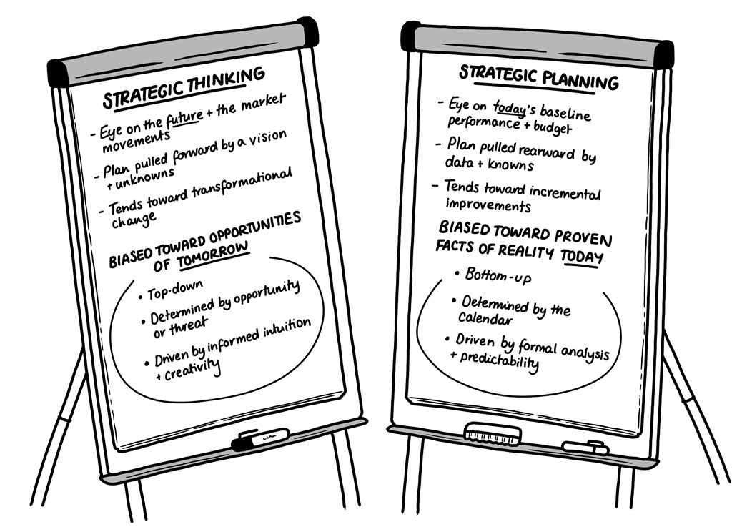
Comparing strategic thinking and corporate planning
Source: Hillen, J. (2025). The Strategy Dialogues: A Primer on Business Strategy and Strategic Management. Moosburg: econcise, p. 204. © 2025 econcise GmbH. For educational use only. Do not copy or post.
31

Slide 32
Strategic planning as the extension of strategic thinking
Source: Hillen, J. (2025). The Strategy Dialogues: A Primer on Business Strategy and Strategic Management. Moosburg: econcise, p. 208. © 2025 econcise GmbH. For educational use only. Do not copy or post.
32

Slide 33
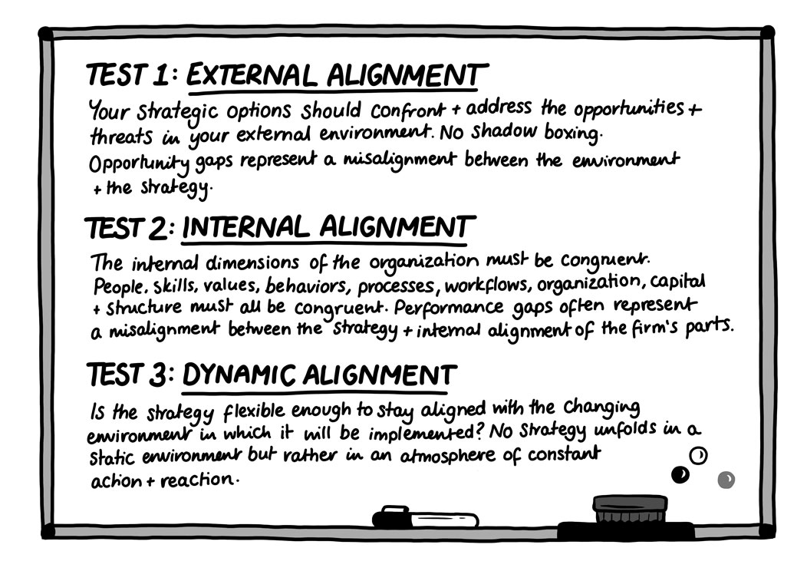
Three tests for alignment & consistency
Source: Hillen, J. (2025). The Strategy Dialogues: A Primer on Business Strategy and Strategic Management. Moosburg: econcise, p. 215. © 2025 econcise GmbH. For educational use only. Do not copy or post.
33

